Slide 1
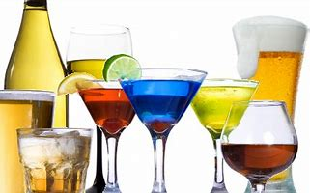
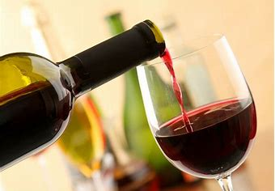
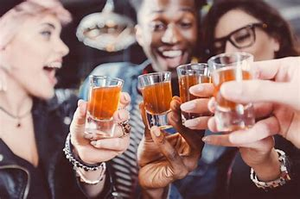
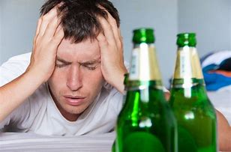
Sin Of Drinking

Slide 2
1 Peter 4:3-4
Referring to their lives before becoming Christians
Actions Characterizing Sinful Life:
- Lewdness
- Lusts
- Drunkenness
- Revelries
- Drinking Parties
- Abominable Idolatries

Slide 3
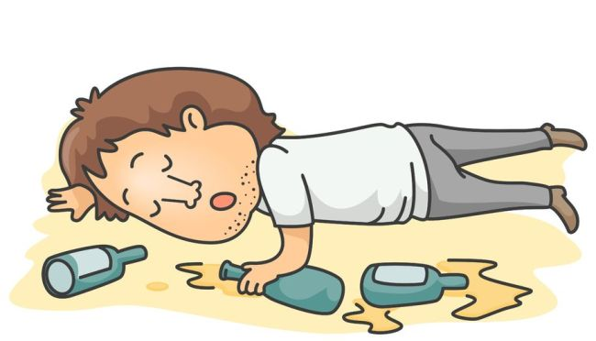
Drunkenness (Oinophlogia)
To be completely drunk due to excess of wine or strong drink…
- Passed out, loss of thought or consciousness

Slide 4
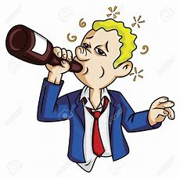
Revelries (Komos)
Letting loose of oneself; opening to use of a drink.
To get a sort of “buzz” feeling it brings

Slide 5
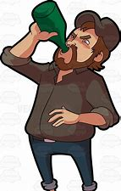
Drinking Parties (Potos)
“To drink” or partake of any amount of strong drink
Same word would have been used for taking drink of water. Context shows us that it is talking about stiff drink

Slide 6
THREE FORMS
Drunkenness
Revelries
Drinking Parties

Slide 7
Ephesians 5:18
We are to fully put on Christ
Not fulfill desires of flesh (Romans 13:14)
Therefore, no place is made to be filled with wine
Contrast:
Drunk With Wine
Filled with Spirit
Impossible to be both at the same time!

Slide 8
Proverbs 20:1
One who is wise does not partake
OT is for our learning
Shows God’s hatred for sin
Cursed Adam and Eve to death
Flooded world due to immorality
Were unwise in disobeying God… We need to be wise

Slide 9
Proverbs 23:31-32
Warns against partaking in such drink
Facts:
Will sparkle in the cup
Will swirl around smoothly
Will bite like a serpent
Will sting like a viper
Will face that bite and sting eventually (Matthew 7:23; Revelation 20:16)

Slide 10
Galatians 5:19-23
Drunkenness, revelries, and the like WILL NOT inherit the kingdom of God!
Those Who Will:
Posses Love, Joy, Peace, Longsuffering, Kindness, Goodness, Faithfulness, Gentleness, and Self-Control
Works of flesh separate us from God, keeping us from Heaven
Possessing fruits of the Spirit allows us to be close to God, and therefore getting us to Heaven

Slide 11
Conclusion
Drinking, even the smallest amount is a sin against God!
Those who sin depart (Matthew 7:23)
There is an outlet:
Forgiveness of sins (1 John 1:9)
Baptism (1 Peter 3:21)

