Slide 1
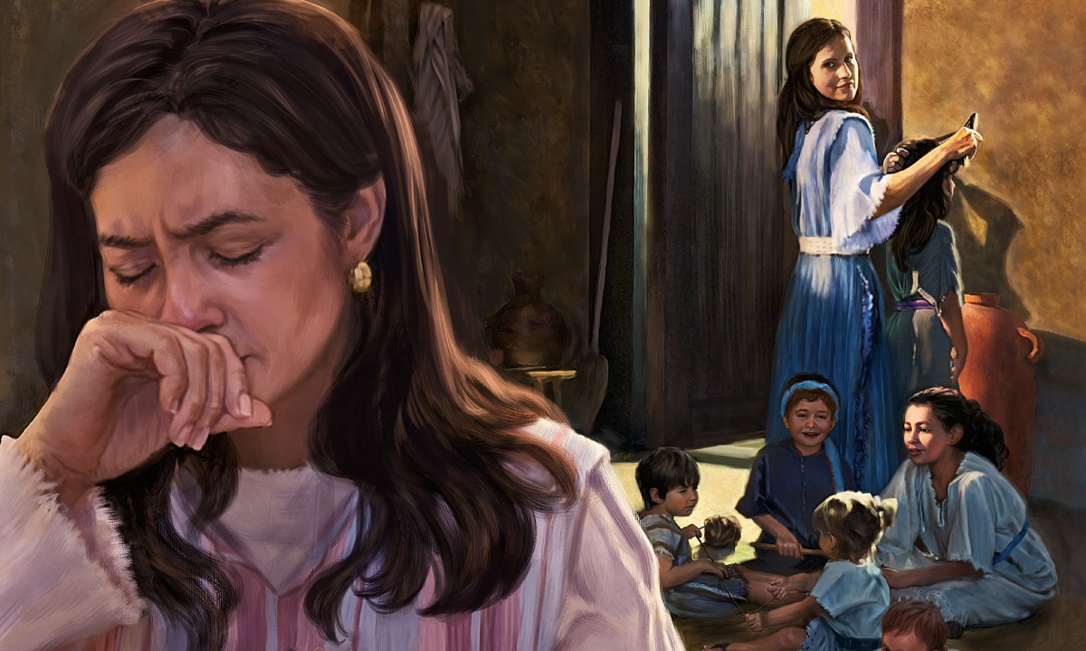
Serving Lord’s Cause Amidst Adversity
1st Samuel 1:9-18

Slide 2
1st Samuel 1:9-18
⁹ So Hannah arose after they had finished eating and drinking in Shiloh. Now Eli the priest was sitting on the seat by the doorpost of the tabernacle of the Lord. ¹⁰ And she was in bitterness of soul, and prayed to the Lord and wept in anguish. ¹¹ Then she made a vow and said, “O Lord of hosts, if You will indeed look on the affliction of Your maidservant and remember me, and not forget Your maidservant, but will give Your maidservant a male child, then I will give him to the Lord all the days of his life, and no razor shall come upon his head.” ¹² And it happened, as she continued praying before the Lord, that Eli watched her mouth. ¹³ Now Hannah spoke in her heart; only her lips moved, but her voice was not heard….

Slide 3
Therefore Eli thought she was drunk. ¹⁴ So Eli said to her, “How long will you be drunk? Put your wine away from you!” ¹⁵ But Hannah answered and said, “No, my lord, I am a woman of sorrowful spirit. I have drunk neither wine nor intoxicating drink, but have poured out my soul before the Lord. ¹⁶ Do not consider your maidservant a wicked woman, for out of the abundance of my complaint and grief I have spoken until now.” ¹⁷ Then Eli answered and said, “Go in peace, and the God of Israel grant your petition which you have asked of Him.” ¹⁸ And she said, “Let your maidservant find favor in your sight.” So the woman went her way and ate, and her face was no longer sad.

Slide 4
Serving the Lord & His Cause…
Is Not Deterred by Surrounding Evil
Gen. 6:5-8 Noah was faithful despite world filled by evil
Phil. 2:14-16 Christians in wicked & perverse time
Is Not Deterred by Reaction of Others
1 Pet. 2:11-12 Christian will be slandered, but live godly
1 Pet. 3:14-16 Evil charges in stark contrast with life
Demands Praying in Midst of Sorrow
Lk. 22:41-46 Jesus prayed while in agony, disciples slept
Jas. 5:13 “Is any among you suffering? He must pray…”
Requires Focus on Lord’s Cause, Not Our Will
Jn. 12:27-28 Jesus is ultimate example (Mk. 14:35-36)
Matt. 16:24 Deny self, take up cross, follow Christ
Must Trust in God’s Deliverance, Not Our Insight

