Slide 1
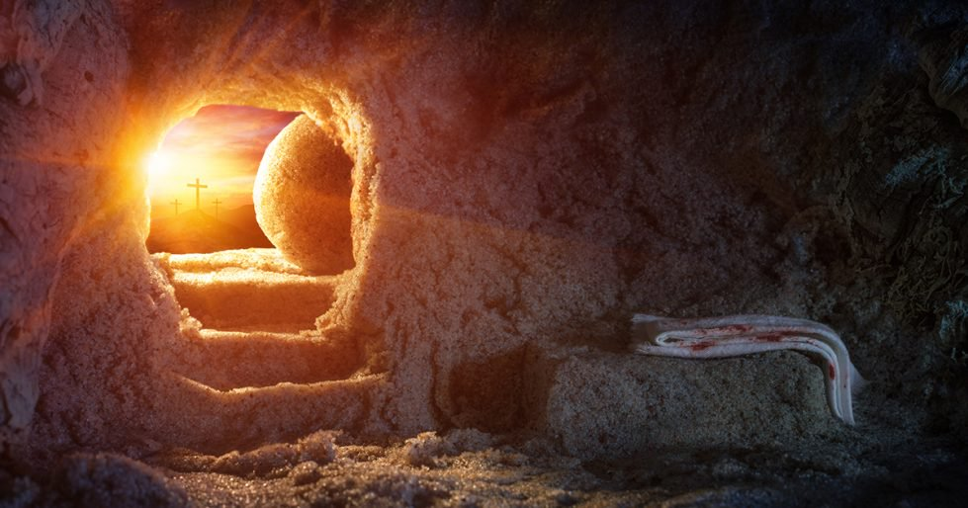
Resurrection of Jesus The Keystone of Our Faith
1st Corinthians 15:1-8

Slide 2
1 Corinthians 15:1-8
¹ Moreover, brethren, I declare to you the gospel which I preached to you, which also you received and in which you stand, ² by which also you are saved, if you hold fast that word which I preached to you — unless you believed in vain. ³ For I delivered to you first of all that which I also received: that Christ died for our sins according to the Scriptures, ⁴ and that He was buried, and that He rose again the third day according to the Scriptures, ⁵ and that He was seen by Cephas, then by the twelve. ⁶ After that He was seen by over five hundred brethren at once, of whom the greater part remain to the present, but some have fallen asleep. ⁷ After that He was seen by James, then by all the apostles. ⁸ Then last of all He was seen by me also, as by one born out of due time.

Slide 3
Foundational to Gospel Message
Acts 1:21-22 Apostles were all witnesses
Acts 2:23-24 Made centerpiece of Pentecost sermon
Acts 2:31-32 Fulfillment of prophecy witnessed
Acts 3:14-15 Affirmed to crowd who killed Jesus
Acts 4:8-10 Affirmed to rulers that killed Jesus
Acts 5:30-32 Affirmed to council of Jewish rulers
Acts 10:39-41 Peter gives witness to Cornelius
Acts 13:29-39 Paul preached as basis of salvation
Acts 26:22-26 Festus scoffed, but Paul affirmed it
Rom. 4:23-25 Enabled forgiveness & justification
Eph. 1:18-21 Blessings to us made possible by it
Rom. 1:1-4 Jesus shown Son of God with power by it

Slide 4
Bible Presents Resurrection of Jesus...
As fact witnessed by vast number
Claim made while most were still alive to verify
As fact publicly stated amidst enemies
Yet, not a single enemy could refute the fact
As fact challenging all to examine evidence
Missing body could be explained, but not the risen one
As fact that changed the lives of witnesses
Saul of Tarsus left privilege to suffer as witness
As fact not denied even at cost of life
Peter, James… suffered death as result, but did not deny
As fact that changed the world despite opposition
Civil powers were all against it, but could not defeat it

Slide 5
1st Corinthians 15 Presents Argument
1 Cor. 15:9-11 Nothing else explains faith of Paul & all
Why else would Paul have gone from persecutor to persecuted?
Paul’s preaching on resurrection is why Corinthians believed
1 Cor. 15:12-19 Consequences if no resurrection
Some said no resurrection, but if true, Christ not raised
If Christ not raised, we are still in sins (also those dead in Christ)
If we only have hope in Christ in this life, we are most pitiable
1 Cor. 15:20-28 Christ’s resurrection assures our victory
Christ is the first-fruits assuring our resurrection as well
Jesus’ resurrection proves His power over death, final enemy
1 Cor. 15:29-34 Denying resurrection requires irrationality
Actions of Paul & Corinthians were irrational if no resurrection
1 Cor. 15:35-49 Glorious hope in reality of resurrection
As Christ raised never to die, so we raised with eternal body
1 Cor. 15:50-58 Truth of resurrection assures final victory

Slide 6
“Therefore we were buried with Him through baptism into death, that just as Christ was raised from the dead by the glory of the Father, even so we also should walk in newness of life” (Romans 6:4).

