Slide 1
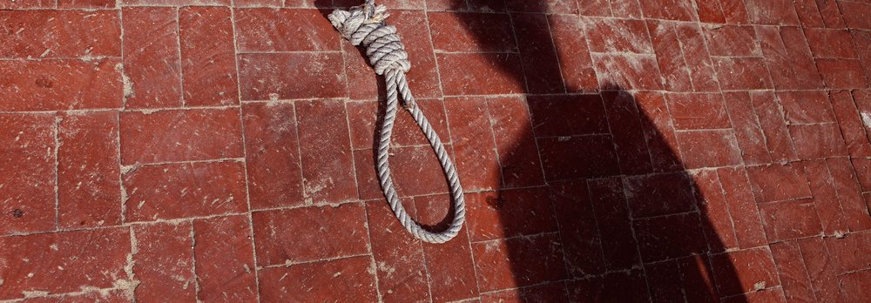
Putting to Death the Old Man
Colossians 3:1-9

Slide 2
Colossians 3:1-9
¹ If then you were raised with Christ, seek those things which are above, where Christ is, sitting at the right hand of God. ² Set your mind on things above, not on things on the earth. ³ For you died, and your life is hidden with Christ in God. ⁴ When Christ who is our life appears, then you also will appear with Him in glory. ⁵ Therefore put to death your members which are on the earth: fornication, uncleanness, passion, evil desire, and covetousness, which is idolatry. ⁶ Because of these things the wrath of God is coming upon the sons of disobedience, ⁷ in which you yourselves once walked when you lived in them. ⁸ But now you yourselves are to put off all these: anger, wrath, malice, blasphemy, filthy language out of your mouth. ⁹ Do not lie to one another, since you have put off the old man with his deeds…

Slide 3
Steps in Full Destruction of Old Man
Putting to Death the Earthly Viewpoint
Gen. 3:1-6 Earthly (carnal) sight introduced – Adam & Eve
Rom. 6:6 Old man must be put to death, not just reduced
Rom. 8:1-9 Carnal mindset contrast with spiritual (8:12-13)
Seeing that Evil Desires & Actions Bring God’s Wrath
Rom. 1:18 All sin incurs God’s wrath by its nature (2:1-11)
Eph. 5:3-7 Not to be deceived, wrath of God on disobedient
Rev. 21:8 All sinners are fit to be in lake of fire, not with God
Identifying & Eliminating Evil’s Various Manifestations
Sins of Flesh – 1 Pet. 4:1-3 Comes from fleshly, sensual lusts
Sinful Attitudes - Eph. 4:30-32 Evil attitudes grieve H.S.
Sins of Speech – Eph. 4:25, 29 Lies, corrupt speech…
Rom. 13:12-14 Done by making no provision for sin
“But Now You Yourselves Are to Put Off All These”

