Slide 1
The Complacency of the World & Zion
Amos 6:1-8

Slide 2
Amos 6:1-8 (NABRE)
¹ Woe to those who are complacent in Zion, secure on the mount of Samaria, leaders of the first among nations, to whom the people of Israel turn. ² Pass over to Calneh and see, go from there to Hamath the great, and down to Gath of the Philistines. Are you better than these kingdoms, or is your territory greater than theirs? ³ You who would put off the day of disaster, yet hasten the time of violence! ⁴ Those who lie on beds of ivory, and lounge upon their couches; eating lambs taken from the flock, and calves from the stall; ⁵ who improvise to the music of the harp, composing on musical instruments like David, ⁶ who drink wine from bowls, and anoint themselves with the best oils, but are not made ill by the collapse of Joseph; ⁷ Therefore, now they shall be the first to go into exile, and the carousing of those who lounged shall cease. ⁸ The Lord God has sworn by his very self — an oracle of the Lord, the God of hosts: I abhor the pride of Jacob, I hate his strongholds, and I will hand over the city with everything in it.

Slide 3
Amos 6:1-8
¹ Woe to those who are complacent in Zion, secure on the mount of Samaria, leaders of the first among nations, to whom the people of Israel turn. ² Pass over to Calneh and see, go from there to Hamath the great, and down to Gath of the Philistines. Are you better than these kingdoms, or is your territory greater than theirs? ³ You who would put off the day of disaster, yet hasten the time of violence! ⁴ Those who lie on beds of ivory, and lounge upon their couches; eating lambs taken from the flock, and calves from the stall; ⁵ who improvise to the music of the harp, composing on musical instruments like David, ⁶ who drink wine from bowls, and anoint themselves with the best oils, but are not made ill by the collapse of Joseph; ⁷ Therefore, now they shall be the first to go into exile, and the carousing of those who lounged shall cease. ⁸ The Lord God has sworn by his very self — an oracle of the Lord, the God of hosts: I abhor the pride of Jacob, I hate his strongholds, and I will hand over the city with everything in it.

Slide 4
Amos 6:1-8
¹ Woe to those who are complacent in Zion, secure on the mount of Samaria, leaders of the first among nations, to whom the people of Israel turn. ² Pass over to Calneh and see, go from there to Hamath the great, and down to Gath of the Philistines. Are you better than these kingdoms, or is your territory greater than theirs? ³ You who would put off the day of disaster, yet hasten the time of violence! ⁴ Those who lie on beds of ivory, and lounge upon their couches; eating lambs taken from the flock, and calves from the stall; ⁵ who improvise to the music of the harp, composing on musical instruments like David, ⁶ who drink wine from bowls, and anoint themselves with the best oils, but are not made ill by the collapse of Joseph; ⁷ Therefore, now they shall be the first to go into exile, and the carousing of those who lounged shall cease. ⁸ The Lord God has sworn by his very self — an oracle of the Lord, the God of hosts: I abhor the pride of Jacob, I hate his strongholds, and I will hand over the city with everything in it.

Slide 5
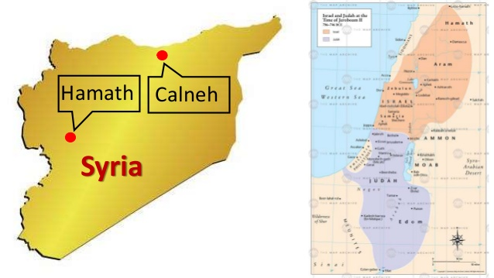
Calneh & Hamath were in Syria, or beyond, to the north of Israel

Slide 6
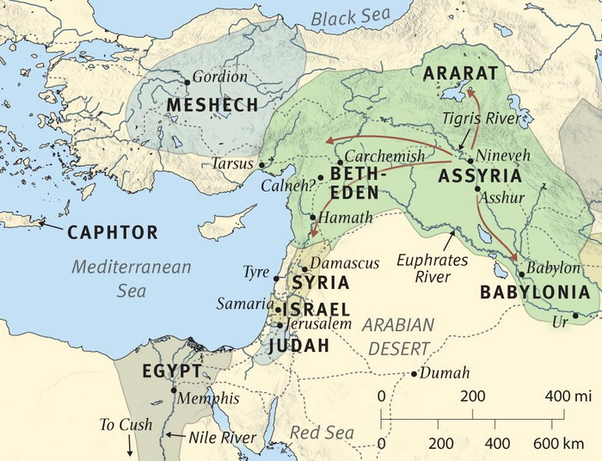
They were overcome by Assyria before Israel

Slide 7
Amos 6:1-8
¹ Woe to those who are complacent in Zion, secure on the mount of Samaria, leaders of the first among nations, to whom the people of Israel turn. ² Pass over to Calneh and see, go from there to Hamath the great, and down to Gath of the Philistines. Are you better than these kingdoms, or is your territory greater than theirs? ³ You who would put off the day of disaster, yet hasten the time of violence! ⁴ Those who lie on beds of ivory, and lounge upon their couches; eating lambs taken from the flock, and calves from the stall; ⁵ who improvise to the music of the harp, composing on musical instruments like David, ⁶ who drink wine from bowls, and anoint themselves with the best oils, but are not made ill by the collapse of Joseph; ⁷ Therefore, now they shall be the first to go into exile, and the carousing of those who lounged shall cease. ⁸ The Lord God has sworn by his very self — an oracle of the Lord, the God of hosts: I abhor the pride of Jacob, I hate his strongholds, and I will hand over the city with everything in it.

Slide 8
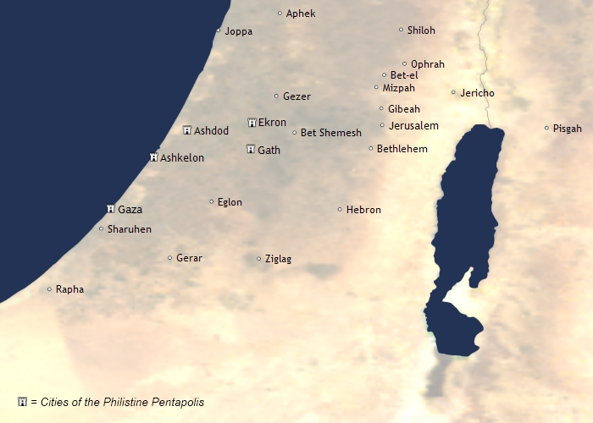
See 1st Samuel 7:13-14

Slide 9
Has the World’s Complacency Affected Zion?
Have the luxuries of affluence taken away our concern?
Mark 10:17-22 Young ruler wanted to follow, but hindered
Matt. 19:23-26 Riches often distracted from spiritual goal
1 Tim. 6:17-19 Charge to rich – Set your hope properly
Has ungodliness of our society altered our standards?
Psa. 50:16-23 Unfit if world’s evil changes us
Rom. 1:32 Cannot practice evil or approve evil doers
Eph. 5:7-12 Recognize, disdain & rebuke works of evil
Are we seeing urgency for evangelism as God sees it?
John 4:34-35 Field is white to harvest – vast number lost
2 Pet. 3:9 God does not desire any to perish being lost
1 Cor. 9:19-23 Need to save lost requires zeal (Titus 2:11f)
Paul: Example of zealous evangelism needed (Phil. 3:7f)

