Slide 1
God’s New Covenant
& Man’s Heart
Jeremiah 31:31-34

Slide 2
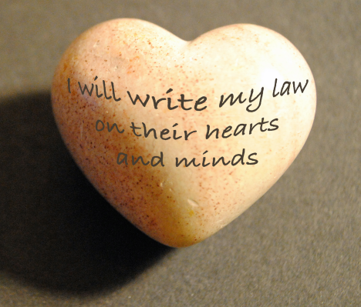
Jeremiah 31:31-34
³¹ “Behold, the days are coming, says the Lord, when I will make a new covenant with the house of Israel and with the house of Judah — ³² not according to the covenant that I made with their fathers in the day that I took them by the hand to lead them out of the land of Egypt, My covenant which they broke, though I was a husband to them, says the Lord. ³³ But this is the covenant that I will make with the house of Israel after those days, says the Lord: I will put My law in their minds, and write it on their hearts; and I will be their God, and they shall be My people. ³⁴ No more shall every man teach his neighbor, and every man his brother, saying, ‘Know the Lord,’ for they all shall know Me, from the least of them to the greatest of them, says the Lord. For I will forgive their iniquity, and their sin I will remember no more.”

Slide 3
Problem with Old Covenant Israel Broke
Not problem of law failing to declare righteousness
Gal. 3:21 If life could come by law, it would have
Problem was with receivers failing to keep it
Heb. 8:7-8 “Because finding fault with them, He says…”
Remember O.T. testimony of Israel’s unfaithfulness
Jdg. 2:10-11 Another generation arose that knew not God
Jdg. 17:6 “Everyone did what was right in his own eyes”
Jdg. 17:6 “Everyone did…” – Repeated at end of Judges
Throughout the history of Israel & Judah it was same
Israel & Judah taken into captivity as punishment
But their hearts never learn lesson as seen in Malachi

Slide 4
God’s New Covenant & Man’s Heart
Gospel has the power to change man from the heart
Jn. 17:17 Christians sanctified by truth of God
Col. 3:10, 16 New man made in God’s image by gospel
Rom. 12:1-2 Transformation of mind by gospel
1 Pet. 1:22-25 Seed of gospel is source of new life
Key to new life is feeding on Christ’s word (gospel)
Jn. 6:53 Must eat Christ’s flesh & drink His blood
Jn. 6:60 Disciples said it was a hard saying
Jn. 6:63 Not speaking of physical body, but His words
Jn. 6:67-68 Peter understood the point

Slide 5
How We Let the Gospel Write on Heart
Without a changed heart, we will fail (Lk. 11:24-26)
Practical steps in letting gospel be written on heart
Study of scripture (1 Pet. 2:2; 2 Tim. 2:15)
Put knowledge learn to action (Col. 1:9-11)
Mature to teach others the truth (Heb. 5:12-14)
Continue fervent in prayer (Col. 4:2)
Increase in love for one another (1 Thess. 3:12)
Have balanced growth in character (2 Pet. 1:5-8)
Keep focus on spiritual things (2 Cor. 4:16-18)
Remember Paul’s prayer for Ephesians (Eph. 3:14-21)
Putting it all together from Ephesians 4:17-24

