Slide 1
“No One Cares for My Soul”
No One Cares for My Soul
Psalm 142

Slide 2
Psalm 142
¹ I cry out to the Lord with my voice; with my voice to the Lord I make my supplication. ² I pour out my complaint before Him; I declare before Him my trouble.
³ When my spirit was overwhelmed within me, then You knew my path. In the way in which I walk they have secretly set a snare for me.
⁴ Look on my right hand and see, for there is no one who acknowledges me; Refuge has failed me; No one cares for my soul.
⁵ I cried out to You, O Lord: I said, “You are my refuge, My portion in the land of the living.
⁶ Attend to my cry, for I am brought very low; Deliver me from my persecutors, for they are stronger than I.
⁷ Bring my soul out of prison, that I may praise Your name; The righteous shall surround me, for You shall deal bountifully with me.”

Slide 3
Psalm 142
¹ I cry out to the Lord with my voice; with my voice to the Lord I make my supplication. ² I pour out my complaint before Him; I declare before Him my trouble.
³ When my spirit was overwhelmed within me, then You knew my path. In the way in which I walk they have secretly set a snare for me.
⁴ Look on my right hand and see, for there is no one who acknowledges me; Refuge has failed me; No one cares for my soul.
⁵ I cried out to You, O Lord: I said, “You are my refuge, My portion in the land of the living.
⁶ Attend to my cry, for I am brought very low; Deliver me from my persecutors, for they are stronger than I.
⁷ Bring my soul out of prison, that I may praise Your name; The righteous shall surround me, for You shall deal bountifully with me.”

Slide 4
An Introduction to the 142nd Psalm
It is titles as “A Contemplation [Heb. “maschil”] of David”
“Maschil” carries a connotation of being more than just a mere thought
It suggests an intense meditation on something of great concern
In this case, it voices the emptiness of David left alone
The setting of this psalm helps us to understand the idea
Most bibles give a note that it was written from a cave
Probably written while hiding on the run from Saul
Seems related in time & circumstance to Psalm 57
Think of David’s deep concerns in this situation

Slide 5
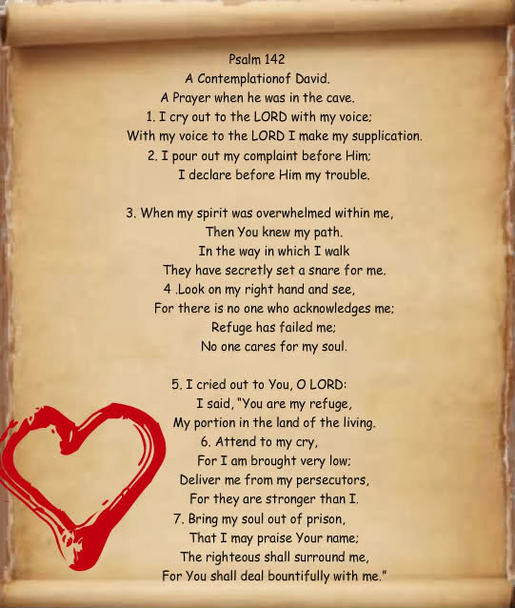
We Often Fail to See…
The Elders care…
1 Tim. 3:5
Heb. 13:17
Other Christians care…
1 Cor. 12:25
Gal. 6:10
But what if it is true & no one cares?

Slide 6
Remember the Example of David (Psalm 57)
¹ Be merciful to me, O God, be merciful to me! For my soul trusts in You; and in the shadow of Your wings I will make my refuge, until these calamities have passed by.
² I will cry out to God Most High, to God who performs all things for me. ³ He shall send from heaven and save me; He reproaches the one who would swallow me up. God shall send forth His mercy and His truth.
⁴ My soul is among lions; I lie among the sons of men who are set on fire, whose teeth are spears and arrows, and their tongue a sharp sword. ⁵ Be exalted, O God, above the heavens; Let Your glory be above all the earth.
⁶ They have prepared a net for my steps; my soul is bowed down; they have dug a pit before me; into the midst of it they themselves have fallen.
⁷ My heart is steadfast, O God, my heart is steadfast; I will sing and give praise.

Slide 7
Remember the Example of Paul (2 Tim. 4:9-18)
⁹ Be diligent to come to me quickly; ¹⁰ for Demas has forsaken me, having loved this present world, and has departed for Thessalonica — Crescens for Galatia, Titus for Dalmatia. ¹¹ Only Luke is with me. Get Mark and bring him with you, for he is useful to me for ministry. ministry. ¹² And Tychicus I have sent to Ephesus. ¹³ Bring the cloak that I left with Carpus at Troas when you come — and the books, especially the parchments. ¹⁴ Alexander the coppersmith did me much harm. May the Lord repay him according to his works. ¹⁵ You also must beware of him, for he has greatly resisted our words. ¹⁶ At my first defense no one stood with me, but all forsook me. May it not be charged against them. ¹⁷ But the Lord stood with me and strengthened me, so that the message might be preached fully through me, and that all the Gentiles might hear. Also I was delivered out of the mouth of the lion. ¹⁸ And the Lord will deliver me from every evil work and preserve me for His heavenly kingdom. To Him be glory forever and ever. Amen!

Slide 8
Remember the Example of Jesus (Matt. 26:36-56)
³⁶ Then Jesus came with them to a place called Gethsemane, and said to the disciples, “Sit here while I go and pray over there.” ³⁷ And He took with Him Peter and the two sons of Zebedee, and He began to be sorrowful and deeply distressed. ³⁸ Then He said to them, “My soul is exceedingly sorrowful, even to death. Stay here and watch with Me.” ³⁹ He went a little farther and fell on His face, and prayed, saying, “O My Father, if it is possible, let this cup pass from Me; nevertheless, not as I will, but as You will.” ⁴⁰ Then He came to the disciples and found them sleeping, and said to Peter, “What! Could you not watch with Me one hour? ⁴¹ Watch and pray, lest you enter into temptation. The spirit indeed is willing, but the flesh is weak.” ⁴² Again, a second time, He went away and prayed, saying, “O My Father, if this cup cannot pass away from Me unless I drink it, Your will be done.” ⁴³ And He came and found them asleep again, for their eyes were heavy.

Slide 9
⁴⁴ So He left them, went away again, and prayed the third time, saying the same words. ⁴⁵ Then He came to His disciples and said to them, “Are you still sleeping and resting? Behold, the hour is at hand, and the Son of Man is being betrayed into the hands of sinners. ⁴⁶ Rise, let us be going. See, My betrayer is at hand.” ⁴⁷ And while He was still speaking, behold, Judas, one of the twelve, with a great multitude with swords and clubs, came from the chief priests and elders of the people. ⁴⁸ Now His betrayer had given them a sign, saying, “Whomever I kiss, He is the One; seize Him.” ⁴⁹ Immediately he went up to Jesus and said, “Greetings, Rabbi!” and kissed Him. ⁵⁰ But Jesus said to him, “Friend, why have you come?” Then they came and laid hands on Jesus and took Him…. ⁵⁵ In that hour Jesus said to the multitudes, “Have you come out, as against a robber, with swords and clubs to take Me? I sat daily with you, teaching in the temple, and you did not seize Me. ⁵⁶ But all this was done that the Scriptures of the prophets might be fulfilled.” Then all the disciples forsook Him and fled.

Slide 10
Lessons We Must Learn in Such Times
First, we can depend on God as faithful & caring
2 Tim. 2:13 If we are faithless, He remains faithful…
1 Pet. 5:7 “Casting all care upon Him, for he cares for you”
Heb. 4:15-16; Rom. 5:8 Faithfulness & care proven
We must go to our Father and our Lord for help
2 Cor. 12:8 “I pleaded with the Lord three times…”
Matt. 6:26 Our heavenly Father values & cares for us
Be persistent in prayer
Lk. 18:1-7 We always ought to pray & not lose heart
Seek to learn from such times and grow
James 1:2-4 Trials work to produce patience in us
Keep a constant view of heaven – it’s worth it!
1 Pet. 1:3-9 Focusing hope on heaven causes to endure

