Slide 1
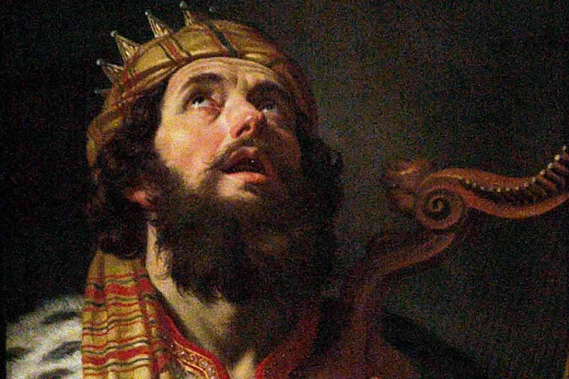
David’s Portrait of Forgiveness
Psalm 32

Slide 2
Psalm 32
¹ Blessed is he whose transgression is forgiven, whose sin is covered. ² Blessed is the man to whom the Lord does not impute iniquity, and in whose spirit there is no deceit. ³ When I kept silent, my bones grew old through my groaning all the day long. ⁴ For day and night Your hand was heavy upon me; my vitality was turned into the drought of summer. Selah
⁵ I acknowledged my sin to You, and my iniquity I have not hidden. I said, “I will confess my transgressions to the Lord,” and You forgave the iniquity of my sin. ⁶ For this cause everyone who is godly shall pray to You in a time when You may be found; surely in a flood of great waters they shall not come near him. ⁷ You are my hiding place; You shall preserve me from trouble; You shall surround me with songs of deliverance. Selah
⁸ I will instruct you and teach you in the way you should go; I will guide you with My eye. ⁹ Do not be like the horse or like the mule, which have no understanding, which must be harnessed with bit and bridle, else they will not come near you. ¹⁰ Many sorrows shall be to the wicked; but he who trusts in the Lord, mercy shall surround him. ¹¹ Be glad in the Lord and rejoice, you righteous; and shout for joy, all you upright in heart!

Slide 3
Psalm 32
⁸ I will instruct you and teach you in the way you should go; I will guide you with My eye. ⁹ Do not be like the horse or like the mule, which have no understanding, which must be harnessed with bit and bridle, else they will not come near you. ¹⁰ Many sorrows shall be to the wicked; but he who trusts in the Lord, mercy shall surround him. ¹¹ Be glad in the Lord and rejoice, you righteous; and shout for joy, all you upright in heart!

Slide 4
The Longing for Forgiveness
¹ Blessed is he whose transgression is forgiven, whose sin is covered. ² Blessed is the man to whom the Lord does not impute iniquity, and in whose spirit there is no deceit. ³ When I kept silent, my bones grew old through my groaning all the day long. ⁴ For day and night Your hand was heavy upon me; my vitality was turned into the drought of summer. Selah
Beauty of forgiveness seen in Old Testament
Psa. 103:12 Sin removed as far as east from west
Isa. 43:25 Sin blotted out & remembered no more
Isa. 55:7 “For He will abundantly pardon”
Beauty of forgiveness seen in New Testament
Col. 1:14 “Redemption through His blood”
Col. 2:13 Made alive together with Christ
Heb. 10:14-18 Perfected, sanctified, sin not remembered

Slide 5
Actions in Seeking Forgiveness
⁵ I acknowledged my sin to You, and my iniquity I have not hidden. I said, “I will confess my transgressions to the Lord,” and You forgave the iniquity of my sin. ⁶ For this cause everyone who is godly shall pray to You in a time when You may be found; surely in a flood of great waters they shall not come near him. ⁷ You are my hiding place; You shall preserve me from trouble; You shall surround me with songs of deliverance. Selah
Remaining silent & trying to hide sin makes it worse
Prov. 28:13a Not prosper if we cover our sins
Isa. 29:15 Woe to those who hide sin in the dark
Isa. 30:1 Take counsel & devise plan to sin
Acknowledging our sins is necessary for forgiveness
Prov. 28:13b If confess & forsake, we obtain mercy
1 John 1:9 If we confess, He is faithful to forgive all
Luke 15:18-21 Like returning to lost love of one’s father

Slide 6
Learning & Avoiding Sin in Future
⁸ I will instruct you and teach you in the way you should go; I will guide you with My eye. ⁹ Do not be like the horse or like the mule, which have no understanding, which must be harnessed with bit and bridle, else they will not come near you. ¹⁰ Many sorrows shall be to the wicked; but he who trusts in the Lord, mercy shall surround him. ¹¹ Be glad in the Lord and rejoice, you righteous; and shout for joy, all you upright in heart!
All begin by fearing the punishment for sin
Matt. 10:28 Fear destruction of body & soul in hell
2 Thess. 1:7-9 Render vengeance & eternal destruction
But we must grow to see sin as God sees it
Ezra 9:10-15 Unclean, abomination, filth, great guilt…
Lk. 15:15-16 Like wanting to eat the pig slop
2 Pet. 2:20-22 Dog to vomit, sow to wallowing in mire
Final step is to serve God out of love
1 Jn. 4:16-19 Perfect love casts out fear; obey of love

