Slide 1
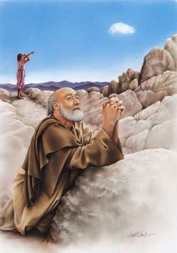
Lessons on Prayer from Elijah
James 5:16-18

Slide 2
James 5:16-18
¹⁶ Confess your trespasses to one another, and pray for one another, that you may be healed. The effective, fervent prayer of a righteous man avails much. ¹⁷ Elijah was a man with a nature like ours, and he prayed earnestly that it would not rain; and it did not rain on the land for three years and six months. ¹⁸ And he prayed again, and the heaven gave rain, and the earth produced its fruit.

Slide 3
James 5:16-18
¹⁶ Confess your trespasses to one another, and pray for one another, that you may be healed. The effective, fervent prayer of a righteous man avails much. ¹⁷ Elijah was a man with a nature like ours, and he prayed earnestly that it would not rain; and it did not rain on the land for three years and six months. ¹⁸ And he prayed again, and the heaven gave rain, and the earth produced its fruit.
What Elijah Did in Prayer, We Can Also Do

Slide 4
Lessons on Prayer from Elijah
Lord Hears Prayers of the Righteous
Isa. 59:1-2 Sin causes separation so God will not hear
Jn. 9:30-33 “If a man is a worshiper of God & does His will”
1 Pet. 3:12 Ears open to the prayers of the righteous
We Must Pray Fervently (energeo) & Earnestly
Phil. 2:13 Same word used in this text
Rom. 12:10-12 Not lagging in diligence, fervent in spirit
We Must Pray Persistently (1 Kgs. 18:42-44)
Luke 11:5-9 Persistence yields effect, works more with God
Luke 18:1-8 Parable to always pray and not lose heart
We Must Pray with Faith, Confident of an Answer
1 Kgs. 18:44-45 Elijah was expecting rain to come as prayed
James 1:5-8 Must ask in faith without doubting

