Slide 1
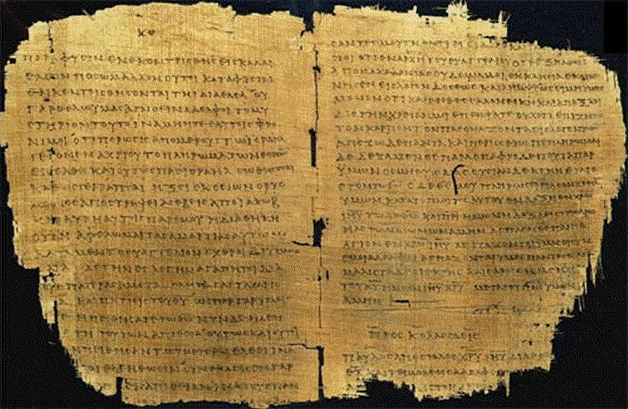
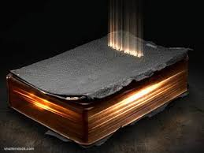
Qualities of the Gospel
1st Peter 1:22-25

Slide 2
1st Peter 1:22-25
²² Since you have purified your souls in obeying the truth through the Spirit in sincere love of the brethren, love one another fervently with a pure heart, ²³ having been born again, not of corruptible seed but incorruptible, through the word of God which lives and abides forever, ²⁴ because “All flesh is as grass, and all the glory of man as the flower of the grass. The grass withers, and its flower falls away, ²⁵ but the word of the Lord endures forever.” Now this is the word which by the gospel was preached to you.

Slide 3
This Word of the Gospel…
Endures
Indestructible, Cannot Be Eradicated
Lives
Always Relevant to Nature & Need of Man
Saves
Conveys Message of Salvation in Christ

Slide 4
The Word of the Gospel Endures
Scripture makes claim of being indestructible
Psa. 119:89 “Forever… Your word is settled in heaven”
Isa. 40:8 “The word of our God stands forever”
Matt. 24:35 “My words will by no means pass away”
Inspiration of Holy Spirit assured accuracy (Jn. 14:26; 16:13)
There have been efforts to destroy Scripture
Happened with O.T. Scripture
Happened with N.T. in time of Roman rule
Happened with efforts of Roman Catholic Church
There have been repeated claim of NT omissions
Modern claims for “Gospel of Thomas” and others

Slide 5
AUTHOR | BOOK | DATE WRITTEN | EARLIEST COPIES | TIME GAP | NUMBER of COPIES
Homer | Iliad | 800 B.C. | c. 400 B.C. | c. 400 yrs. | 643
Herodotus | History | 480-425 B.C. | c. A.D. 900 | c. 1350 yrs. | 8
Thucydides | History | 460-400 B.C. | c. A.D. 900 | c. 1300 yrs. | 8
Plato |  | 400 B.C. | c. A.D. 900 | c. 1300 yrs. | 7
Demosthenes |  | 300 B.C. | c. A.D. 1100 | c. 1400 yrs. | 200
Caesar | Gallic Wars | 100-44 B.C. | c. A.D. 900 | c. 1000 yrs. | 10
Livy | History of | 59 B.C. – A.D. 17 | 4th cent. (partial) mostly 10th cent. | c. 400 yrs. c. 1000 yrs. | 1 partial 19 copies
Tacitus | Annals | A.D. 100 | c. A.D. 1100 | c. 1000 yrs. | 20
Pliny Secundus | Natural History | A.D. 61-113 | c. A.D. 850 | c. 750 yrs. | 7
Inspired Writers | New Testament | A.D. 50-96 | c. 114 (fragment) c. 200 (books) c. 250 (most of NT) c. 325 (complete NT) | 25-50 yrs. 100 yrs. 150 yrs. 225 yrs. | 5686 - Greek 19,284 - Other languages 24,970+ Total
Taken from The New Evidence That Demands a Verdict by Josh McDowell (p. 38)

Slide 6
Writer & Known Dates (A.D.) | Gospels | Acts | Epistles of Paul | General Epistles | Revelation | Totals
Justin Martyr (converted 130 – martyred 165) | 268 | 10 | 43 | 6 | 3 266 allusions | 330
Irenaeus (born 115-202?) | 1038 | 194 | 499 | 23 | 65 | 1,819
Clement of Alex. (150-215) | 1107 | 44 | 1127 | 207 | 11 | 2,406
Origen (185-254) | 9231 | 349 | 7778 | 399 | 165 | 17,992
Tertullian (140-230) | 3822 | 502 | 2609 | 120 | 205 | 7,258
Hippolytus (160-225) | 734 | 42 | 387 | 27 | 188 | 1,378
Eusebius (263-340) | 3258 | 211 | 1592 | 88 | 27 | 5,176
Grand Totals | 19,368 | 1,352 | 14,035 | 870 | 664 | 36,289
Edited from The New Evidence That Demands a Verdict by Josh McDowell (p. 43) with added material by HRO

Slide 7
Last eve I passed beside a blacksmith’s door And heard the anvil ring the vesper chime; When looking in, I saw upon the floor, Old hammers worn with beating years of time. “How may anvils have you had,” said I, “To wear and batter all these hammers so?” “Just one,” said he; then said with twinkling eye, “The anvil wears the hammers out, you know.” And so, I thought, the anvil of God’s word For ages skeptics’ blows have beat upon; Yet, though the noise of falling blows was heard, The anvil is unharmed — the hammers gone!
--- John Clifford ---

Slide 8
The Word of the Gospel Lives
The Gospel addresses the unchanging nature and needs of man
Psa. 19:8 Word of God has always addressed inner man
Psa. 119:130 Gives light and understanding
Matt. 4:4 Word of God gives life as food for man’s soul
Jn. 6:63 Words of Christ are spirit and life
2 Pet. 1:19-21 Gospel is complete word given by H.S.
Jn. 17:17 Truth of the gospel message sanctifies us
Men who seek to alter God’s word in order to make it relevant actually produce the opposite

Slide 9
The Word of the Gospel Saves
The Gospel is the source for message of salvation
Rom. 1:16-17 Gospel is power of God to salvation
Heb. 4:12-13 Exposes man as he is & compares to truth
Eph. 6:14-17 Armor of God provides for salvation
1 Tim. 2:3-4 God wants all saved by knowledge of truth
Titus 2:11-14 Gospel message called “grace of God”
The “Social Gospel” changes its focus from salvation to social reform, entertainment, etc.
The “Health & Wealth” gospel of televangelists
Same problem exists with brethren changing the gospel to purpose other than salvation

