Slide 1
Strength Produced & Reproduced
2nd Timothy 2:1-2

Slide 2
2nd Timothy 2:1-2
¹ You therefore, my son, be strong in the grace that is in Christ Jesus. ² And the things that you have heard from me among many witnesses, commit these to faithful men who will be able to teach others also.

Slide 3
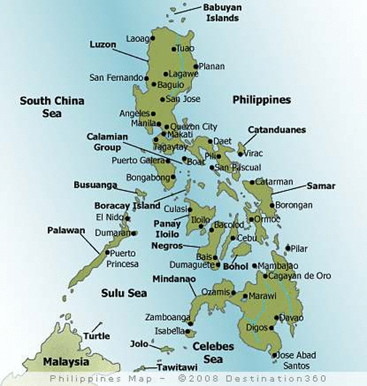
Preview for This Effort in the Philippines
Tuguegarao

Slide 4
Tuguegarao

Slide 5
Work in Angeles City
Background of work – Clark Airbase (USAF)
Two to four hour bus ride from Manila
Lordy Salunga is preacher – very knowledgeable
One of few preachers raised by faithful parents
Heard American brethren since his youth
Was a national scholar & college professor
Edited “Sword & Shield” – depth of Bible study
I had agreed to hold meeting for church there several years ago and just now able to do so
Held at end of what is called “Holy Week”

Slide 6
Tuguegarao
Lectures & P.T. in Bacolod
P.T. Classes on 1 Cor.

Slide 7
2nd Timothy 2:1-2
¹ You therefore, my son, be strong in the grace that is in Christ Jesus. ² And the things that you have heard from me among many witnesses, commit these to faithful men who will be able to teach others also.

Slide 8
Spiritual Strength Produced & Reproduced
Spiritual Strength Is Found Only in Christ
Eph. 6:10 “Be strong in the Lord…”
Eph. 3:14-19 Strength through Spirit to inner man
Col. 1:9-14 Power given “in the kingdom of the Son…”
Once Strength Is Found, Must Be Reproduced in Faithful Men (Evangelism)
1 Cor. 4:17 Seen in Timothy
Phil. 2:19-21 Character needed in work (Col. 4:7-9)
Once Reproduced, Must Continue Reproduction
Acts 8:4 First century church showed it (Acts 11:22-26)
Eph. 4:11-16 Plan for strength & growth of church

