Slide 1
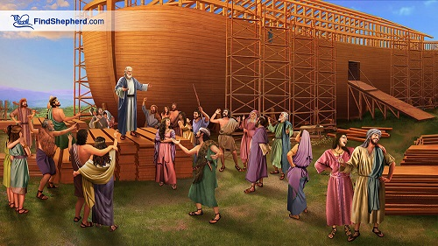
A Corrupt World vs. Faithful Noah
Genesis 6:5-12

Slide 2
Genesis 6:5-12
⁵ Then the Lord saw that the wickedness of man was great in the earth, and that every intent of the thoughts of his heart was only evil continually. ⁶ And the Lord was sorry that He had made man on the earth, and He was grieved in His heart. ⁷ So the Lord said, “I will destroy man whom I have created from the face of the earth, both man and beast, creeping thing and birds of the air, for I am sorry that I have made them. ⁸ But Noah found grace in the eyes of the Lord. ⁹ This is the genealogy of Noah. Noah was a just man, perfect in his generations. Noah walked with God. ¹⁰ And Noah begot three sons: Shem, Ham, and Japheth. ¹¹ The earth also was corrupt before God, and the earth was filled with violence. ¹² So God looked upon the earth, and indeed it was corrupt; for all flesh had corrupted their way on the earth.

Slide 3
Comparing the Characteristics…
A Corrupt World
Faithful Noah
Wickedness of man was great
Noah found grace in Lord’s eyes
Every intent of thoughts of his heart was only evil
2 Peter 2:14
Proverbs 4:23
Romans 1:18-21, 32
Corrupt
Psalm 14:1-3
Proverbs 6:16-19
Filled with violence
Ezekiel 7:23; 8:17-18; 9:9
A just (righteous) man, perfect in his generations
Psalm 37:39-40
Titus 2:11-12
Philippians 1:9-11
Walked with God
Genesis 5:21-24
Malachi 2:4-6
1 John 1:6-9

