Slide 1
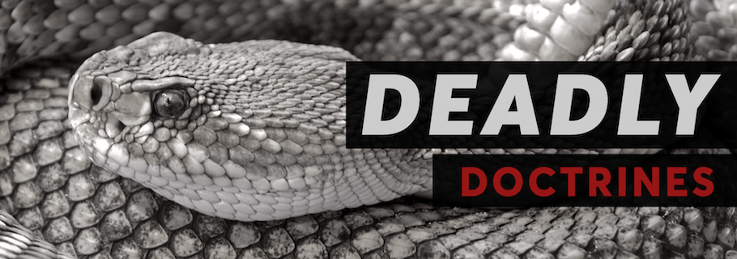
The Danger of Religious Lies
Ezekiel 13:22-23

Slide 2
Ezekiel 13:1-2, 22-23
¹ And the word of the Lord came to me, saying, ² “Son of man, prophesy against the prophets of Israel who prophesy, and say to those who prophesy out of their own heart, ‘Hear the word of the Lord! … ²² Because with lies you have made the heart of the righteous sad, whom I have not made sad; and you have strengthened the hands of the wicked, so that he does not turn from his wicked way to save his life. ²³ Therefore you shall no longer envision futility nor practice divination; for I will deliver My people out of your hand, and you shall know that I am the Lord.’ ”

Slide 3
The Danger of Religious Lies (Error)
They make the heart of the righteous sad
Amos 5:12 Afflicted the just, diverted justice from poor
Isaiah 5:20-23 Take justice away from the righteous
They strengthen the hands of the wicked
Jeremiah 23:13-14 Strengthen the hands of evildoers
Malachi 2:17 → v. 13-16 Doing evil called good (practice)
They cause wicked not to turn from evil & be saved
2 Kings 22:8-13 Book of law lost, but still condemned
Micah 3:5-8 Prophets useless if not showing sin to Israel
2 Corinthians 4:3-4 If gospel veiled, no power to save
Truth does the opposite in every case
John 17:17
2 Timothy 3:16-17
2 John 9

Slide 4
Modern Religious Lies
“One Church Is as Good as Any Other”
But the Bible Teaches the Opposite
Jesus promised to built only one church (Matt. 16:18)
Church is the body of Christ (Eph. 1:22-23)
There was only one body or church in N.T. (Eph. 4:4)
Only one church was bought by the blood of Christ (Acts 20:28)
All saved are add to that church (Acts 2:47)
What Is the Effect of This Religious Lie?

Slide 5
Modern Religious Lies
“We Are Saved by Faith Only”
But the Bible Teaches the Opposite
We are not saved by faith only (James 2:18-24, 26)
Jesus said must believe & be baptized (Mk. 16:15-16)
Repent & be baptized for remission of sins (Acts 2:38)
Sins washed away in baptism (Acts 22:16)
We are baptized into the death of Christ (Rom. 6:3-4)
As many as baptized into Christ put Him on (Gal. 3:27)
Baptism also “now saves us” (1 Peter 3:21)
Sin removed in baptism by work of God (Col. 2:11-12)
What Is the Effect of This Religious Lie?

Slide 6
Modern Religious Lies
“It’s Alright to Drink Intoxicants as Long as We Don’t Get Drunk”
But the Bible Teaches the Opposite
Do not even look on it in the cup (Prov. 23:31-32)
Not wise if we drink wine & strong drink (Prov. 20:1)
Intoxicants enslave the heart (Hosea 4:11)
Steal ability to distinguish holy & unholy (Lev. 10:9-10)
Drinking intoxicant condemned as whole (1 Peter 4:3)
“Make no provision for flesh…” (Rom. 13:11-14)
What Is the Effect of This Religious Lie?

Slide 7
Modern Religious Lies
“It’s Only Opinion What Is Modest Dress”
But the Bible Teaches the Opposite
N.T. commands to wear modest apparel (1 Tim. 2:8-10)
Proper clothing part of “chaste conduct (1 Pet. 3:1-6)
Nakedness was shameful at fall (Gen. 3:7, 10, 21)
“Nakedness” of loins & thighs covered (Exod. 28:42)
Called “naked” when thigh uncovered (Isa. 47:2-3)
Called “naked” when buttocks uncovered (Isa. 20:4)
Called “naked” when breast shown (Ezek. 16:7-8)
Nakedness is still sinful in N.T. (Rev. 3:17; 16:15; 17:16)
What Is the Effect of This Religious Lie?

Slide 8
Same Thing Is True of Any Religious Lie (Error)
They make the heart of the righteous sad
They strengthen the hands of the wicked
They cause wicked not to turn from evil & be saved
Only truth can make righteous glad, weaken hands of wicked & point sinner to salvation

