Slide 1
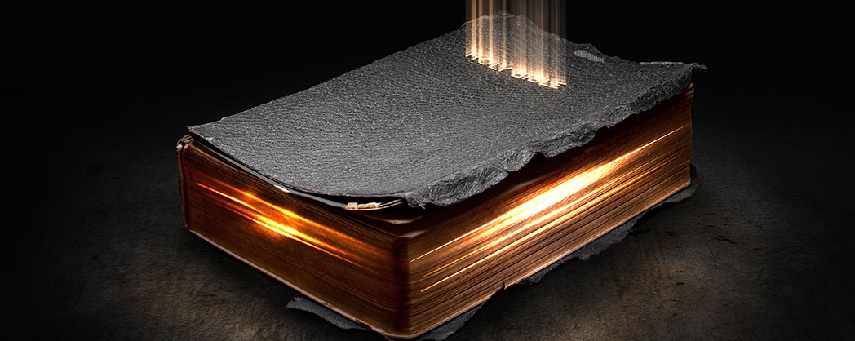
Gaining Christ & Being Found in Him
Philippians 3:1-11

Slide 2
Philippians 3:1-11
¹ Finally, my brethren, rejoice in the Lord. For me to write the same things to you is not tedious, but for you it is safe. ² Beware of dogs, beware of evil workers, beware of the mutilation! ³ For we are the circumcision, who worship God in the Spirit, rejoice in Christ Jesus, and have no confidence in the flesh, ⁴ though I also might have confidence in the flesh. If anyone else thinks he may have confidence in the flesh, I more so: ⁵ circumcised the eighth day, of the stock of Israel, of the tribe of Benjamin, a Hebrew of the Hebrews; concerning the law, a Pharisee; ⁶ concerning zeal, persecuting the church; concerning the righteousness which is in the law, blameless.

Slide 3
⁷ But what things were gain to me, these I have counted loss for Christ. ⁸ Yet indeed I also count all things loss for the excellence of the knowledge of Christ Jesus my Lord, for whom I have suffered the loss of all things, and count them as rubbish, that I may gain Christ ⁹ and be found in Him, not having my own righteousness, which is from the law, but that which is through faith in Christ, the righteousness which is from God by faith; ¹⁰ that I may know Him and the power of His resurrection, and the fellowship of His sufferings, being conformed to His death, ¹¹ if, by any means, I may attain to the resurrection from the dead.

Slide 4
⁷ But what things were gain to me, these I have counted loss for Christ. ⁸ Yet indeed I also count all things loss for the excellence of the knowledge of Christ Jesus my Lord, for whom I have suffered the loss of all things, and count them as rubbish, that I may gain Christ ⁹ and be found in Him, not having my own righteousness, which is from the law, but that which is through faith in Christ, the righteousness which is from God by faith; ¹⁰ that I may know Him and the power of His resurrection, and the fellowship of His sufferings, being conformed to His death, ¹¹ if, by any means, I may attain to the resurrection from the dead.

Slide 5
⁷ But what things were gain to me, these I have counted loss for Christ. ⁸ Yet indeed I also count all things loss for the excellence of the knowledge of Christ Jesus my Lord, for whom I have suffered the loss of all things, and count them as rubbish, that I may gain Christ ⁹ and be found in Him, not having my own righteousness, which is from the law, but that which is through faith in Christ, the righteousness which is from God by faith; ¹⁰ that I may know Him and the power of His resurrection, and the fellowship of His sufferings, being conformed to His death, ¹¹ if, by any means, I may attain to the resurrection from the dead.

Slide 6
Having a Christ-Centered Focus in Life
Guided by the righteousness of God by faith
Rom. 10:1-3 Jews were ignorant of God’s righteousness
1 Cor. 15:34 Righteousness seen by knowledge from God
“That I may know Him…”
1 Jn. 2:3-6 “By this we know that we know Him…”
John 17:1-3 Jesus came to manifest God & give eternal life
2 Pet. 1:2-4 Knowing Him → life, godliness & all promises
“And the power of His resurrection…”
Rom. 6:3-6 Not final resurrection, but resurrection to new life
2 Cor. 5:17 Made new creation in Christ; old passed away
“And the fellowship of His sufferings”
Gal. 6:17 “I bear in my body the marks of the Lord Jesus”
1 Pet. 4:1 Christ suffered & we must do same (1 Pet. 2:21)

Slide 7
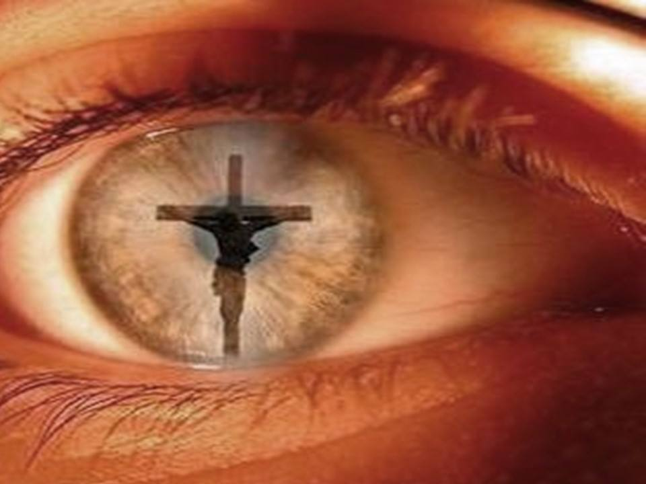
Is My Focus Truly Christ-Centered?

