Slide 1
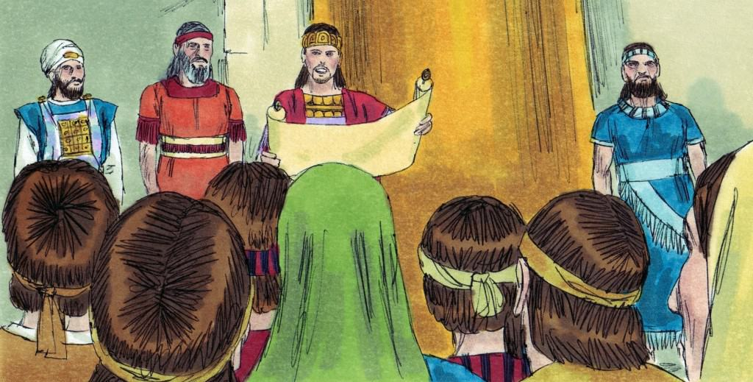
Josiah: Turned to the Lord with all his heart, soul & might
2 Kings 23:21-25

Slide 2
2 Kings 23:21-25
²¹ Then the king commanded all the people, saying, “Keep the Passover to the Lord your God, as it is written in this Book of the Covenant.” ²² Such a Passover surely had never been held since the days of the judges who judged Israel, nor in all the days of the kings of Israel and the kings of Judah. ²³ But in the eighteenth year of King Josiah this Passover was held before the Lord in Jerusalem. ²⁴ Moreover Josiah put away those who consulted mediums and spiritists, the household gods and idols, all the abominations that were seen in the land of Judah and in Jerusalem, that he might perform the words of the law which were written in the book that Hilkiah the priest found in the house of the Lord. ²⁵ Now before him there was no king like him, who turned to the Lord with all his heart, with all his soul, and with all his might, according to all the Law of Moses; nor after him did any arise like him.

Slide 3
2 Kings 23:21-25
²¹ Then the king commanded all the people, saying, “Keep the Passover to the Lord your God, as it is written in this Book of the Covenant.” ²² Such a Passover surely had never been held since the days of the judges who judged Israel, nor in all the days of the kings of Israel and the kings of Judah. ²³ But in the eighteenth year of King Josiah this Passover was held before the Lord in Jerusalem. ²⁴ Moreover Josiah put away those who consulted mediums and spiritists, the household gods and idols, all the abominations that were seen in the land of Judah and in Jerusalem, that he might perform the words of the law which were written in the book that Hilkiah the priest found in the house of the Lord. ²⁵ Now before him there was no king like him, who turned to the Lord with all his heart, with all his soul, and with all his might, according to all the Law of Moses; nor after him did any arise like him.

Slide 4
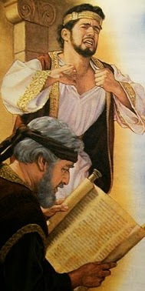
Why Was Josiah So Commended by God?

Slide 5
Background: Understanding Problem
Ancestry of Josiah (2 Kings 21)
Grandson of Manasseh who was exceedingly evil
Son of Amon who followed evil of Manasseh
Early actions Josiah show mindset (22:1-7)
Did what was right in eyes of the Lord (22:2)
Started repair of the temple & gave money to restore
While doing right, book of Law found (22:8-13)
Hilkiah found it & brought to Shaphan who read it
Shephan brought it & read it before King Josiah
Josiah tore clothes understanding Israel’s disobedience
Lord confirmed His will from the Law (22:14-20)

Slide 6
Background: Correcting the Problem
Josiah read Law to all the people (2 Kings 23:1-2)
Josiah & people made covenant to obey (23:3)
Josiah committed to obey Law with all heart & soul
“And all the people took a stand for the covenant”
Action taken to fulfill obedience to Law (23:4-25)
Removed vessels of idolatry & priests (4-5)
Destroyed the idols & their altars (6, 14)
Tore down booths for the sodomites in the temple (7)
Defiled idolatrous places of worship (8, 13, 16)
Destroyed the altars of idolatry (12, 15, 19)
Killed the idolatrous priests (20)
Commanded to keep Passover (21-23)
Put away occult practices (24)
Approval was based on full desire & action to obey

Slide 7
Path of Restoration & Commendation…
Starts with Returning to God’s Standard – His Word
Galatians 1:6-9 Curse pronounced on those who leave it
1 John 1:1-4; 2:7 Word provides for truth & direction
Revelation 2:5 Must remember the standard & return to it
Requires Spiritual Leaders Supported by God’s People
1 Cor. 5:1-5 Needed to put away popular fornicator
Acts 20:25-32 Elders must protect the flock from wolves
Titus 1:9 Elders must hold to word & convict the erring
Hebrews 13:7, 17 All must esteem & submit to such rule
Demands Courage to Do What Is Right Despite Cost
Deut. 31:1-8 → Joshua 1:5-9 → Joshua 24:14-18
Hebrews 12:1-4 → Heb. 13:6 “with good courage we say”
Turning to Lord Involves All Heart, Soul & Might…

