Slide 2


Slide 3
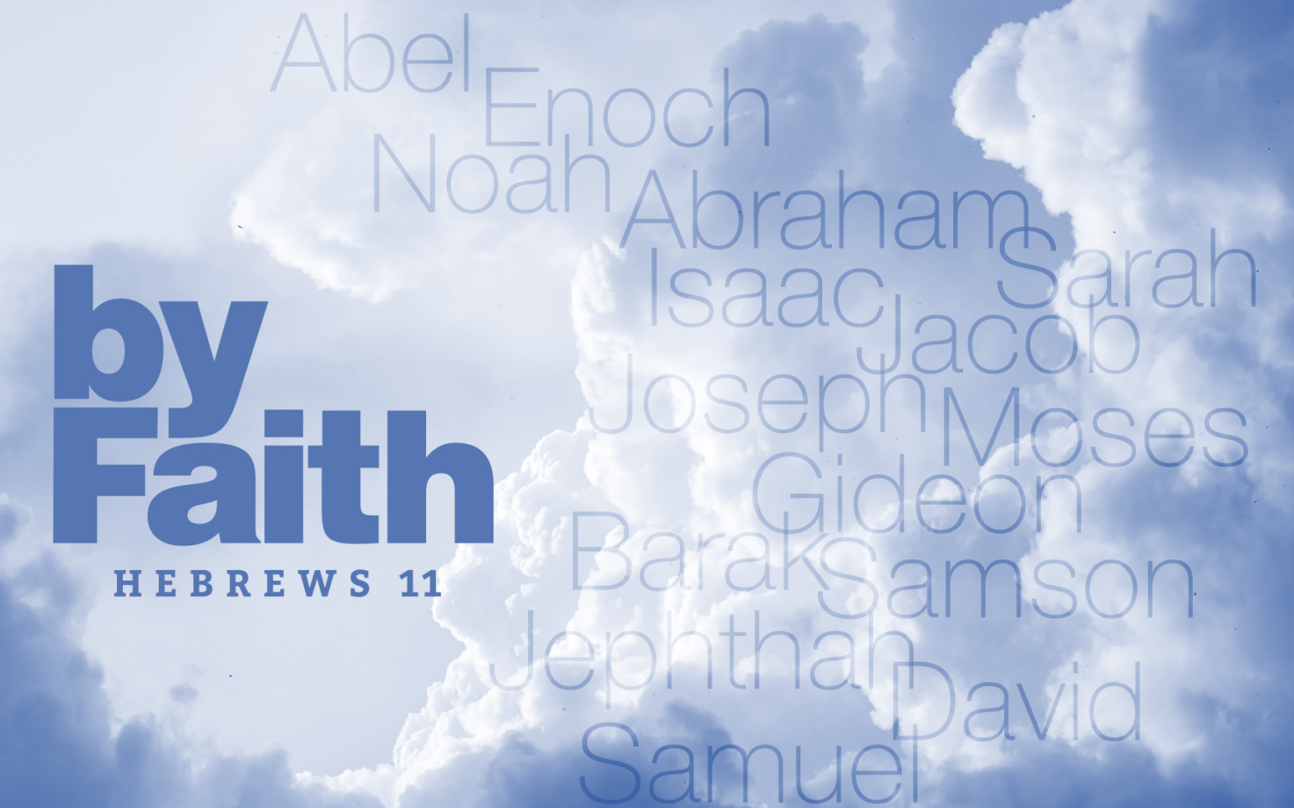
But without faith it is impossible to please Him, for he who comes to God must believe that He is, and that He is a rewarder of those who diligently seek Him.
Hebrews 11:6
Now faith is the substance of things hoped for, the evidence of things not seen. For by it the elders obtained a good testimony.
Hebrews 11:1-2

Slide 4
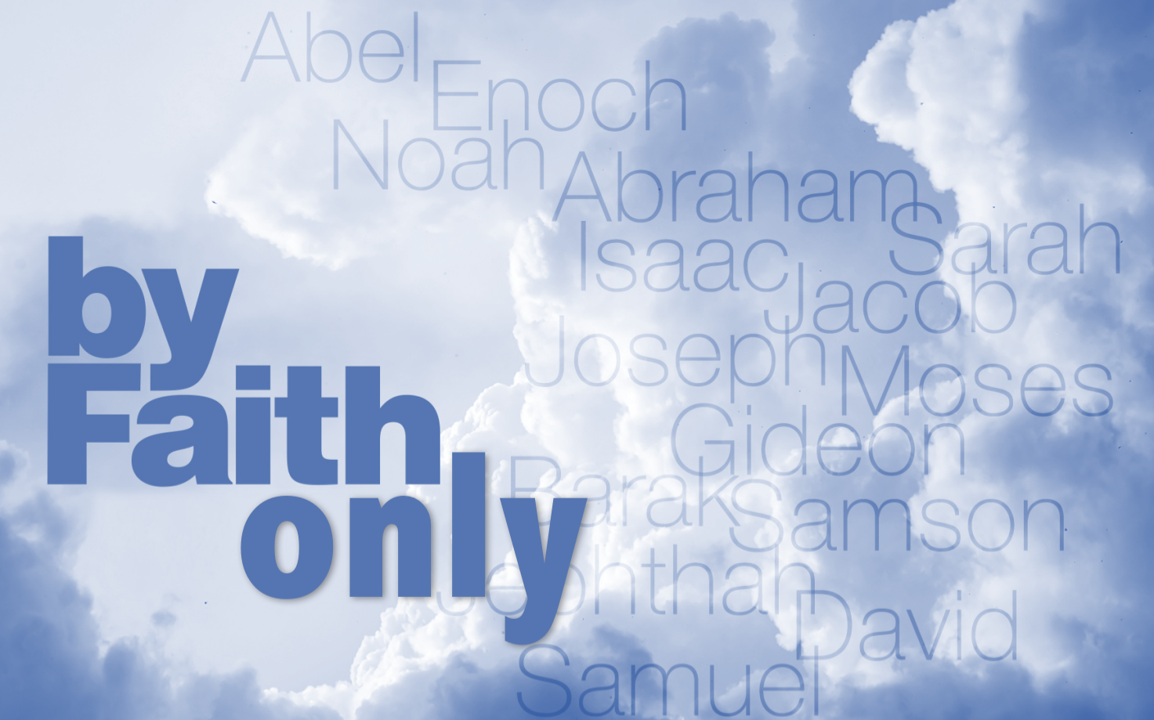
  when it is Obedient, Heb 11:8
  when it Works, Heb 11:7
  when it Walks with, Heb 11:5
  when it Worships, Heb 11:4
  when it Waits, Heb 11:9-10

