Slide 1
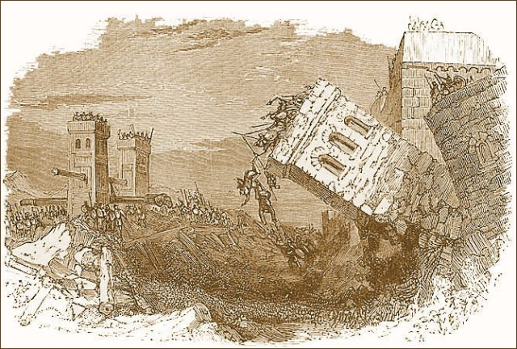
Unless You Repent, You Will All Perish
Luke 13:1-5

Slide 2
Luke 13:1-5
¹ There were present at that season some who told Him about the Galileans whose blood Pilate had mingled with their sacrifices. ² And Jesus answered and said to them, “Do you suppose that these Galileans were worse sinners than all other Galileans, because they suffered such things? ³ I tell you, no; but unless you repent you will all likewise perish. ⁴ Or those eighteen on whom the tower in Siloam fell and killed them, do you think that they were worse sinners than all other men who dwelt in Jerusalem? ⁵ I tell you, no; but unless you repent you will all likewise perish.”

Slide 3
Luke 13:1-5
¹ There were present at that season some who told Him about the Galileans whose blood Pilate had mingled with their sacrifices. ² And Jesus answered and said to them, “Do you suppose that these Galileans were worse sinners than all other Galileans, because they suffered such things? ³ I tell you, no; but unless you repent you will all likewise perish. ⁴ Or those eighteen on whom the tower in Siloam fell and killed them, do you think that they were worse sinners than all other men who dwelt in Jerusalem? ⁵ I tell you, no; but unless you repent you will all likewise perish.”

Slide 4
Why Must All Repent?
Because it is fundamental to gospel message from start
Luke 24:44-47 Part of gospel from beginning (Acts 2:38)
Acts 17:30-31 Now commands all men everywhere to repent
Because it involves a change of will in the sinner
Ezekiel 18:31 Described as “a new heart & a new spirit”
Acts 8:18-23 Sin began in heart of Simon, change required
2 Corinthians 7:10-11 Note full change of will described
Because it produces a new conduct in one’s life
Ezekiel 18:21 Demand is to leave all sin & keep all statutes
Acts 26:19-20 “Do works befitting repentance”
Because it is essential for the remission of sins
Acts 2:38 Repent & be baptized every one for remission
Acts 3:19-23 Repentance brings forgiveness vs. destruction

