Slide 1
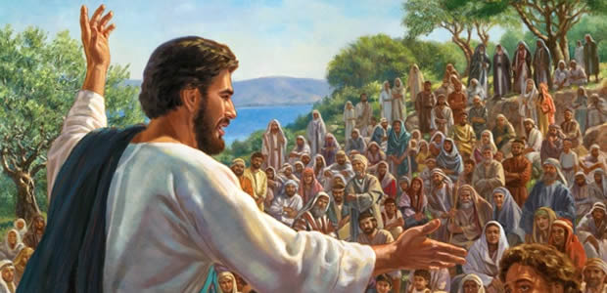
Being True Disciples of Jesus
Matthew 16:24-27

Slide 2
Matthew 16:24-27
²⁴ Then Jesus said to His disciples, “If anyone desires to come after Me, let him deny himself, and take up his cross, and follow Me. ²⁵ For whoever desires to save his life will lose it, but whoever loses his life for My sake will find it. ²⁶ For what profit is it to a man if he gains the whole world, and loses his own soul? Or what will a man give in exchange for his soul? ²⁷ For the Son of Man will come in the glory of His Father with His angels, and then He will reward each according to his works.”

Slide 3
Cannot Be Disciple of Jesus If…
Luke 14
²⁶ “If anyone comes to Me and does not hate his father and mother, wife and children, brothers and sisters, yes, and his own life also, he cannot be My disciple
²⁷ And whoever does not bear his cross and come after Me cannot be My disciple
³³ So likewise, whoever of you does not forsake all that he has cannot be My disciple

Slide 4
Matthew 16:24-27
²⁴ Then Jesus said to His disciples, “If anyone desires to come after Me, let him deny himself, and take up his cross, and follow Me. ²⁵ For whoever desires to save his life will lose it, but whoever loses his life for My sake will find it. ²⁶ For what profit is it to a man if he gains the whole world, and loses his own soul? Or what will a man give in exchange for his soul? ²⁷ For the Son of Man will come in the glory of His Father with His angels, and then He will reward each according to his works.”

Slide 5
Matthew 16:24-27
²⁴ Then Jesus said to His disciples, “If anyone desires to come after Me, let him deny himself, and take up his cross, and follow Me. ²⁵ For whoever desires to save his life will lose it, but whoever loses his life for My sake will find it. ²⁶ For what profit is it to a man if he gains the whole world, and loses his own soul? Or what will a man give in exchange for his soul? ²⁷ For the Son of Man will come in the glory of His Father with His angels, and then He will reward each according to his works.”

Slide 6
Matthew 16:24-27
²⁴ Then Jesus said to His disciples, “If anyone desires to come after Me, let him deny himself, and take up his cross, and follow Me. ²⁵ For whoever desires to save his life will lose it, but whoever loses his life for My sake will find it. ²⁶ For what profit is it to a man if he gains the whole world, and loses his own soul? Or what will a man give in exchange for his soul? ²⁷ For the Son of Man will come in the glory of His Father with His angels, and then He will reward each according to his works.”

Slide 7
Matthew 16:24-27
²⁴ Then Jesus said to His disciples, “If anyone desires to come after Me, let him deny himself, and take up his cross, and follow Me. ²⁵ For whoever desires to save his life will lose it, but whoever loses his life for My sake will find it. ²⁶ For what profit is it to a man if he gains the whole world, and loses his own soul? Or what will a man give in exchange for his soul? ²⁷ For the Son of Man will come in the glory of His Father with His angels, and then He will reward each according to his works.”

Slide 8
Being True Disciple Involves…
Denying Self
Romans 8:13 Must put to death the things of flesh
Romans 15:1 “… and not to please ourselves”
1 Cor. 15:4-5 Fundamental to the nature of “love”
Taking Up His Cross
Hebrews 12:1-2 Looking to the example of Jesus
Galatians 6:14 “Cross” is line of distinction w/world
Matt. 10:34-38 “Cross” = suffering & conflict
Following Jesus
Galatians 2:20 No longer I, but Christ lives in me…
Matthew 7:21-23 Must obey His will ( Lk. 6:46)
1 Pet. 2:21-25 Jesus left example to follow (Jn. 10:27)

Slide 9
Can I Be a True Disciple If…
I Listen to Self above Jesus?
I Put Priority on My Thoughts above His Word?
I Value Earthly Relationships by Choosing Them over HIM and His Truth?
I Choose Popular Path of Popular over Truth?
I Refuse to Suffer for His Truth?
I Do Not Fully Follow Jesus’ Teaching in All Things?
I Call Him Lord, But Do Not Obey Him?

Slide 10
Am I Truly a Disciple of Jesus?

