Slide 2
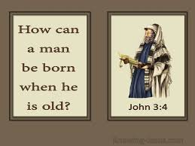
John 3

Slide 3
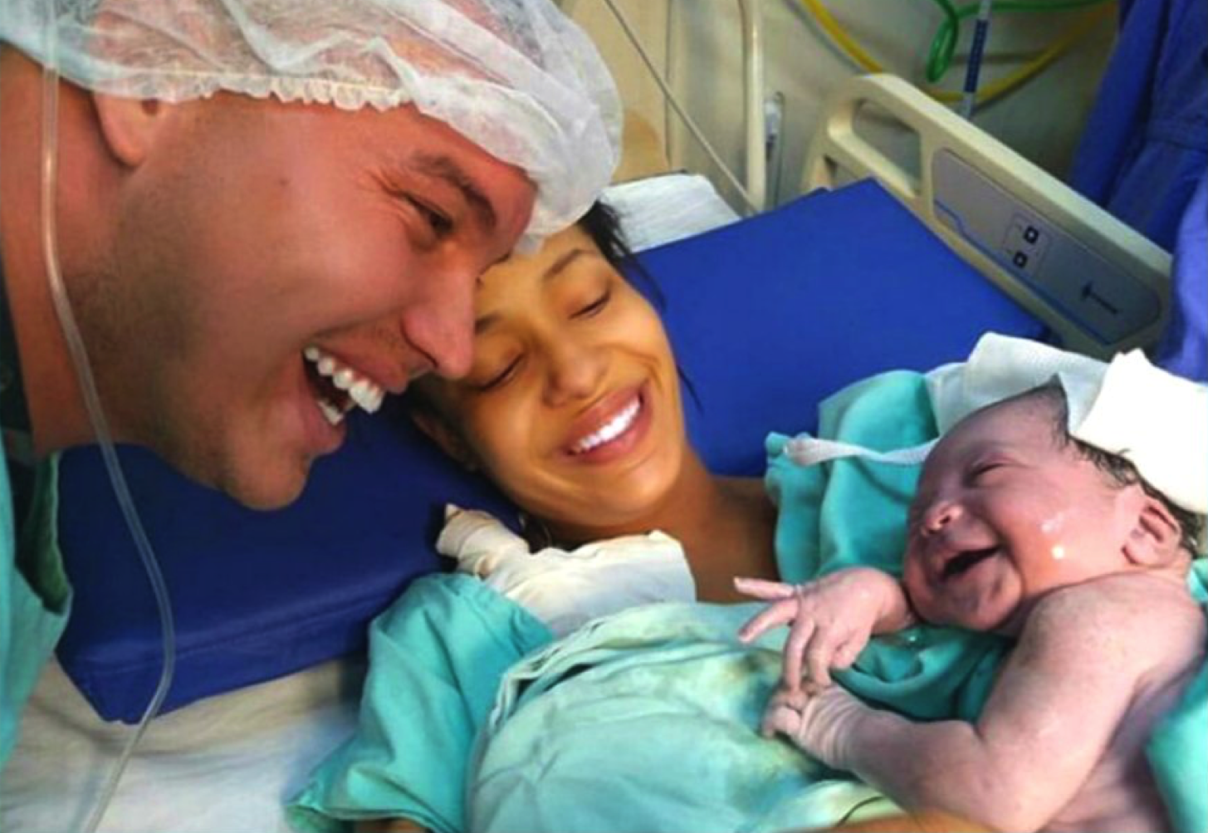
How Can A Man Be Born Again When He Is Old?
John 3:1-9

Slide 4
John 3:1-9
¹ There was a man of the Pharisees named Nicodemus, a ruler of the Jews. ² This man came to Jesus by night and said to Him, “Rabbi, we know that You are a teacher come from God; for no one can do these signs that You do unless God is with him.” ³ Jesus answered and said to him, “Most assuredly, I say to you, unless one is born again, he cannot see the kingdom of God.” ⁴ Nicodemus said to Him, “How can a man be born when he is old? Can he enter a second time into his mother’s womb and be born?” ⁵ Jesus answered, “Most assuredly, I say to you, unless one is born of water and the Spirit, he cannot enter the kingdom of God. ⁶ That which is born of the flesh is flesh, and that which is born of the Spirit is spirit. ⁷ Do not marvel that I said to you, ‘You must be born again.’ ⁸ The wind blows where it wishes, and you hear the sound of it, but cannot tell where it comes from and where it goes. So is everyone who is born of the Spirit.” ⁹ Nicodemus answered and said to Him, “How can these things be?”

Slide 5
A New Beginning… In the Spiritual New Birth of Baptism
Scripture Teaches That We Are Born Again Spiritually in Baptism
Romans 6:3-11 Raised from baptism to new life
1 Peter 1:22-23 → 1 Pet. 3:21 Cleansed – How?
Hebrews 9:13-14 Cleanse by blood of Christ
Acts 2:37-38 Remission of sin is new beginning
Do You Need A New Beginning in Your Life?

Slide 6
A New Beginning… In Forgiveness

Slide 8
A New Beginning… In Forgiveness
Scripture Teaches That Forgiveness Gives Us New Beginning
2 Corinthians 5:17-19 Forgiveness brought possibility of reconciliation with God
Ephesians 1:3-7 Forgiveness by blood in Christ
Matthew 6:14-15 We must forgive others
Ephesians 4:31-32 Must forgive like Christ did
Do You Need New Beginning In Forgiveness?

Slide 9
A New Beginning… In Family Relationships

Slide 10
A New Beginning… In Family Relationships
Scripture Teaches Us How To Achieve Family Renewal
Colossians 3:18-21 Renew family to God’s plan
Ephesians 5:22-31 → Eph. 6:1-4 Family is renewed to God’s plan when we all obey His will
Luke 15:11-32 Same reconciliation & renewal available with God is pictured within family
Does Your Family Need A New Beginning?

