Slide 2
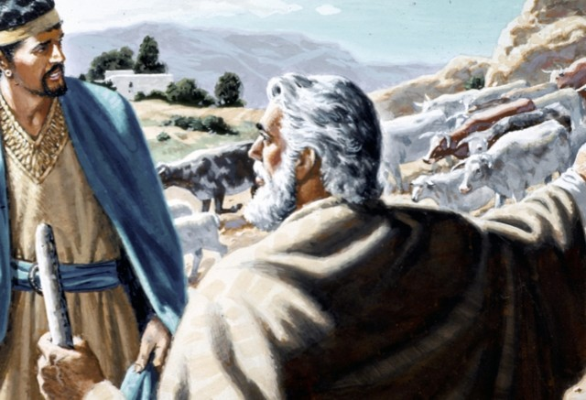
1 Samuel 15
¹ Samuel also said to Saul, “The Lord sent me to anoint you king over His people, over Israel. Now therefore, heed the voice of the words of the Lord. ² Thus says the Lord of hosts: ‘I will punish Amalek for what he did to Israel, how he ambushed him on the way when he came up from Egypt. ³ Now go and attack Amalek, and utterly destroy all that they have, and do not spare them. But kill both man and woman, infant and nursing child, ox and sheep, camel and donkey.’ ” ⁴ So Saul gathered the people together and numbered them in Telaim, two hundred thousand foot soldiers and ten thousand men of Judah. ⁵ And Saul came to a city of Amalek, and lay in wait in the valley. ⁶ Then Saul said to the Kenites, “Go, depart, get down from among the Amalekites, lest I destroy you with them. For you showed kindness to all the children of Israel when they came up out of Egypt.” So the Kenites departed from among the Amalekites.

Slide 3
1 Samuel 15
⁷ And Saul attacked the Amalekites, from Havilah all the way to Shur, which is east of Egypt. ⁸ He also took Agag king of the Amalekites alive, and utterly destroyed all the people with the edge of the sword. ⁹ But Saul and the people spared Agag and the best of the sheep, the oxen, the fatlings, the lambs, and all that was good, and were unwilling to utterly destroy them. But everything despised and worthless, that they utterly destroyed. ¹⁰ Now the word of the Lord came to Samuel, saying, ¹¹ “I greatly regret that I have set up Saul as king, for he has turned back from following Me, and has not performed My commandments.” And it grieved Samuel, and he cried out to the Lord all night.

Slide 4
1 Samuel 15
The Command
1 Samuel 15:3 – “utterly destroy all that they have, and do not spare them”
The Action
1 Samuel 15:7-9 – “Spared Agag and the best of the sheep, the oxen, the fatlings, the lambs, and all that was good”
God’s Response
1 Samuel 15:11 – “I greatly regret that I have set Saul as King, for he has turned back from following Me, and he has not performed my commandments”

Slide 5
The Commands of The Lord
1 Samuel 15

Slide 6
The Commands of The Lord
1 John 5:3; Deuteronomy 30:11 – God’s commands are not burdensome nor are they hard
Deuteronomy 29:29 – What has been revealed (commands) are so we may do His words (keep His commands)

Slide 7
Looseness With God’s Commands
1 Samuel 15:13 – “I have performed the commandment of the Lord”
1 Samuel 15:20 – “I have obeyed the voice of the Lord”

Slide 8
Looseness With God’s Commands
We must keep all that is commanded
Deuteronomy 6:1-2 – Keep all His statutes and commandments which he commands
Joshua 1:8 – Observe to do according to all that is written in it
Psalm 119:4 – Commanded to keep His precepts diligently
James 1:21-25 – A doer of the word is one who keeps the word

Slide 9
Looseness With God’s Commands
Subjective vs Objective Truth
John 8:31-32 – “You shall know the truth and the truth shall make you free”
Ephesians 3:1-4 – “when you read you may understand my knowledge in the mystery of Christ”
Ephesians 5:17 – “Do not be unwise but understand what the will of the Lord is”
2 Timothy 3:13-17 – The scripture makes one complete thoroughly equipped to every good work

Slide 10
Looseness With God’s Commands
Subjective vs Objective Truth
Psalm 19:7-11 – God’s word changes lives
Psalm 119:97-105 – God’s word is to guide me and provide me direction
2 Corinthians 5:9-10 – We aim to be well pleasing to Him and are judged by the works done whether good or bad

Slide 11
Man Does It His Way
1 Samuel 15:15 – “the people spared… to sacrifice to the Lord your God”
1 Samuel 15:21 – “the people took… to sacrifice to the Lord your God at Gilgal”
1 Samuel 15:22 – “to obey is better than sacrifice”

Slide 12
Man Does It His Way
Man’s ways are not God’s ways
Isaiah 55:8-9 – God’s ways are higher than man’s ways
Jeremiah 10:23 – The way of man is not in himself
Proverbs 14:12 – There is a way that seems right to man but its end is death

Slide 13
Man Does It His Way
When man does it his way…
2 Timothy 1:13 – Does not hold fast to the pattern of sound words
1 Corinthians 4:6 – Goes beyond what is written
Deuteronomy 4:2 – Takes away or adds to the word of God

Slide 14
Man Does It His Way
When man does it his way…
Instrumental Music
Colossians 3:16-17; Ephesians 5:19
Lords Supper
Acts 20:7
Church Organization
Colossians 1:18 – Christ is the head; Acts 20:28; Peter 5:1-3 – elders oversee the local body

Slide 15
Man Does It His Way
When man does it his way…
Divorce for any reason
Matthew 19:9
Drunkenness
Galatians 5:19-21
Abortion
Luke 1:41 “babe leaped in the womb”, Galatians 5:19-21
Homosexuality
1 Corinthians 6:9-10

Slide 16
Fear The People
1 Samuel 15:24 – “I feared the people and obeyed their voice”

Slide 17
Fear The People
The people will look to something other than truth
2 Timothy 4:1-4 – They will look for what they want to hear
We must not hold back any part of the truth
Acts 20:18-21,27 – Keep nothing back, proclaim it all, declare the whole council of God

Slide 18
What Do I Do?
1 Samuel 15:17 – “When you were little in your own eyes”

Slide 19
What Do I Do?
Humility, Honesty, and Desire
Matthew 13:3-23; Luke 8:4-15 – The good and honest heart receives the word
James 1:21-25 – Become a doer of the word
1 Peter 2:1-2 – Lay aside all evil and desire the word, growing by it

Slide 20
The Commands of The Lord
1 Samuel 15

