Slide 2
Matthew 12:33-37
³³ “Either make the tree good and its fruit good, or else make the tree bad and its fruit bad; for a tree is known by its fruit. ³⁴ Brood of vipers! How can you, being evil, speak good things? For out of the abundance of the heart the mouth speaks. ³⁵ A good man out of the good treasure of his heart brings forth good things, and an evil man out of the evil treasure brings forth evil things. ³⁶ But I say to you that for every idle word men may speak, they will give account of it in the day of judgment. ³⁷ For by your words you will be justified, and by your words you will be condemned.”

Slide 3
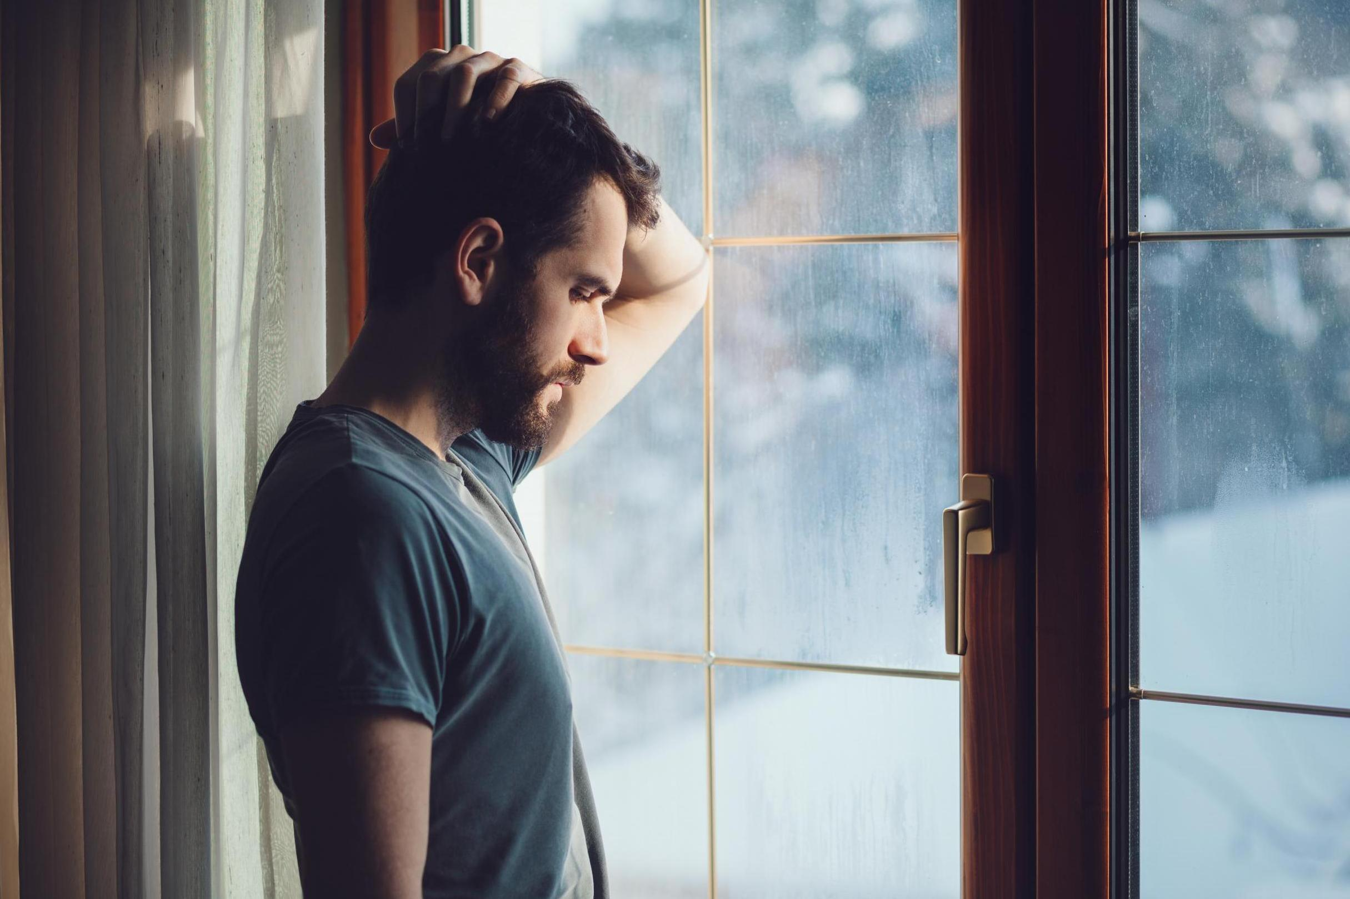
Words I Didn’t Say

Slide 4
Words of God
We are not to be ashamed of God’s word
Mark 8:38; Luke 9:26 – We are not to be ashamed of Christ and His words
Romans 1:16 – “I am not ashamed of the gospel of Christ”
Why we don’t say the words of God?
We love the praise of men
We are distracted by the world
We don’t think they will be willing to hear or accept it
We fear hurting those we are close to

Slide 5
Words of Confession (of our sins)
Confession is a requirement
1 John 1:9 – Confession of sins is required, if we confess, He is faithful and just to forgive us
Proverbs 28:13-14 – The one who confesses and forsakes their sins will have mercy
Psalm 32:5 – God will forgive confessed transgressions
Why we don’t confess?
We will have another day or time
We fear how it will look
We fear hurting those we are close to

Slide 6
Words of Forgiveness
Forgiveness is a requirement
Matthew 6:14-15 – If you forgive you will be forgiven, if you do not forgive you will not be forgiven
Ephesians 4:32 – Forgiving one another as Christ forgave you
Matthew 18:21-35 – Remember the debt we have been forgiven
Why we don’t forgive?
We have forgiven them enough
What they did hurts too bad
They were caught, they aren’t truly sorry

Slide 7
Words I Didn’t Say
Words of God
Words of Confession
Words of Forgiveness

Slide 8
Words I Didn’t Say

