Slide 1
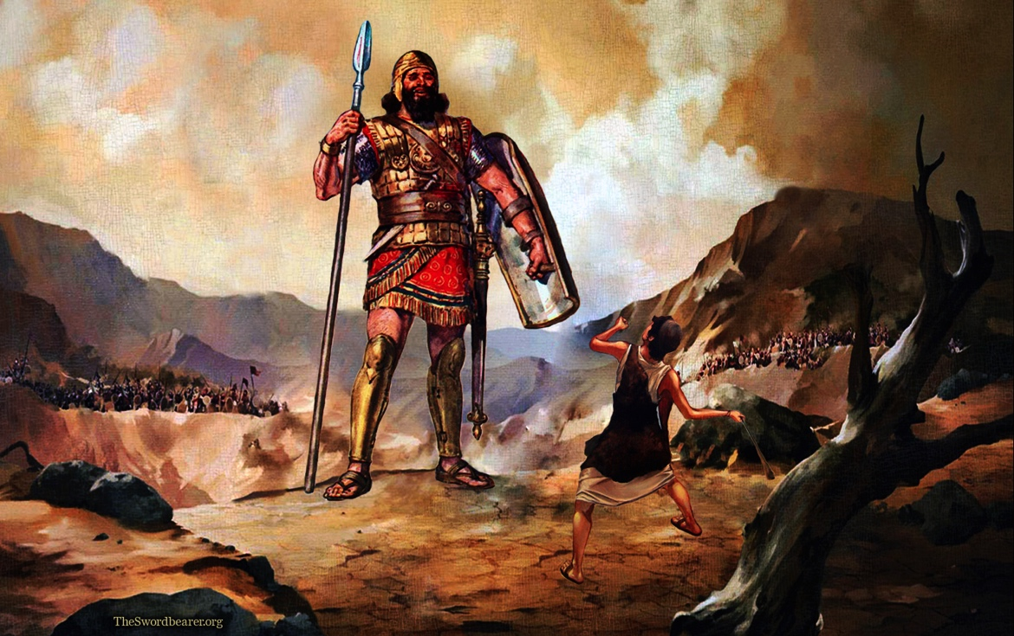
Is There Not A Cause?
1 Samuel 17:26-29

Slide 2
1 Samuel 17:26-29
²⁶ Then David spoke to the men who stood by him, saying, “What shall be done for the man who kills this Philistine and takes away the reproach from Israel? For who is this uncircumcised Philistine, that he should defy the armies of the living God?” ²⁷ And the people answered him in this manner, saying, “So shall it be done for the man who kills him.” ²⁸ Now Eliab his oldest brother heard when he spoke to the men; and Eliab’s anger was aroused against David, and he said, “Why did you come down here? And with whom have you left those few sheep in the wilderness? I know your pride and the insolence of your heart, for you have come down to see the battle.” ²⁹ And David said, “What have I done now? Is there not a cause”?

Slide 3
1 Samuel 17:26-29
²⁶ Then David spoke to the men who stood by him, saying, “What shall be done for the man who kills this Philistine and takes away the reproach from Israel? For who is this uncircumcised Philistine, that he should defy the armies of the living God?” ²⁷ And the people answered him in this manner, saying, “So shall it be done for the man who kills him.” ²⁸ Now Eliab his oldest brother heard when he spoke to the men; and Eliab’s anger was aroused against David, and he said, “Why did you come down here? And with whom have you left those few sheep in the wilderness? I know your pride and the insolence of your heart, for you have come down to see the battle.” ²⁹ And David said, “What have I done now? Is there not a cause”?
“Is There Not A Cause?”

Slide 4
1 Samuel 17:31-37
³¹ Now when the words which David spoke were heard, they reported them to Saul; and he sent for him. ³² Then David said to Saul, “Let no man’s heart fail because of him; your servant will go and fight with this Philistine.” ³³ And Saul said to David, “You are not able to go against this Philistine to fight with him; for you are a youth, and he a man of war from his youth.” ³⁴ But David said to Saul, “Your servant used to keep his father’s sheep, and when a lion or a bear came and took a lamb out of the flock, ³⁵ I went out after it and struck it, and delivered the lamb from its mouth; and when it arose against me, I caught it by its beard, and struck and killed it. ³⁶ Your servant has killed both lion and bear; and this uncircumcised Philistine will be like one of them, seeing he has defied the armies of the living God.” ³⁷ Moreover David said, “The Lord, who delivered me from the paw of the lion and from the paw of the bear, He will deliver me from the hand of this Philistine.”

Slide 5
Was There Not A Cause With Israel?
Goliath showed contempt for the armies of Israel with his challenge against them
“I defy the armies of Israel this day; give me a man, that we may fight together”
But the armies of Israel went to battle at the instruction of Jehovah God & has His power
Thus, Goliath’s challenge was actually defying God
David saw the cause was at stake & took action
“Your servant has killed both lion and bear; and this uncircumcised Philistine will be like one of them, seeing he has defied the armies of the living God”

Slide 6
Is There Not A Cause In Our Homes?
There is a culture that surrounds our families that is increasingly defiant to God’s will for our homes
There is a cause for husbands & fathers to take a leading role in assuring godly guidance to families
1 Peter 3:7 Husbands as joint heirs to the grace of life
Eph. 6:4 “…in training & admonition of the Lord”
Wives & children need to see an example of strength and courage in spiritual priorities and actions
Make a decision to serve God first no matter what (Josh. 24:14-15 “As for me & my house, we will…”)

Slide 7
Is There Not A Cause In The Church?
There is a trend at work to compromise the truth regarding the uniqueness of the Lord’s church
It is not a denomination (Matt. 16:18; Acts 20:28)
The Lord’s church is the pillar and ground of the truth (1 Timothy 3:15)
Like the shepherd David, elders must seek good of the cause by leading & protecting the flock
Titus 1:7-9 Able to exhort & convict those who oppose
Hebrews 13:7, 17 Responsibilities of shepherds & flock
We must all keep preeminence of the cause in mind

Slide 8
Is There Not A Cause Within Self?
There is a call for us to become more and more like the world that surrounds us & defy God in…
Morals
Priorities
Language
Doctrine
Action
But we must remember our call to be separate
2 Corinthians 6:14-18 Come out & be separate
1 Peter 2:4-5, 9-12 “His own special people”
We will stand before God at Judgment (2 Cor. 5:10)

