Slide 1
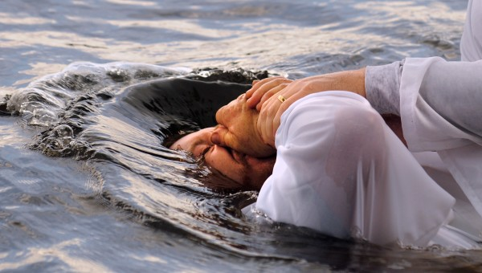
Why Baptism?
1st Peter 3:18-22

Slide 2
1 Peter 3:18-22
¹⁸ For Christ also suffered for sins once for all time, the just for the unjust, so that He might bring us to God, having been put to death in the flesh, but made alive in the spirit; ¹⁹ in which He also went and made proclamation to the spirits in prison, ²⁰ who once were disobedient when the patience of God kept waiting in the days of Noah, during the construction of the ark, in which a few, that is, eight persons, were brought safely through the water.²¹ Corresponding to that, baptism now saves you — not the removal of dirt from the flesh, but an appeal to God for a good conscience — through the resurrection of Jesus Christ, ²² who is at the right hand of God, having gone into heaven, after angels and authorities and powers had been subjected to Him. [NASB]

Slide 3
Salvation Is Based on Sacrifice of Christ
¹⁸ For Christ also suffered for sins once for all time, the just for the unjust, so that He might bring us to God, having been put to death in the flesh, but made alive in the spirit…
Salvation can only be found in Christ (Acts 4:7-12)
Man did not begin the process of reconciliation, but Christ first gave His blood (Romans 5:6-11)
That salvation in Christ, through His blood, is revealed in His gospel (1 Peter 1:17-25)

Slide 4
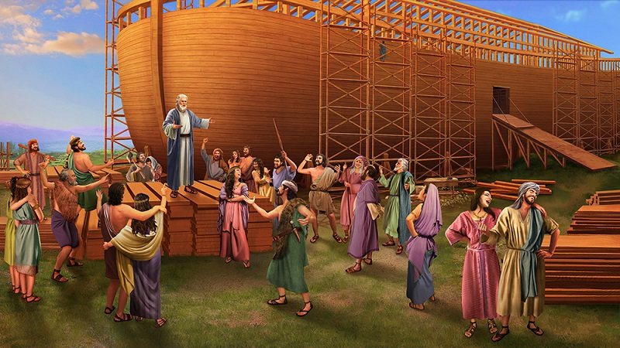
Christ Preached Salvation Through Noah While Ark Was Being Built
¹⁹ in which He also went and made proclamation to the spirits in prison, ²⁰ who once were disobedient when the patience of God kept waiting in the days of Noah, during the construction of the ark, in which a few, that is, eight persons, were brought safely through the water.
God bringing salvation to Noah’s house, while destroying world, was a figure (2 Peter 2:4-9)
Provided for salvation in the ark (Hebrews 11:7)
Water that brought destruction to world delivered Noah & those saved (1 Peter 3:21)

Slide 5
Correspondingly, Baptism Now Saves Us
²¹ Corresponding to that, baptism now saves you — not the removal of dirt from the flesh, but an appeal to God for a good conscience — through the resurrection of Jesus Christ, ²² who is at the right hand of God, having gone into heaven, after angels and authorities and powers had been subjected to Him.
Baptism is not a meritorious work, but an appeal to God for salvation through Christ (Romans 6:3-6)
Gk. eperotema – an intense desire, earnest seeking
Only Christ’s blood can cleanse conscience (Hebrews 9:13-14)
Baptism is a calling on Christ (Acts 22:16; 2:38)

