Slide 1
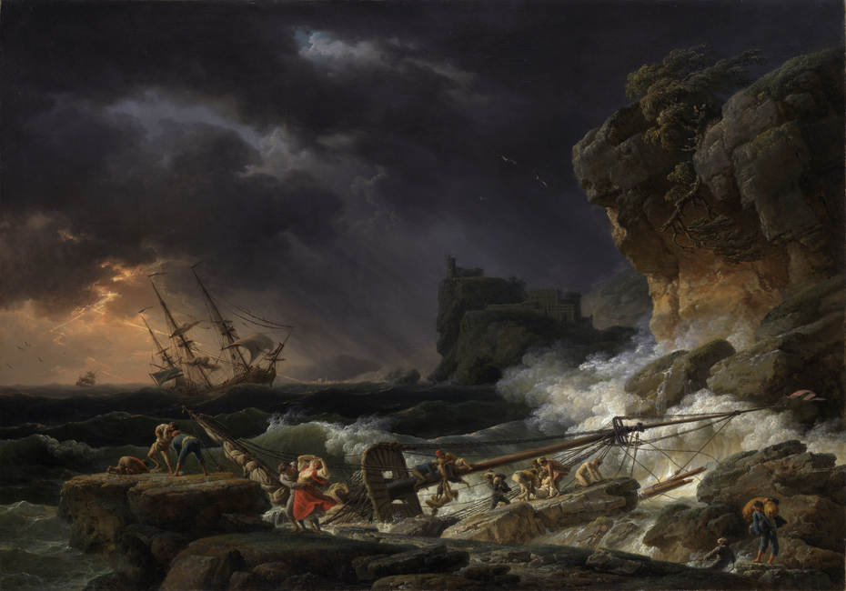
“They Overthrow the Faith of Some”
2nd Timothy 2:15-19

Slide 2
1 Timothy 1:18-20
¹⁸ This charge I commit unto thee, my child Timothy, according to the prophecies which led the way to thee, that by them thou mayest war the good warfare; ¹⁹ holding faith and a good conscience; which some having thrust from them made shipwreck concerning the faith: ²⁰ of whom is Hymenaeus and Alexander; whom I delivered unto Satan, that they might be taught not to blaspheme. [ASV]

Slide 3
2 Timothy 2:15-19
¹⁵ Be diligent to present yourself approved to God, a worker who does not need to be ashamed, rightly dividing the word of truth. ¹⁶ But shun profane and idle babblings, for they will increase to more ungodliness. ¹⁷ And their message will spread like cancer. Hymenaeus and Philetus are of this sort, ¹⁸ who have strayed concerning the truth, saying that the resurrection is already past; and they overthrow the faith of some. ¹⁹ Nevertheless the solid foundation of God stands, having this seal: “The Lord knows those who are His,” and, “Let everyone who names the name of Christ depart from iniquity.”

Slide 4
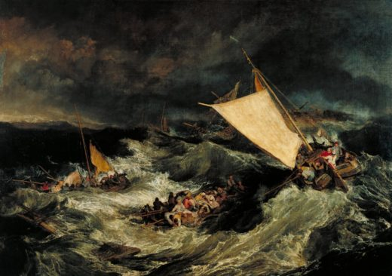
How Do They Overthrow Faith?
They stray from the message of truth
Remember: Faith comes by hearing word of God
Destroying faith starts by taking focus off the word
Mark 7:6-9
2 Timothy 3:16 – 4:5
They teach another doctrine that seems harmless
Once focus off God’s word, ready to introduce error
Most effective to first introduce what seems harmless
Galatians 1:6-9
2 John 9-11

Slide 5
How Do They Overthrow Faith?
Error metastasizes to attack other parts of faith
Error never stagnant – grows worse (2 Tim. 3:13)
1 Corinthians 15:12-19
Galatians 5:1-6
There are no “safe” or “harmless” changes to word
A heart once solid in faith is overthrown
When once faithful soul strays, the effect is tragic
1 Timothy 1:18-20
Jude 11-13
2 Peter 2:20-22

Slide 6
What Prevents the Overthrowing of Faith?
“Nevertheless the solid foundation of God stands”
God’s word is always the solid foundation
Luke 6:46-49
Applications of this truth
“No big deal if say Genesis 1-2 figurative”
“Don’t believe Calvinism, but some truth…”
“Saying ‘One True Church’ is too narrow”

