Slide 1
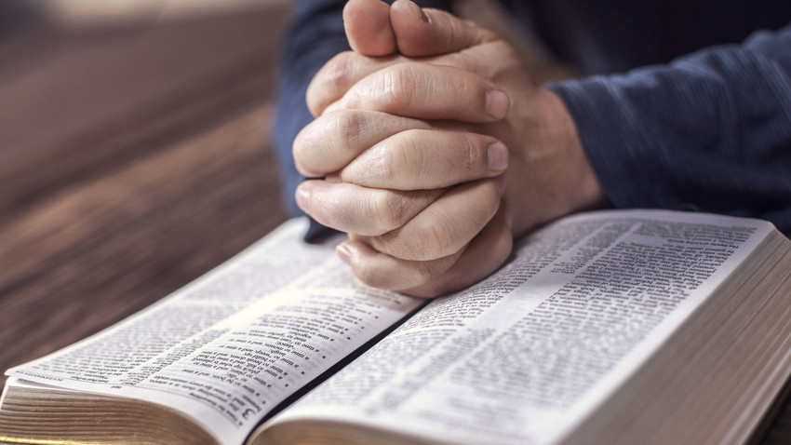
Peace & Wisdom
James 3:13-18

Slide 2
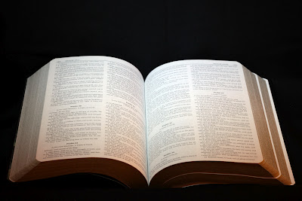
James 3:13-18
¹³ Who is wise and understanding among you? Let him show by good conduct that his works are done in the meekness of wisdom. ¹⁴ But if you have bitter envy and self-seeking in your hearts, do not boast and lie against the truth. ¹⁵ This wisdom does not descend from above, but is earthly, sensual, demonic. ¹⁶ For where envy and self-seeking exist, confusion and every evil thing are there. ¹⁷ But the wisdom that is from above is first pure, then peaceable, gentle, willing to yield, full of mercy and good fruits, without partiality and without hypocrisy. ¹⁸ Now the fruit of righteousness is sown in peace by those who make peace.

Slide 3
In the Absence of Peace…
Jealousy, faction and every vile deed exist when true peace is not present
Greed, degeneracy and violence are joined together by their very nature
James 4:1-3
2 Timothy 3:1-4
Romans 1:28-32
Romans 8:6
Results of the absence of peace should cause us to recognize its value

Slide 4
Wisdom, Peace & God
Wisdom is not a result of folly or foolish people, but of wise actions & wise people
Wisdom personified & shown to have desirable companions including peace (Prov. 3:13-17)
Wise God is described as the origin of true peace
Romans 15:33; 16:20
Philippians 4:9
1 Thessalonians 5:23-24
Peace is ultimately achieved by following the example of Christ (Col. 3:12-15)

Slide 5
True Peace & Wisdom → God & Purity
“Wisdom that is from above is first pure…”
Psalm 34:14
1 Peter 3:10-12
Romans 12:17-18
Hebrews 12:14-16
Some think that peace is result of compromise or greater tolerance of every form of ungodliness
Truth is that compromise with evil only makes a lack of peace certain
We must have faith to accept God’s way is best

