Slide 1
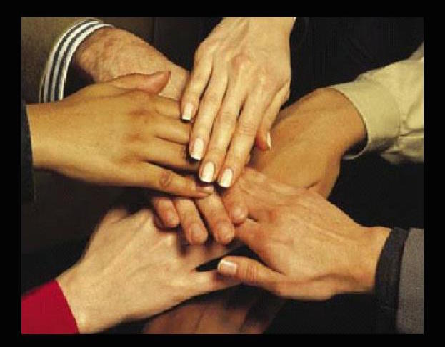
A Plea for Unity
1 Corinthians 1:10-13

Slide 2
1 Corinthians 1:10-13
¹⁰ Now I plead with you, brethren, by the name of our Lord Jesus Christ, that you all speak the same thing, and that there be no divisions among you, but that you be perfectly joined together in the same mind and in the same judgment. ¹¹ For it has been declared to me concerning you, my brethren, by those of Chloe’s household, that there are contentions among you. ¹² Now I say this, that each of you says, “I am of Paul,” or “I am of Apollos,” or “I am of Cephas,” or “I am of Christ.” ¹³ Is Christ divided? Was Paul crucified for you? Or were you baptized in the name of Paul?

Slide 3
“Now I Plead With You, Brethren”
Contentions & divisions present at Corinth
Various groups were following after men rather than acting on truth (1 Cor. 4:6)
Reminded that Christ must be the focus & foundation of their service
Paul pleads with them to have unity “by the name of our Lord Jesus Christ”
Word “plead” (parakaleo) means to “call near”
Only a heart grieved by division can recognize the urgent need to call all together in Christ

Slide 4
“That You All Speak the Same Thing…”

Slide 5
Unity of Speech Based on Truth
Content of message must be true to Word
1 Peter 4:11 “Speak as the oracles of God”
Colossians 3:17 “Do all in name of the Lord”
Ephesians 4:29 “Good for necessary edification”
Titus 2:1 Things “proper for sound doctrine”
True unity can only exist where the truth of God’s word is proclaimed by all members
Demands both knowing it & teaching it

Slide 6
“And That There Be No Divisions Among You...”

Slide 7
Schisms Harm & Must Be Healed
Divisions present in Corinth caused souls involved to be in danger (3:3; 11:17-19)
Philippians 2:5-8 “Let this mind be in you”
Ephesians 4:13-16 “All come to unity of faith”
1 Peter 3:8-11 “Seek peace & pursue it”
Cannot have brethren divided in sentiment & united in action
Unity demands effort in thought & action

Slide 8
“That You Be Perfectly Joined… in Same Mind & Same Judgment”

Slide 9
Joined in Same Mind & Judgment
Mind (nous) - seat of reflective thought; faculties of understanding & perception
Judgment (gnome) - understanding as the end product of the thought process; resolve
United understanding achieved by process
Philippians 1:27 Word directs spirit & life
Ephesians 4:1-6 Unity directed by Spirit
2 Corinthians 13:11 Same mind = live in peace
Colossians 2:1-7 Process in application

Slide 10
How Will I Answer the Plea for Unity?

