Slide 1
Factors of a Pilgrim’s Hope
1 Peter 1:1-5

Slide 2
1 Peter 1:1-5
¹ Peter, an apostle of Jesus Christ, to the pilgrims of the Dispersion in Pontus, Galatia, Cappadocia, Asia, and Bithynia, ² elect according to the foreknowledge of God the Father, in sanctification of the Spirit, for obedience and sprinkling of the blood of Jesus Christ: Grace to you and peace be multiplied. ³ Blessed be the God and Father of our Lord Jesus Christ, who according to His abundant mercy has begotten us again to a living hope through the resurrection of Jesus Christ from the dead, ⁴ to an inheritance incorruptible and undefiled and that does not fade away, reserved in heaven for you, ⁵ who are kept by the power of God through faith for salvation ready to be revealed in the last time.

Slide 3
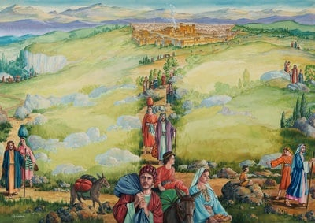
Early Christians Fled Persecution
Tended to Lead Many to Despair & Sorrow

Slide 4
What Led Pilgrim to Hope?
A New Life (Begotten Again)
1 Peter 1:22-25
2 Corinthians 5:17
An Assurance of Hope by Resurrection of Christ
1 Corinthians 15:3-8 → 1 Cor. 15:12-20
Acts 2:22-32 → Acts 3:15; 4:33; 10:39-40; Rom. 1:4
An Incorruptible, Undefiled, Unfading Inheritance
Philippians 3:20-21
Revelation 21:1-5, 23-27
A Living Faith in the Power of God
Acts 27:25
Romans 4:18-21

Slide 5
Do You Have a Pilgrim’s Hope?

