Slide 1
Learning Submission & Service
Mark 10:42-45

Slide 2
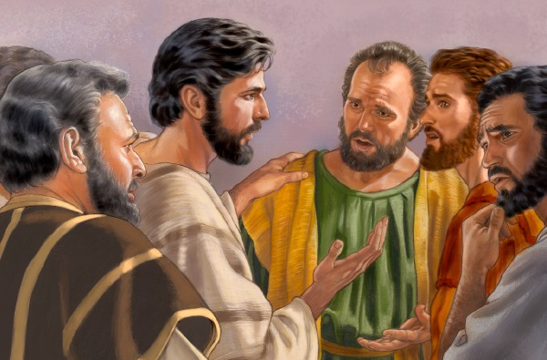
Background to Text (Mark 10:35-41)
³⁵ Then James and John, the sons of Zebedee, came to Him, saying, “Teacher, we want You to do for us whatever we ask.” ³⁶ And He said to them, “What do you want Me to do for you?” ³⁷ They said to Him, “Grant us that we may sit, one on Your right hand and the other on Your left, in Your glory.” ³⁸ But Jesus said to them, “You do not know what you ask. Are you able to drink the cup that I drink, and be baptized with the baptism that I am baptized with?” ³⁹ They said to Him, “We are able.” So Jesus said to them, “You will indeed drink the cup that I drink, and with the baptism I am baptized with you will be baptized; ⁴⁰ but to sit on My right hand and on My left is not Mine to give, but it is for those for whom it is prepared.” ⁴¹ And when the ten heard it, they began to be greatly displeased with James and John.

Slide 3
Mark 10:42-46
⁴² But Jesus called them to Himself and said to them, “You know that those who are considered rulers over the Gentiles lord it over them, and their great ones exercise authority over them. ⁴³ Yet it shall not be so among you; but whoever desires to become great among you shall be your servant. ⁴⁴ And whoever of you desires to be first shall be slave of all. ⁴⁵ For even the Son of Man did not come to be served, but to serve, and to give His life a ransom for many.”

Slide 4
Submission Often Devalued by World
Women’s Liberation movement
Tell wives that submission = Inferiority
Judge value based on advanced job status
Materialism & greed conflict with submission
Attitude of seeking self-interest over all others
“Nobody has the right to tell me what to do!”
Basic attitude of anarchy in civil realm
Gets one in trouble in the business world
Brings rebellion in family relations
Causes problems when present in a local church

Slide 5
Principles of Submission & Service
Often Missing in Lives of Believers
2 Kings 5:13 Naaman too proud
Luke 22:24-26 Apostles sought glory
But Clearly Required in Scripture
James 4:7 We must submit to God
Eph. 5:21 We must submit to one another
Heb. 13:17 We must submit to elder

Slide 6
Pride Hinders Submission & Service
Pride fosters oppression of others (Psa. 10:2)
Pride goes with violent actions (Psa. 73:6)
Israel’s self-seeking prevented concern for condition & plight of others (Amos 6:1-6)
Haughty → Self-righteous (Luke 18:9-14)
Inflated view of self vs. spirit of gentleness (Gal. 6:1-5)
Pride prevents service; humility furthers it

Slide 7
Submissive Service Must Be Taught
Note Jesus choosing apostles (Luke 6:12-16)
Apostles needed much work
Showed undeserved respect of rich (Matt. 19:23-25)
Wanted glory (Matt. 18:1)
Disputed with one another (Luke 22:24)
Peter claimed superiority (Matt. 26:33)
Jesus taught them how to serve
Exemplified service to multitude (Luke 6:17f)
Taught principles of submission (Luke 6:20f)
Submission & Service Must Be Taught Today

