Slide 1
Making Our Calling & Election Sure
2nd Peter 1:5-11

Slide 2
2nd Peter 1:5-11
⁵ But also for this very reason, giving all diligence, add to your faith virtue, to virtue knowledge, ⁶ to knowledge self-control, to self-control perseverance, to perseverance godliness, ⁷ to godliness brotherly kindness, and to brotherly kindness love. ⁸ For if these things are yours and abound, you will be neither barren nor unfruitful in the knowledge of our Lord Jesus Christ. ⁹ For he who lacks these things is shortsighted, even to blindness, and has forgotten that he was cleansed from his old sins. ¹⁰ Therefore, brethren, be even more diligent to make your calling and election sure, for if you do these things you will never stumble; ¹¹ for so an entrance will be supplied to you abundantly into the everlasting kingdom of our Lord and Savior Jesus Christ.

Slide 3
2nd Peter 1:5-11
⁵ But also for this very reason, giving all diligence, add to your faith virtue, to virtue knowledge, ⁶ to knowledge self-control, to self-control perseverance, to perseverance godliness, ⁷ to godliness brotherly kindness, and to brotherly kindness love. ⁸ For if these things are yours and abound, you will be neither barren nor unfruitful in the knowledge of our Lord Jesus Christ. ⁹ For he who lacks these things is shortsighted, even to blindness, and has forgotten that he was cleansed from his old sins. ¹⁰ Therefore, brethren, be even more diligent to make your calling and election sure, for if you do these things you will never stumble; ¹¹ for so an entrance will be supplied to you abundantly into the everlasting kingdom of our Lord and Savior Jesus Christ.

Slide 4
How Do Christians Make Our Calling & Election Sure?

Slide 5
Must Make Traits Ours & Abound
Acceptance with God has always demanded an abounding presence of proper character
Deut. 6:5 Love God with all heart, soul & might
Deut. 10:12 Walk & serve God in all ways w/ all heart
Gospel demands abounding service of Christians
1 Cor. 15:58 Always abounding in work of the Lord
2 Cor. 9:8 Abound unto every good work
If we seek the minimum of service (“what do we have to do”), our attitude will prevent full service
Our spiritual service is opportunity, not “have to”

Slide 6
Must Not Be Barren or Unfruitful
Abounding service will produce obvious results
Lack of fruit is unacceptable to the Lord
Matthew 13:22 Thorny soil became unfruitful
Luke 13:6-9 Time given to bear fruit, but must produce
Fruit is the natural product of Christian’s character
Ephesians 5:7-10 “The fruit of the light is…”
Galatians 5:22-23 “The fruit of the Spirit is…”
Spreading truth & exemplifying godly character is fruit expected

Slide 7
Unfruitfulness
Blindness
(Short-Sighted)
Is Due To

Slide 8
“If You Do These Things You Will Never Stumble…”
Promise of heavenly home is certain to the faithful
Jn. 14:1-3 “If it were not so, I would have told you”
Heb. 6:19-20 A hope both sure and steadfast
1 Pet. 1:3-5 Incorruptible, undefiled, does not fade away
Col. 1:3-5 Hope laid up in the heavens
Heb. 11:16 Better, that is, a heavenly country
Rev. 22:14 Right to enter by doing His commands
Heaven is not an eternal destiny by surprise
It is a prepared place for a prepared people

Slide 9
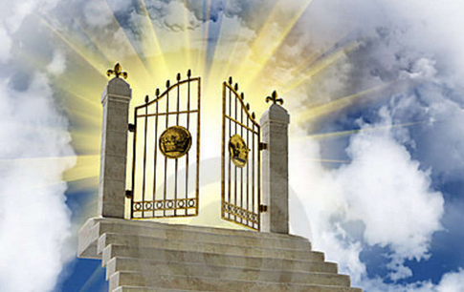
Am I Prepared for the Home of God’s Holy People?

