Slide 1
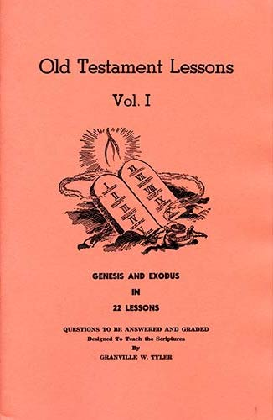
Genesis - Exodus
Lesson # 6
Genesis 25 - 29

Slide 2
OT Lessons Vol 1
Class | Date | Teacher | Lesson | Text
1 | Sunday, September 05, 2021 | Curt | Intro
2 | Wednesday, September 08, 2021 | Harry | 1 | Gen 1-5
3 | Sunday, September 12, 2021 | Curt | 2 | Gen 6-10
4 | Wednesday, September 15, 2021 | Harry | 3 | Gen 11-15
5 | Sunday, September 19, 2021 | Curt | 4 | Gen 16-19
6 | Wednesday, September 22, 2021 | Harry | 5 | Gen 20-24
7 | Sunday, September 26, 2021 | Curt | 6 | Gen 25-29
8 | Wednesday, September 29, 2021 | Harry | 7 | Gen 30-34
9 | Sunday, October 03, 2021 | Curt | 8 | Gen 35-39
10 | Wednesday, October 06, 2021 | Harry | 9 | Gen 40-45
11 | Sunday, October 10, 2021 | Curt | 10 | Gen 46-50
12 | Wednesday, October 13, 2021 | Harry | 11 | Gen 1-50
13 | Sunday, October 17, 2021 | Curt | 12 | Ex 1-4
14 | Wednesday, October 20, 2021 | Harry | 13 | Ex 5-7
15 | Sunday, October 24, 2021 | Curt | 14 | Ex 8-11
16 | Wednesday, October 27, 2021 | Harry | 15 | Ex 12-15
17 | Sunday, October 31, 2021 | Curt | 16 | Ex 16-20
18 | Wednesday, November 03, 2021 | Harry | Singing
19 | Sunday, November 07, 2021 | Curt | 17 | Ex 21-24
20 | Wednesday, November 10, 2021 | Harry | 18 | Ex 25, 35, 37
21 | Sunday, November 14, 2021 | Curt | 19 | Ex 26-27, 36, 38
22 | Wednesday, November 17, 2021 | Harry | 20 | Ex 28-30, 39
23 | Sunday, November 21, 2021 | Curt | 21 | Ex 31-34
24 | Wednesday, November 24, 2021 | Harry | 22 | Ex 40, 25-30, 35-39
25 | Sunday, November 28, 2021 | Curt | Review
Today : Lesson 6
Scriptures Covered: Genesis 25 - 29
Keturah and Sons
Abraham’s death
Jacob and Esau and their wives

Slide 3
Overview of Genesis
Chap. 1
Chap. 2
Chap. 3
Chap. 4
Chap. 5
Chap. 6
Chap. 7
Chap. 8
Chap. 9
Chap. 10
Chap. 11
Chap. 12
Chap. 13
Chap. 14
Chap. 15
Creation
More on creation of man & woman – Garden of Eden
Sin enters the world – Consequences given
Cain kills Abel – Evil spreads
Genealogy from Adam to Noah
God decides to destroy world – Noah builds Ark
Noah, family & animals enter the Ark – Flood begins
Flood abates – Noah, family & animals leave Ark
Man allowed to eat animals – Covenant of rainbow
Genealogy and dwelling places of Noah & his sons
Confusion at Babel – Genealogy Shem to Abram
God’s promise to Abram – Sojourns in Canaan & Egypt
Abram returns to Canaan – Separates from Lot
War of 4 kings and 5 kings – Melchizedek & Abram
God’s second giving of promises to Abram

Slide 4
Overview of Genesis
Chap. 16
Chap. 17
Chap. 18
Chap. 19
Chap. 20
Chap. 21
Chap. 22
Chap. 23
Chap. 24
Chap. 25
Chap. 26
Chap. 27
Chap. 28
Chap. 29
Chap. 30
Abraham, Hagar and Ishmael
Covenant of Circumcision – Abraham, Sarah and Isaac
Sarah laughs – Sodom’s end – For the sake of 10
Lot rescued – Sodom and Gomorrah – Moab & Ben-ammi
Abraham & Abimelech
Isaac is born as promised – Hagar & Ishmael sent away
Abraham tested by God to offer up Isaac
Sarah’s death and burial in cave of Machpeleh (Hebron)
Servant of Abraham sent to find Isaac’s wife - Rebekah

Slide 5
Chapter 25
After the death of Sarah, Abraham takes Katurah as a wife, who bears him six sons
Abraham dies and is buried with Sarah
Ishmael has twelve sons, a fulfillment of God’s promise (Gen 17:21)
Rebekah has twins, Jacob and Esau, who were very different in looks and nature
Esau sells his birthright to Jacob for a meal of lentil stew and bread

Slide 6
Chapter 26
Isaac sojourns in the land of the Philistines and receives a promise from God
Isaac settles in Gerar. Abimelech finds out about Rebekah being his wife
God blesses Isaac and he becomes very wealthy
Isaac digs wells, then moves to Beersheba
Abimelech, Ahuzzath and Phicol make an oath with Isaac
Esau marries two Hittite wives

Slide 7
Chapter 27
Rebekah plots to convince Isaac that Jacob is Esau
Isaac is deceived and blesses Jacob, thinking he is Esau
Esau receives a blessing (?) from Isaac, but he hates it and Jacob
Rebekah wants Jacob to flee when she learns of Esau’s plan to murder him
The Hittite women are a curse to Rebekah

Slide 8
Chapter 28
Jacob is to go to Paddan-aram to take a wife from among the daughters of Laban
Esau takes another Ishmaelite wife
Jacob goes toward Haran, stopping to sleep on a stone
He dreams, sees a ladder, and receives a message from God
Jacob makes a vow to serve God and to give Him a tenth

Slide 9
Chapter 29
Jacob finds Rachel, daughter of Laban, his mother’s brother
Jacob works for Laban seven years for Rachel
Laban’s tricks Jacob into marrying Leah first, but then gives him Rachel
Although “hated”, Leah bears Jacob four sons (the first of the twelve tribes):
Reuben (means “See, a son”)
Simeon (sounds like Hebrew for “Heard”)
Levi (sounds like Hebrew for “Attached”)
Judah (sounds like Hebrew for “Praise”)

Slide 10
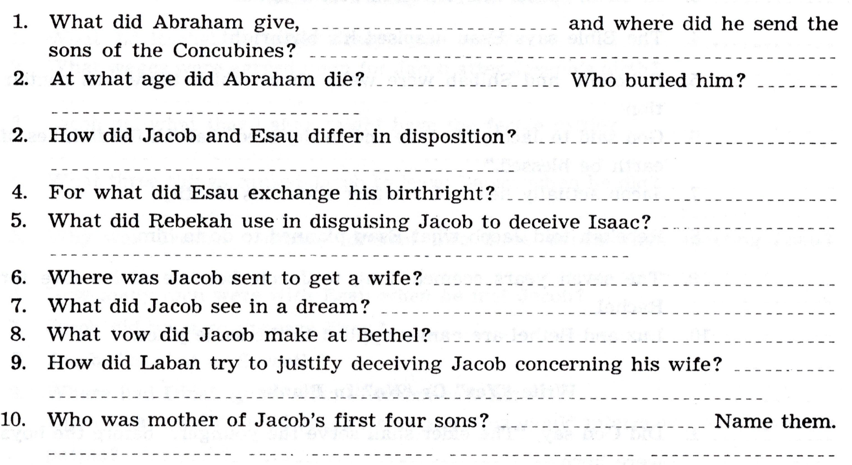

Slide 11
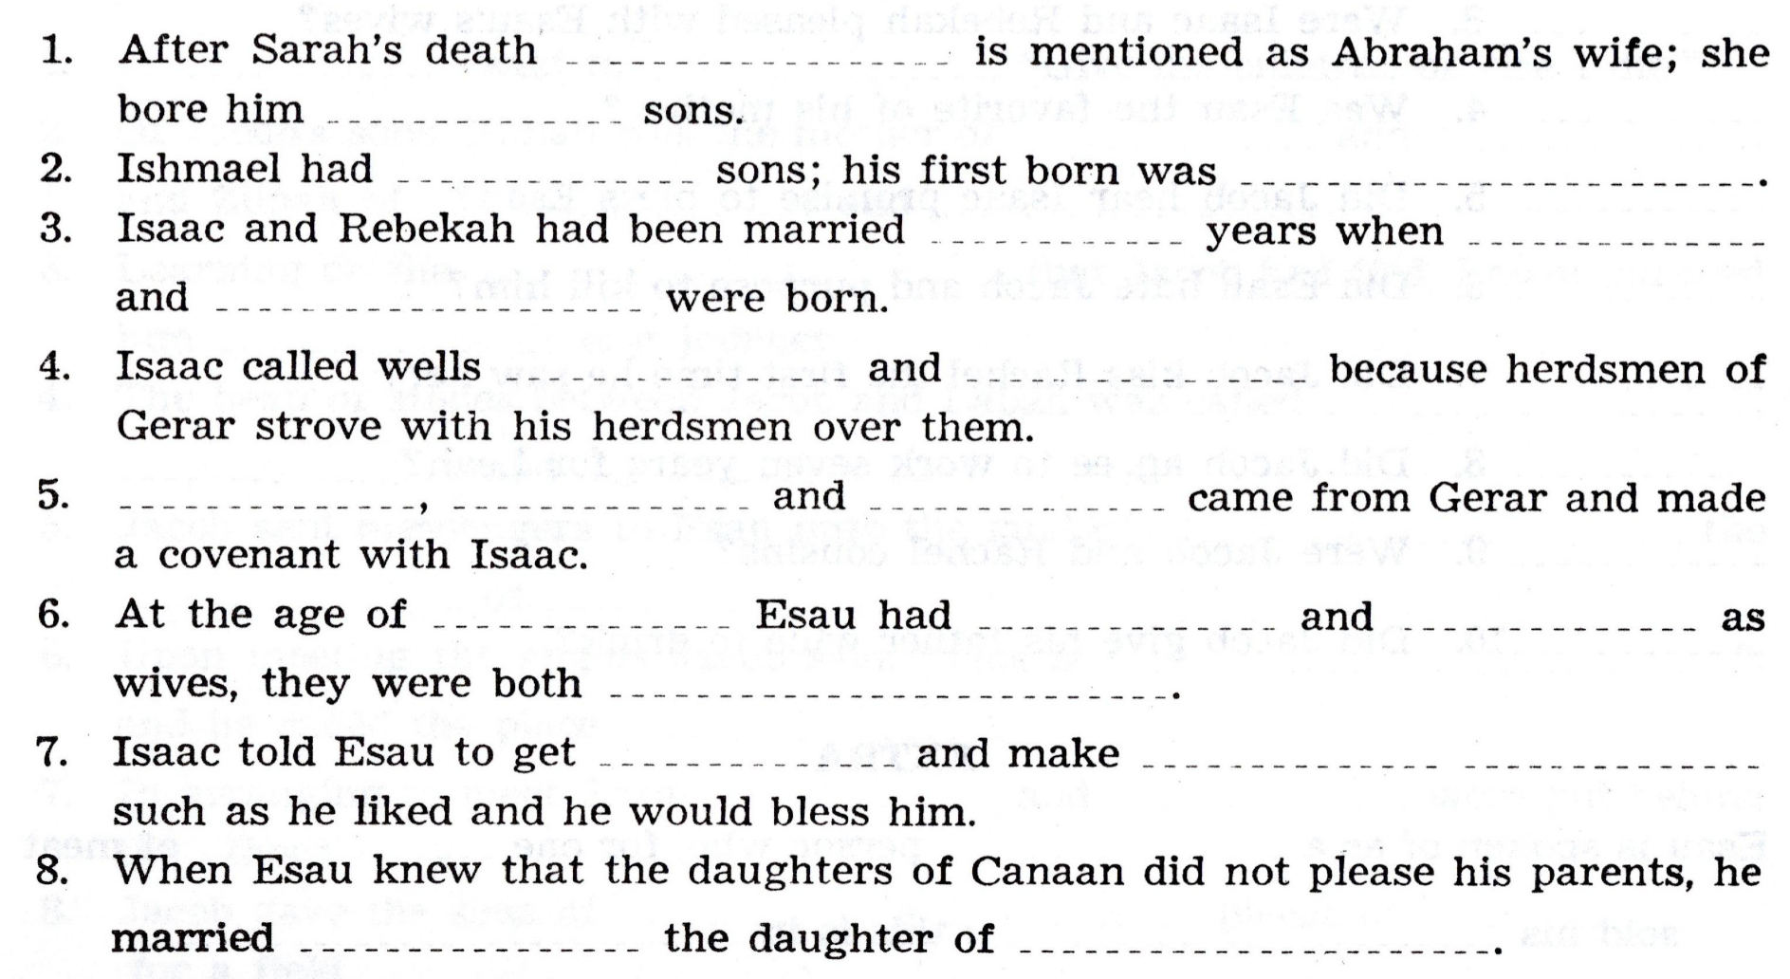

Slide 13
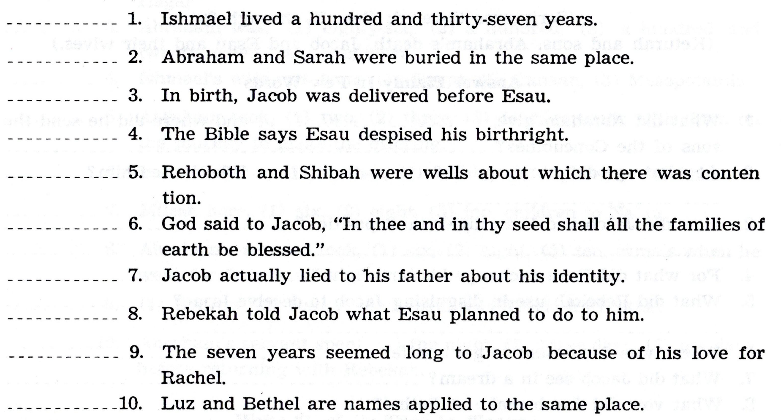

Slide 14
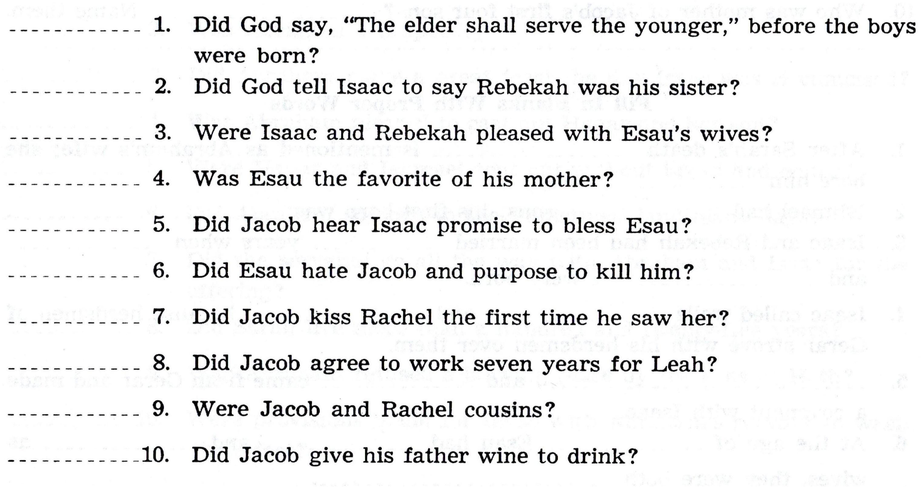

Slide 16
How Can I be Ready for the Next class?
Read the text before class. What text is that?
Study. By yourself or with your spouse / kids / gkids. Make it a family study
Fill out the answers in the book, as you read the scriptures, or afterwards
Add the verse(s) where you found the answer(s)
Come prepared to discuss the text and the answers

