Slide 1
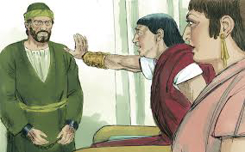
The Lesson & the Reaction
Acts 24:24-25

Slide 2
Acts 24:24-25
²⁴ And after some days, when Felix came with his wife Drusilla, who was Jewish, he sent for Paul and heard him concerning the faith in Christ. ²⁵ Now as he reasoned about righteousness, self-control, and the judgment to come, Felix was afraid and answered, “Go away for now; when I have a convenient time I will call for you.”

Slide 3
Content of the Lesson
Righteousness
Psalm 119:137
1 Corinthians 15:34 Know God & act opposite to sin
1 Cor. 6:9-10 Unrighteous (evil doers) not inherit heaven
Self-Control
Proverbs 25:28 Must have rule over self (Rom. 6:12-14)
2 Peter 1:5-8 Self-control fundamental to proper character
2 Corinthians 10:4-5 How it is achieved (1 Cor. 9:25, 27)
Judgment
Acts 17:30-31 Ignorance of old changed in view of it
1 John 4:17 Who we are will be manifest (2 Cor. 5:10)
Hebrews 9:27 It is a fact with consequences (Rev. 21:8)
→ Psa. 119:138, 160, 172
→ Psa. 119:174-175

Slide 4
Reaction to the Lesson
Felix was afraid and answered, “Go away for now; when I have a convenient time I will call for you”
“Afraid” – emphobos – “to fear; be terrified, affrighted”
In original, phrase actually says “Felix became terrified”
In middle voice – Result of fear mix of active & passive
Paul had a part in it by preaching a message that caused great fear when he clearly showed the danger to Felix
Felix had a part in it by listening & making application of the message to himself
Are we teaching as we ought in plainness of speech?
Am I listening to apply the truth to myself?

