Slide 1
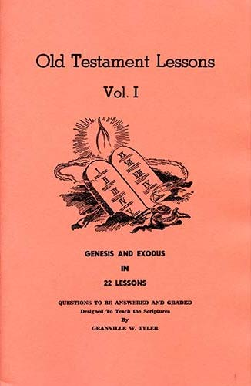
Genesis - Exodus
Lesson # 12
Exodus 1 - 4

Slide 2
OT Lessons Vol 1
Class | Date | Teacher | Lesson | Text
1 | Sunday, September 05, 2021 | Curt | Intro
2 | Wednesday, September 08, 2021 | Harry | 1 | Gen 1-5
3 | Sunday, September 12, 2021 | Curt | 2 | Gen 6-10
4 | Wednesday, September 15, 2021 | Harry | 3 | Gen 11-15
5 | Sunday, September 19, 2021 | Curt | 4 | Gen 16-19
6 | Wednesday, September 22, 2021 | Harry | 5 | Gen 20-24
7 | Sunday, September 26, 2021 | Curt | 6 | Gen 25-29
8 | Wednesday, September 29, 2021 | Harry | 7 | Gen 30-34
9 | Sunday, October 03, 2021 | Curt | 8 | Gen 35-39
10 | Wednesday, October 06, 2021 | Harry | 9 | Gen 40-45
11 | Sunday, October 10, 2021 | Curt | 10 | Gen 46-50
12 | Wednesday, October 13, 2021 | Harry | 11 | Gen 1-50
13 | Sunday, October 17, 2021 | Curt | 12 | Ex 1-4
14 | Wednesday, October 20, 2021 | Harry | 13 | Ex 5-7
15 | Sunday, October 24, 2021 | Curt | 14 | Ex 8-11
16 | Wednesday, October 27, 2021 | Harry | 15 | Ex 12-15
17 | Sunday, October 31, 2021 | Curt | 16 | Ex 16-20
18 | Wednesday, November 03, 2021 | Harry | Singing
19 | Sunday, November 07, 2021 | Curt | 17 | Ex 21-24
20 | Wednesday, November 10, 2021 | Harry | 18 | Ex 25, 35, 37
21 | Sunday, November 14, 2021 | Curt | 19 | Ex 26-27, 36, 38
22 | Wednesday, November 17, 2021 | Harry | 20 | Ex 28-30, 39
23 | Sunday, November 21, 2021 | Curt | 21 | Ex 31-34
24 | Wednesday, November 24, 2021 | Harry | 22 | Ex 40, 25-30, 35-39
25 | Sunday, November 28, 2021 | Curt | Review
Today : Lesson 12
Scriptures Covered: Exodus 1 - 4
Israel is oppressed
Moses born and reared in Egypt
Moses in Midian
Moses and Aaron sent to deliver Israel
Israel delivered around 1491 B.C.

Slide 3
Chapter 1
Jacob / Israel, all of his brothers, and all of that generation die. “But the people of Israel were fruitful and increased greatly; they multiplied and grew exceedingly strong so that the land was filled with them.”
“Now there arose a new king over Egypt...”
The children of Israel are made to work with hard service, as slaves
The king wants two midwives to kill the male babies, but they would not
Male newborns were to be cast into the Nile, but the females could live

Slide 4
Chapter 2
Moses’ parents hide him for three months, then set him afloat in a basket
Moses is discovered and taken in by the daughter of Pharaoh
Moses’ mother is hired to nurse and care for him
Moses kills an Egyptian and flees to Midian
Moses takes Zipporah as wife. She gives birth to Gershom
The king dies and God hears the groaning of the people of Israel

Slide 5
Chapter 3
Acts 7: 17-35
Moses sees the burning bush and begins a conversation with the LORD
God wants Moses to deliver his people and take them back to the promised land
“Who am I?”, and “What is Your name?”
God says He will strike Egypt and the Hebrews will leave, taking spoils with them

Slide 6
Chapter 4
God gives Moses three signs to use to show that God is with him
Moses angers God, but He allows Moses to take Aaron with him
Zipporah circumcises her son, fulfilling the covenant and appeasing God
Moses reveals to Aaron the instructions, words and signs from God
The people hear the news and see the signs. They believe and worship

Slide 7
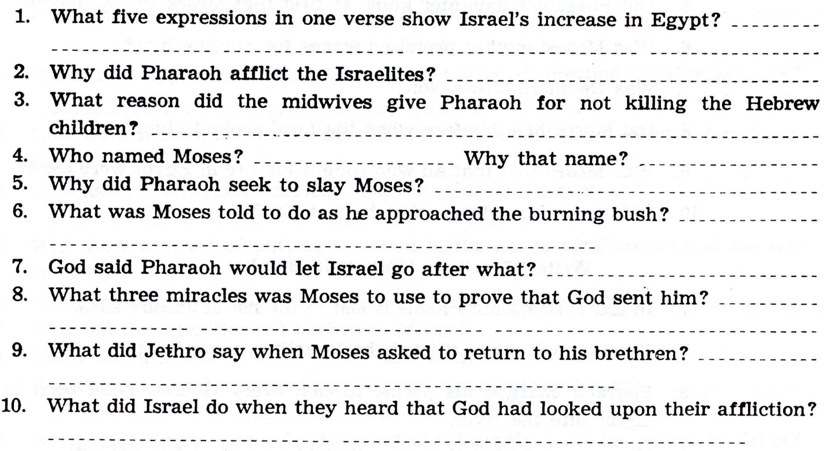

Slide 8
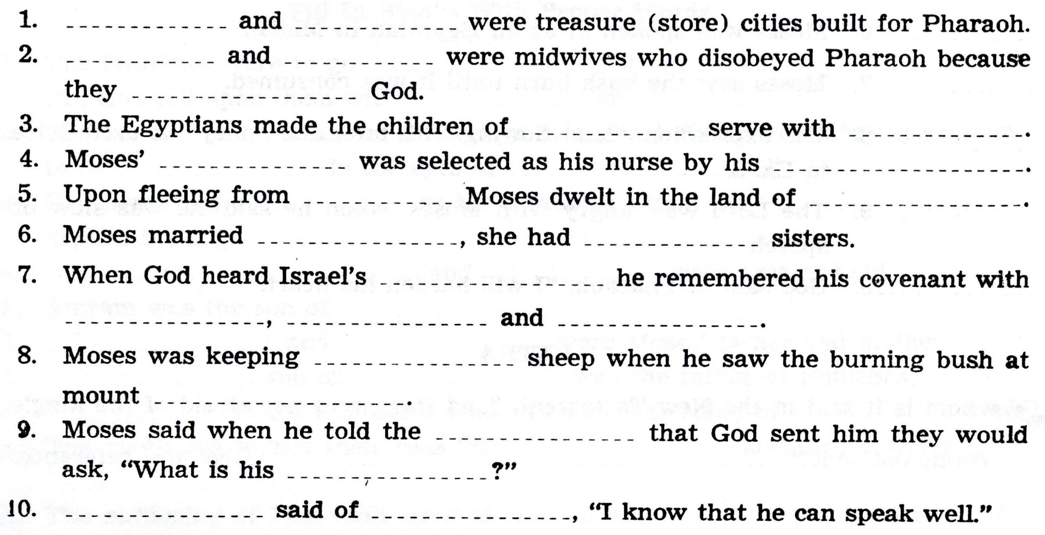

Slide 9
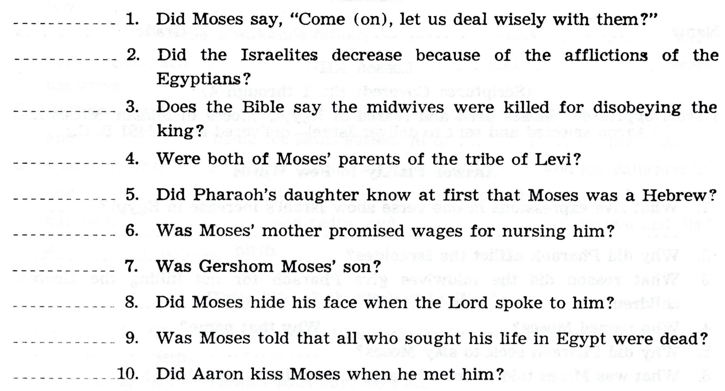

Slide 10
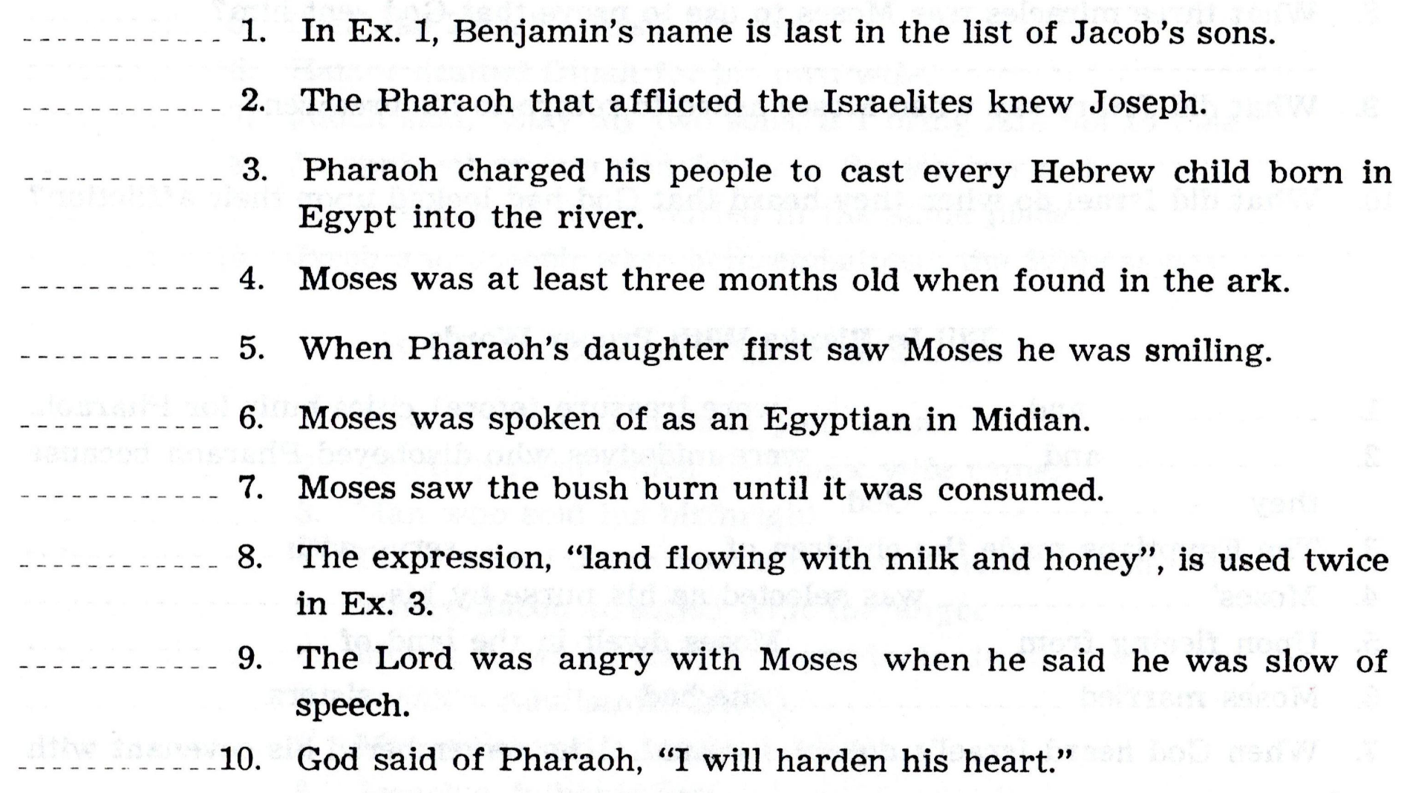

Slide 12
How Can I be Ready for the Next class?
Read the text before class. What text is that?
Study. By yourself or with your spouse / kids / gkids. Make it a family study
Fill out the answers in the book, as you read the scriptures, or afterwards
Add the verse(s) where you found the answer(s)
Come prepared to discuss the text and the answers

Slide 13
Overview of Exodus
Chap. 1
Chap. 2
Chap. 3
Chap. 4
Chap. 5
Chap. 6
Chap. 7
Chap. 8
Chap. 9
Chap. 10
Chap. 11
Chap. 12
Chap. 13
Chap. 14
Chap. 15

