Slide 1
Joshua – 1st Samuel
Lesson #2
Joshua 5 - 8

Slide 2
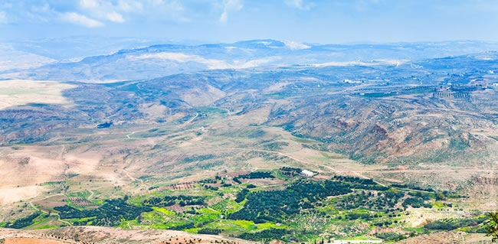
From Mount Nebo to Promise Land

Slide 3
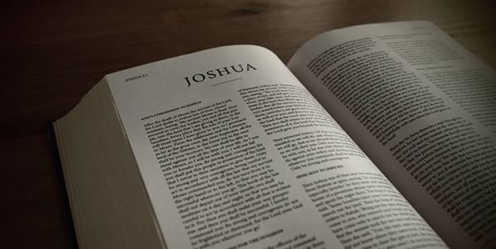
Overview of the Text

Slide 4
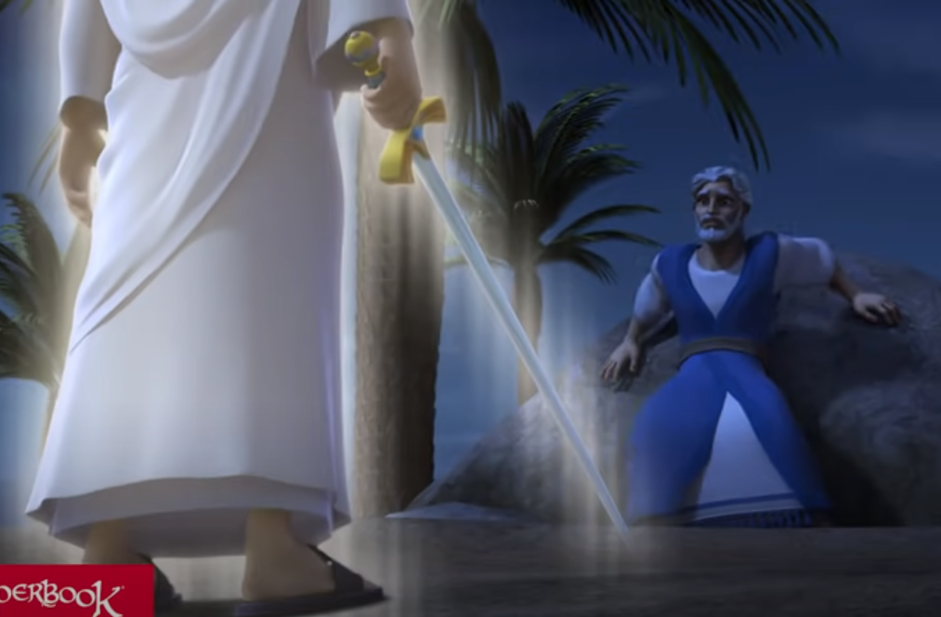
Joshua 5

Slide 5
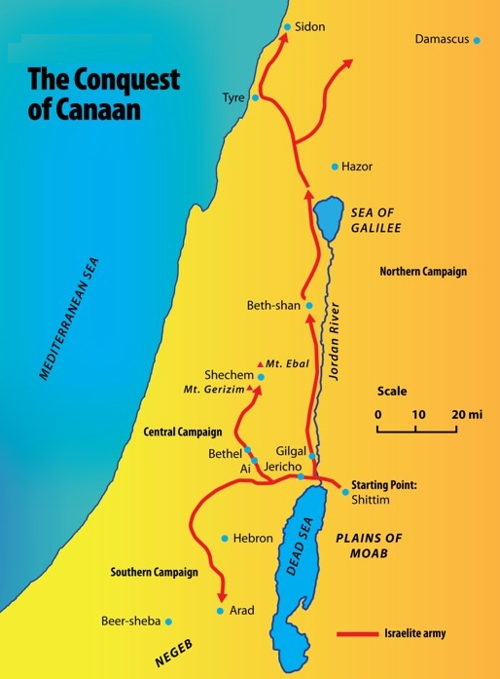
The Conquest of the Promised Land

Slide 6
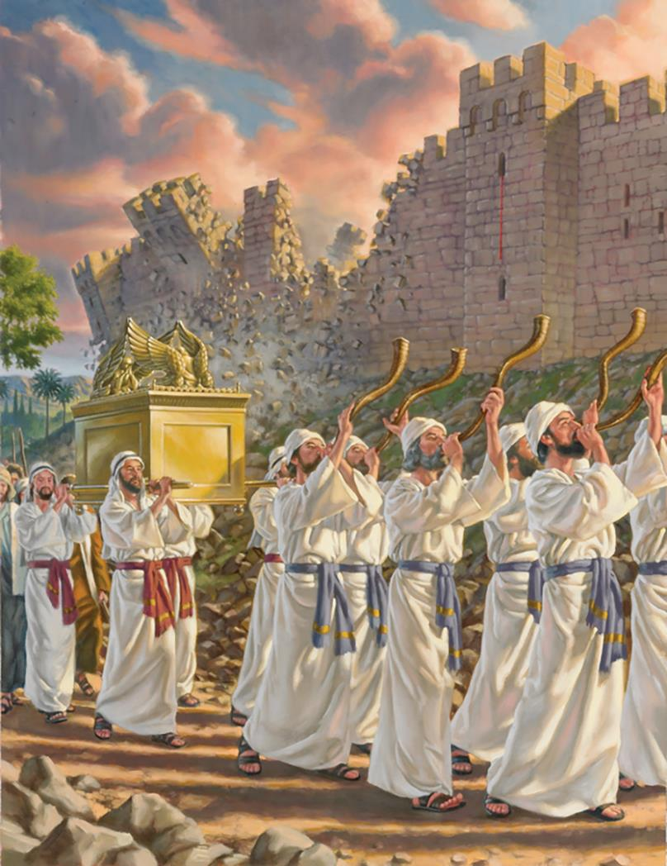
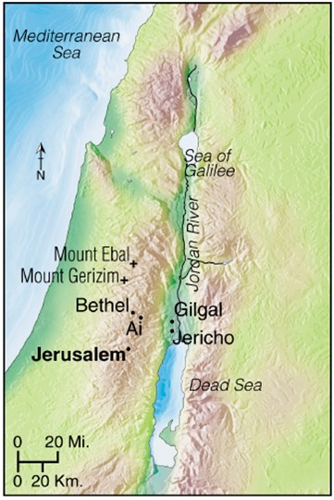
Joshua 6

Slide 7
Joshua 7

Slide 8
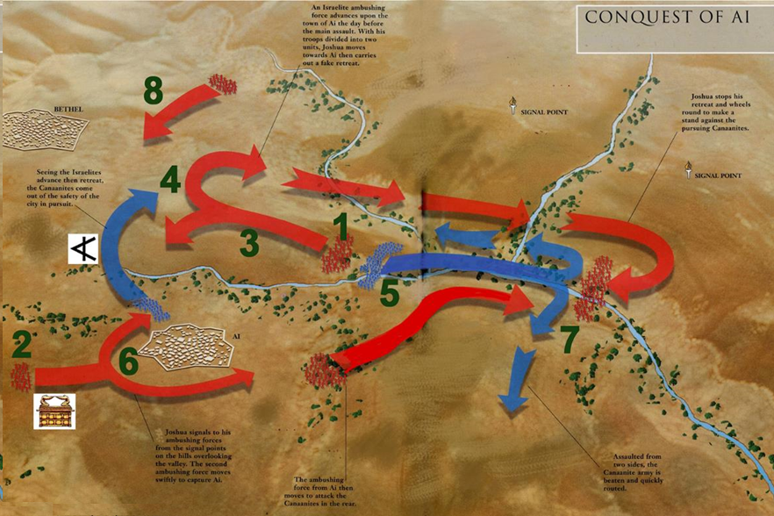
Joshua 8

Slide 9
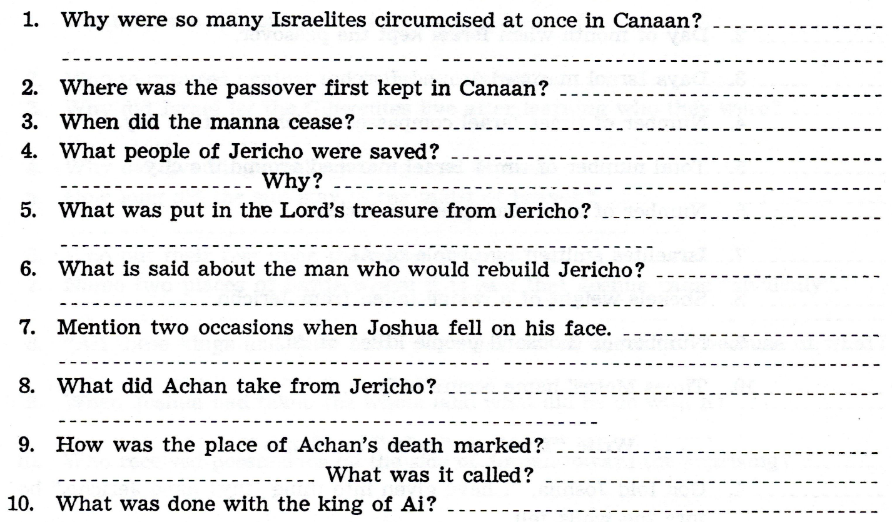

Slide 10
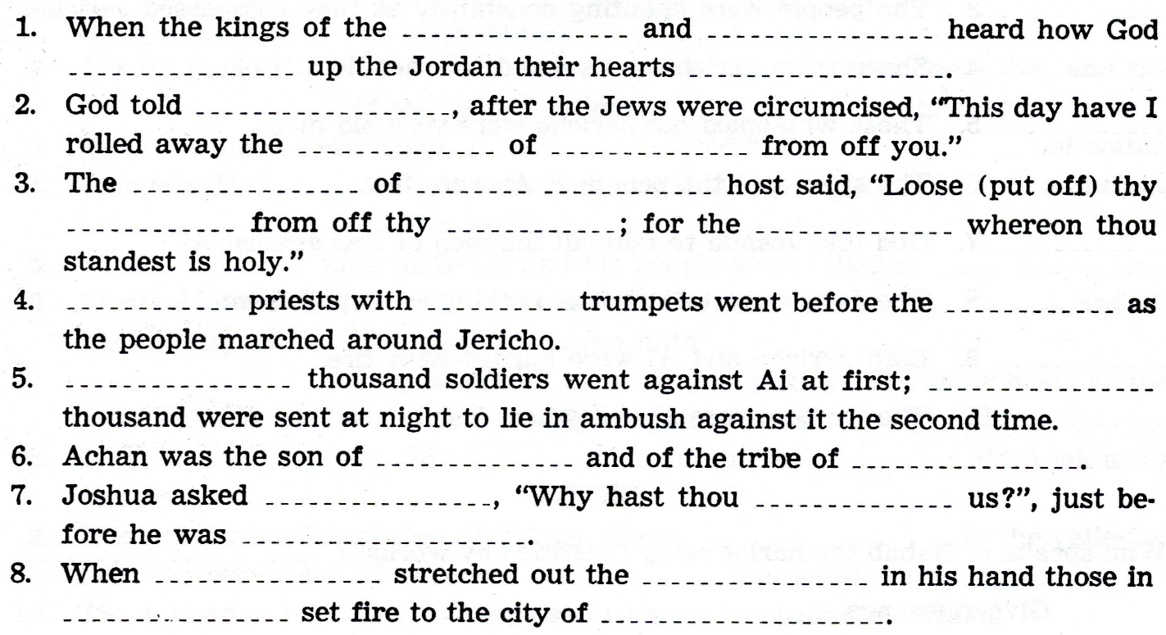

Slide 11
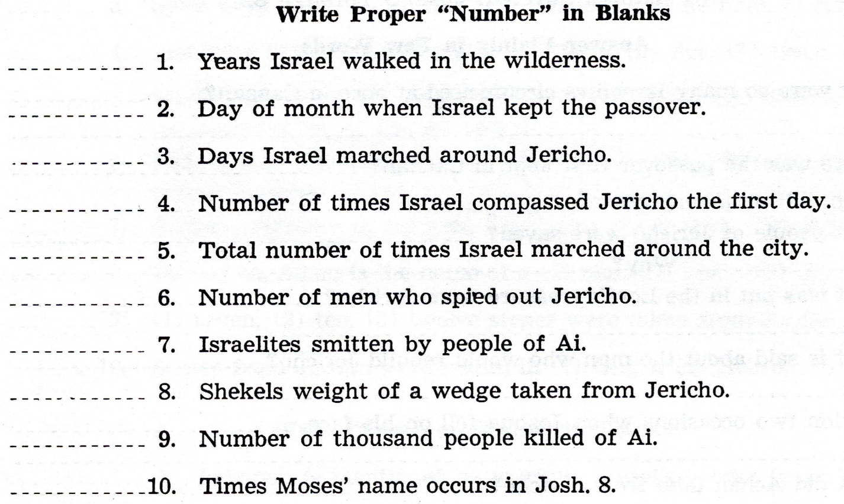

Slide 12
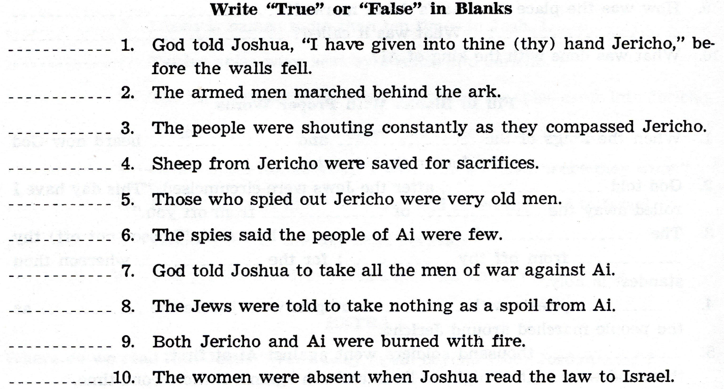

Slide 14
For Wednesday, Dec. 2, 2021
Lesson # 3

