Slide 1
Joshua – 1st Samuel
Lesson #3
Joshua 9 - 12

Slide 2
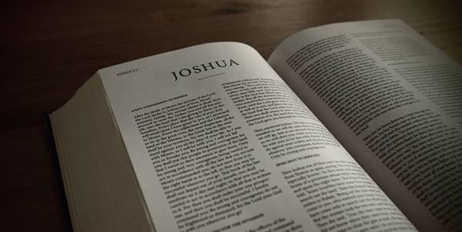
Review
Joshua 1-4 – Joshua takes over as leader, spies sent to Jericho, cross over the Jordan
Joshua 5-8 – Conquer Jericho and Ai

Slide 3
Overview of the Text
Joshua 9 – Deception of Gibeon
Joshua 10 – Conquest of the Southland
Joshua 11 – Conquest of the Northland
Joshua 12 – King’s conquered by Moses and Joshua
“Do not be afraid, nor dismayed; be strong and of good courage” – Joshua 10:25

Slide 4
Overview of the Text
Joshua 9 – Deception of Gibeon
Joshua 10 – Conquest of the Southland
Joshua 11 – Conquest of the Northland
Joshua 12 – King’s conquered by Moses and Joshua
As the Lord commanded… “Joshua did. He left nothing undone of all that the Lord had commanded” – Joshua 11:15

Slide 5
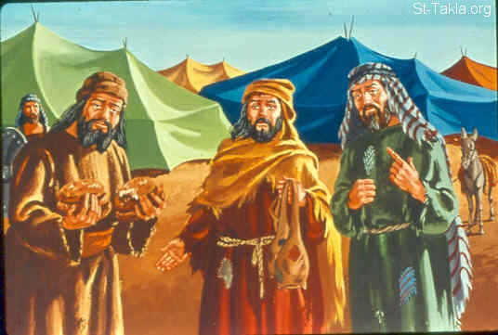
Joshua 9

Slide 6
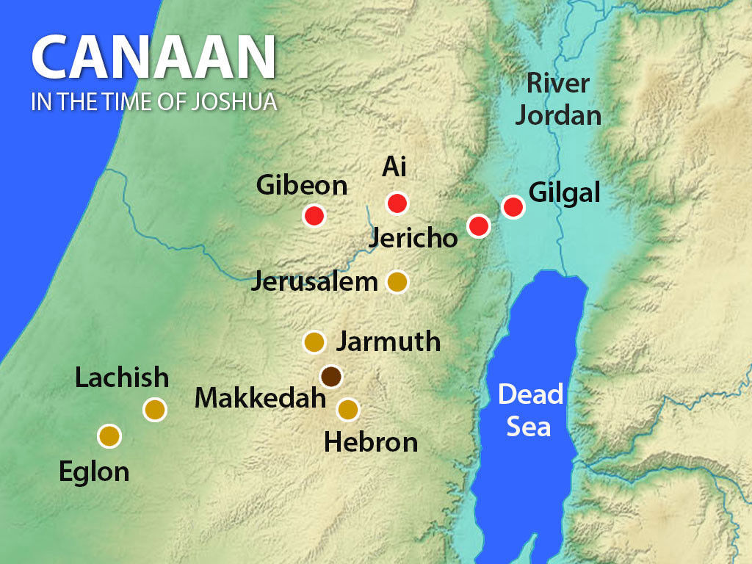
Joshua 9

Slide 7
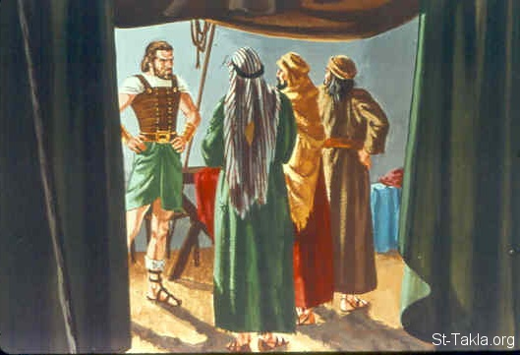
Joshua 9

Slide 8
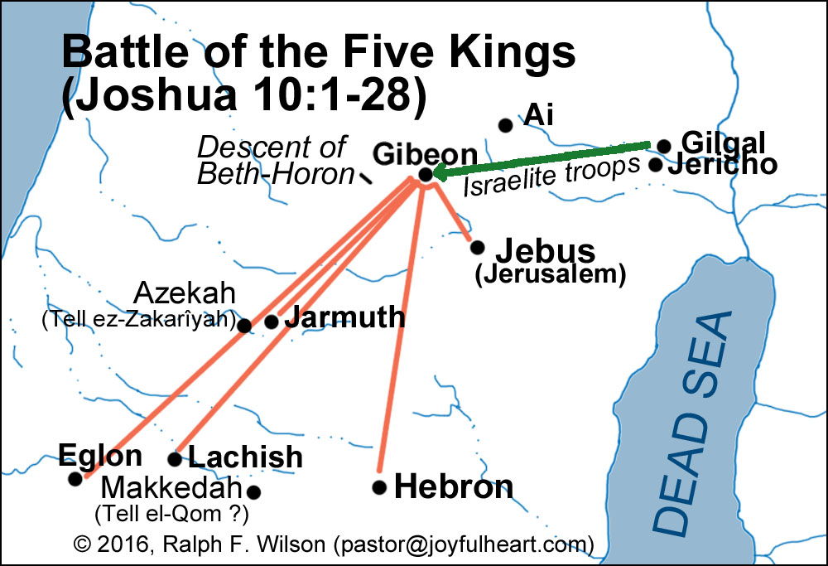
Joshua 10

Slide 9
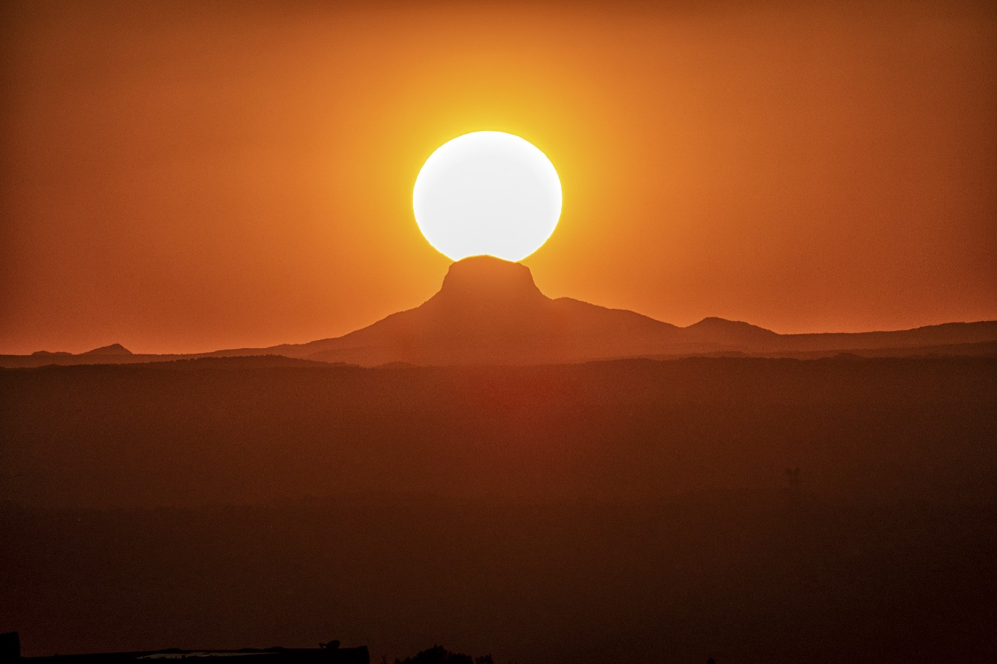
Joshua 10
“the sun stood still , And the moon stopped, Till the people had revenge upon their enemies” (Joshua 10:13)

Slide 10
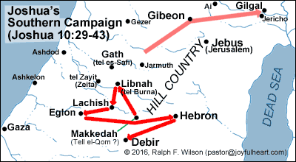
Joshua 10

Slide 11
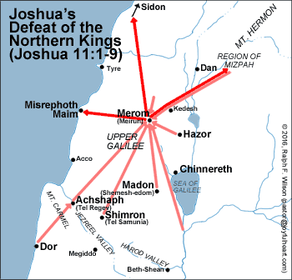
Joshua 11

Slide 12
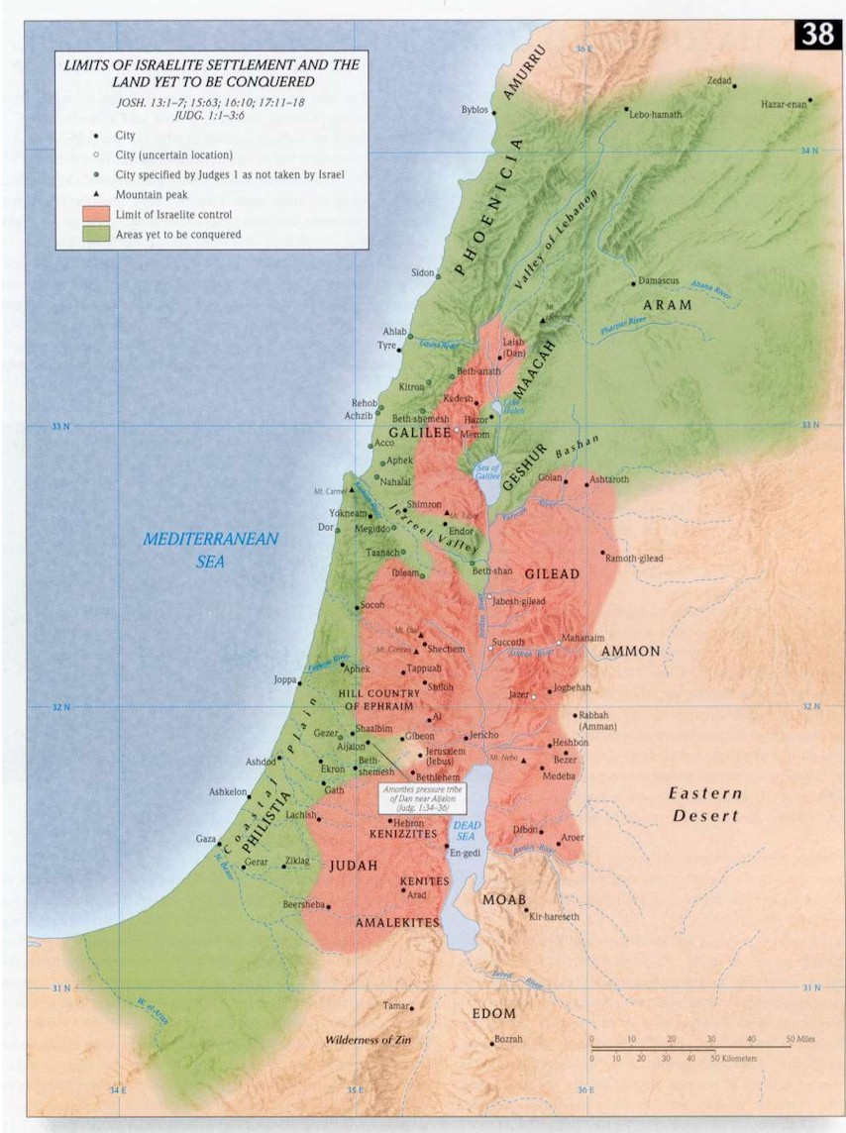
Joshua 12

Slide 13
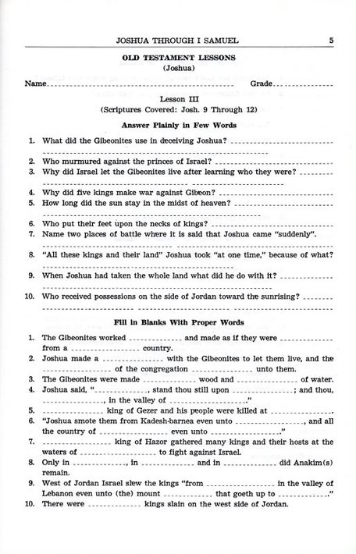

Slide 14
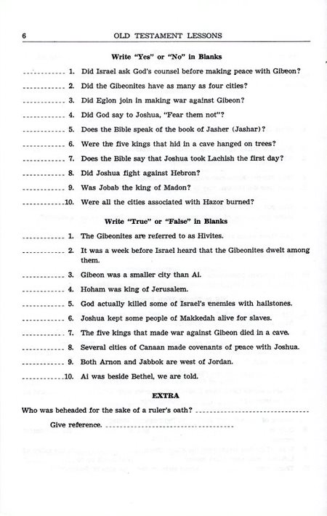

Slide 15
For Sunday (Dec. 12, 2021)
Lesson #4

