Slide 1
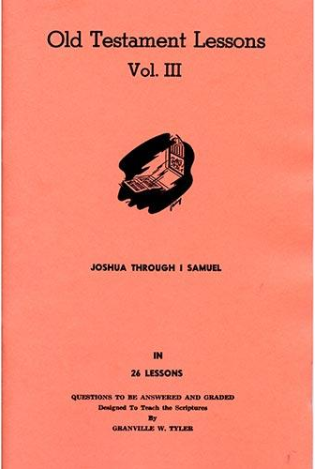
Joshua – 1st Samuel
Lesson #5
Joshua 18 - 21

Slide 2
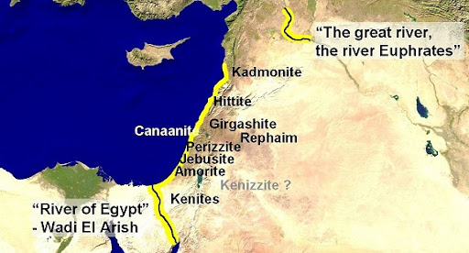
Land Promised to Abraham

Slide 3
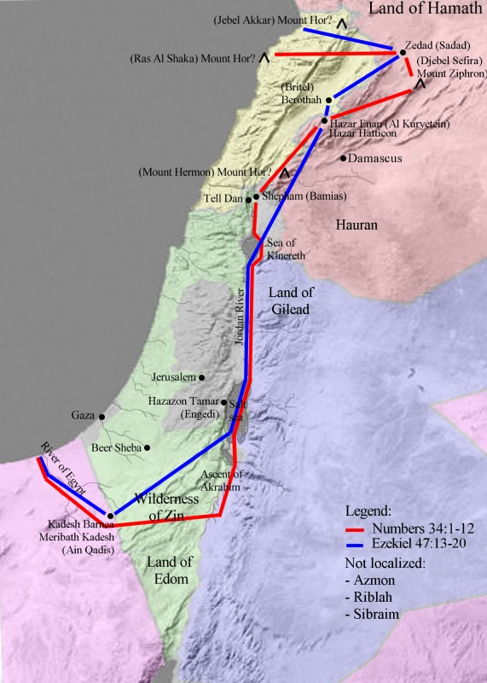
Land Promised from Numbers 34

Slide 4
Numbering the People from Book of Numbers
“Take a census of all the congregation of the children of Israel, by their families, by their fathers’ houses, according to the number of names, every male individually, from twenty years old and above—all who are able to go to war in Israel. You and Aaron shall number them by their armies” (Num. 1:2-3).
46,500
59,300
45,650
74,600
54,400
57,400
40,500
32,200
35,400
62,700
41,500
53,400

Slide 5
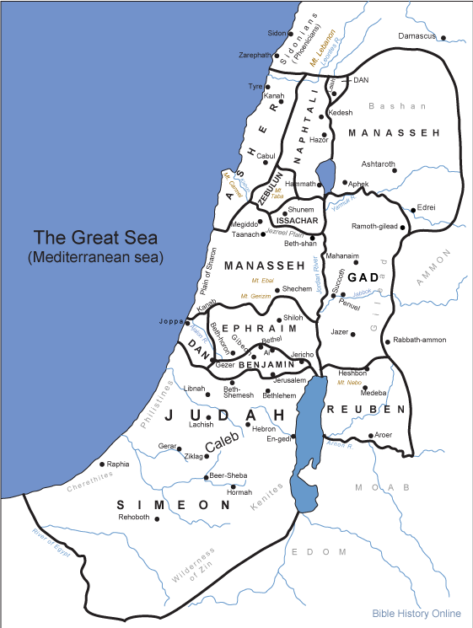
Tribal Allotment of Canaan

Slide 6
Joshua 18:1-6
¹ Now the whole congregation of the children of Israel assembled together at Shiloh, and set up the tabernacle of meeting there. And the land was subdued before them. ² But there remained among the children of Israel seven tribes which had not yet received their inheritance. ³ Then Joshua said to the children of Israel: “How long will you neglect to go and possess the land which the Lord God of your fathers has given you? ⁴ Pick out from among you three men for each tribe, and I will send them; they shall rise and go through the land, survey it according to their inheritance, and come back to me. ⁵ And they shall divide it into seven parts. Judah shall remain in their territory on the south, and the house of Joseph shall remain in their territory on the north. ⁶ You shall therefore survey the land in seven parts and bring the survey here to me, that I may cast lots for you here before the Lord our God.

Slide 7
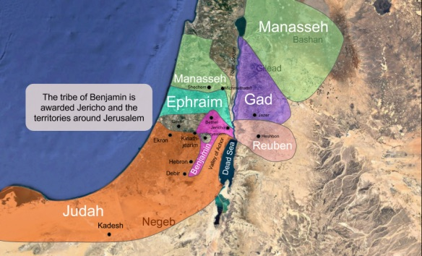
Joshua 18
Benjamin

Slide 8
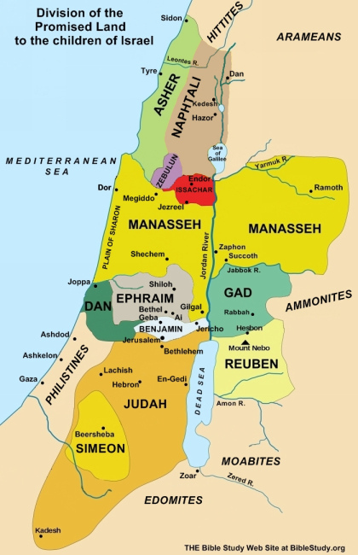
Joshua 19
Simeon
Zebulun
Issachar
Asher
Naphtali
Dan

Slide 9
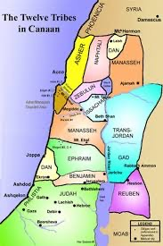
Joshua 19
Simeon
Zebulun
Issachar
Asher
Naphtali
Dan

Slide 10
Joshua 19:51
⁵¹ These were the inheritances which Eleazar the priest, Joshua the son of Nun, and the heads of the fathers of the tribes of the children of Israel divided as an inheritance by lot in Shiloh before the Lord, at the door of the tabernacle of meeting. So they made an end of dividing the country.

Slide 11
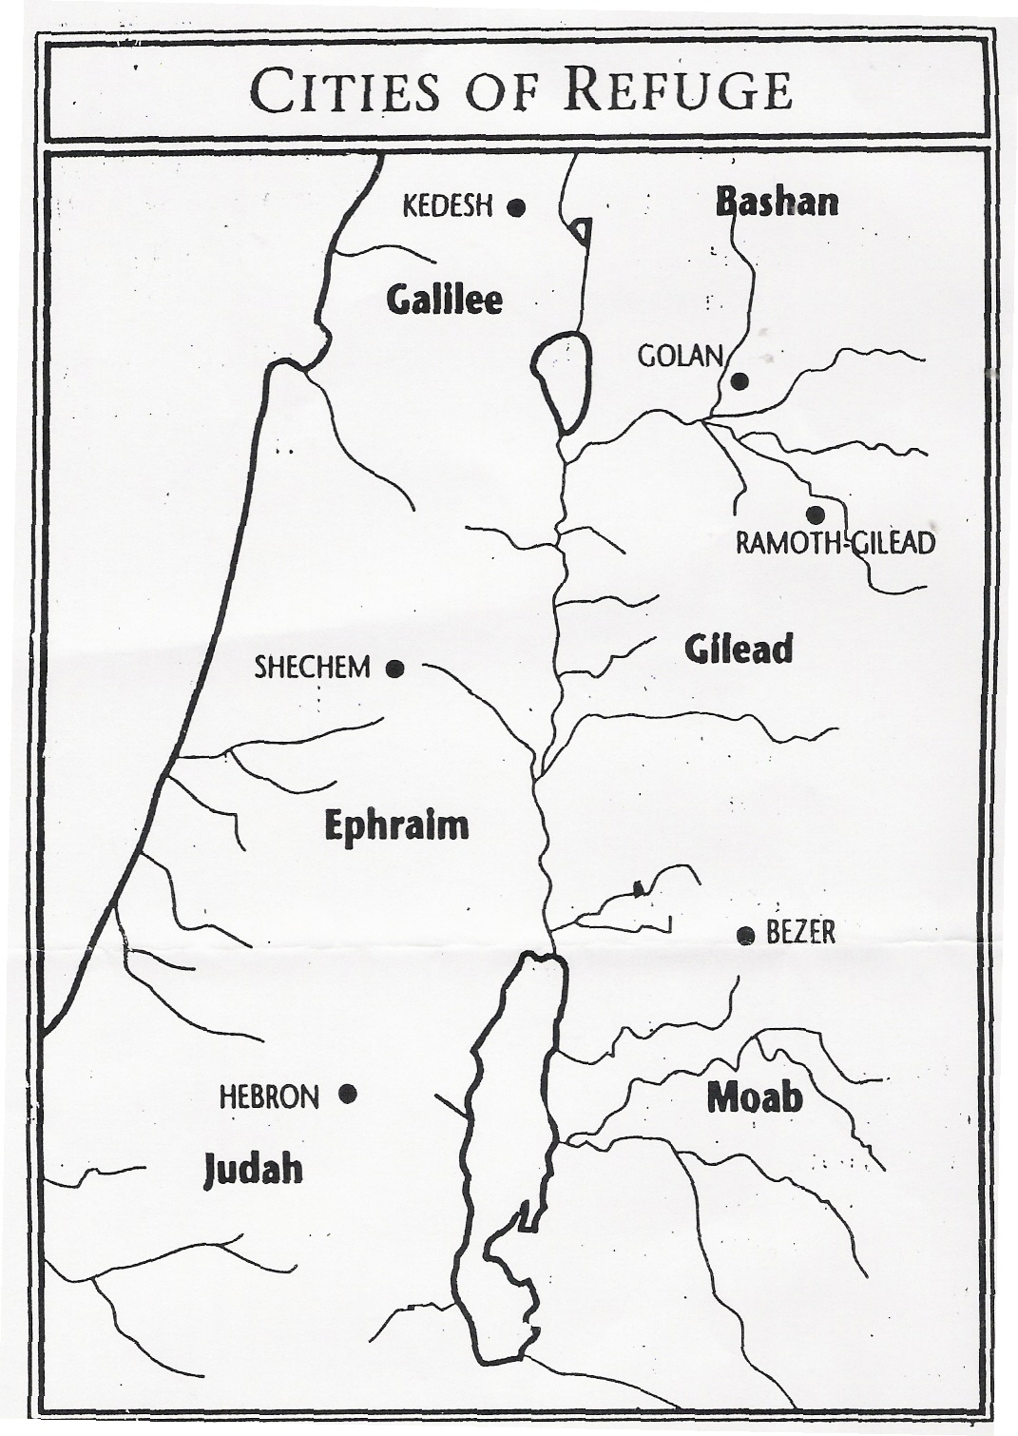
Joshua 20 Cities of Refuge (West of Jordan)

Slide 12
Cities of Refuge (Num. 35:9-15)
⁹ Then the Lord spoke to Moses, saying, ¹⁰ “Speak to the children of Israel, and say to them: ‘When you cross the Jordan into the land of Canaan, ¹¹ then you shall appoint cities to be cities of refuge for you, that the manslayer who kills any person accidentally may flee there. ¹² They shall be cities of refuge for you from the avenger, that the manslayer may not die until he stands before the congregation in judgment. ¹³ And of the cities which you give, you shall have six cities of refuge. ¹⁴ You shall appoint three cities on this side of the Jordan, and three cities you shall appoint in the land of Canaan, which will be cities of refuge. ¹⁵ These six cities shall be for refuge for the children of Israel, for the stranger, and for the sojourner among them, that anyone who kills a person accidentally may flee there.

Slide 13
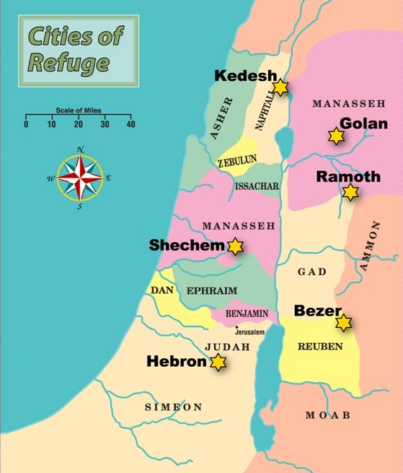

Slide 14
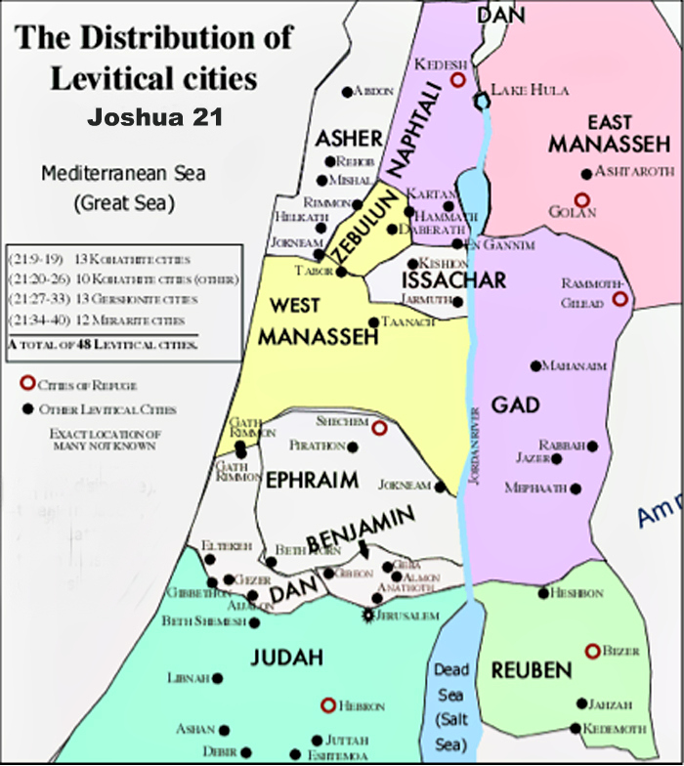
Joshua 21 Levitical Cities

Slide 15
Commands about Cities for Levites (Num. 35:1-8)
¹ And the Lord spoke to Moses in the plains of Moab by the Jordan across from Jericho, saying: ² “Command the children of Israel that they give the Levites cities to dwell in from the inheritance of their possession, and you shall also give the Levites common-land around the cities. ³ They shall have the cities to dwell in; and their common-land shall be for their cattle, for their herds, and for all their animals. ⁴ The common-land of the cities which you will give the Levites shall extend from the wall of the city outward a thousand cubits all around. ⁵ And you shall measure outside the city on the east side two thousand cubits, on the south side two thousand cubits, on the west side two thousand cubits, and on the north side two thousand cubits. The city shall be in the middle. This shall belong to them as common-land for the cities. ⁶ Now among the cities which you will give to the Levites you shall appoint six cities of refuge, to which a manslayer may flee. And to these you shall add forty-two cities. ⁷ So all the cities you will give to the Levites shall be forty-eight; these you shall give with their common-land. ⁸ And the cities which you will give shall be from the possession of the children of Israel; from the larger tribe you shall give many, from the smaller you shall give few. Each shall give some of its cities to the Levites, in proportion to the inheritance that each receives.”
H

Slide 16
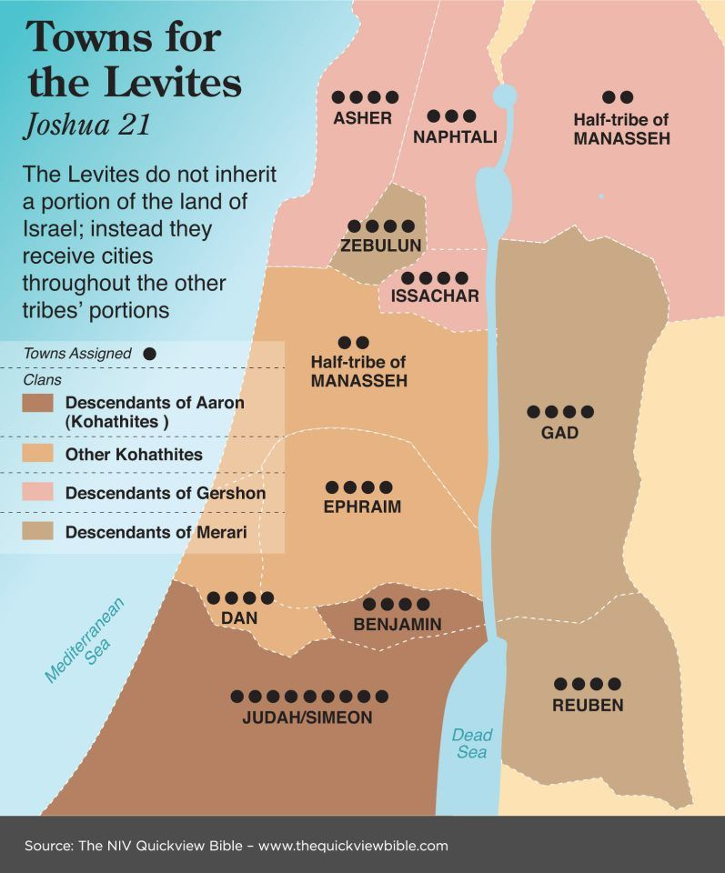

Slide 17
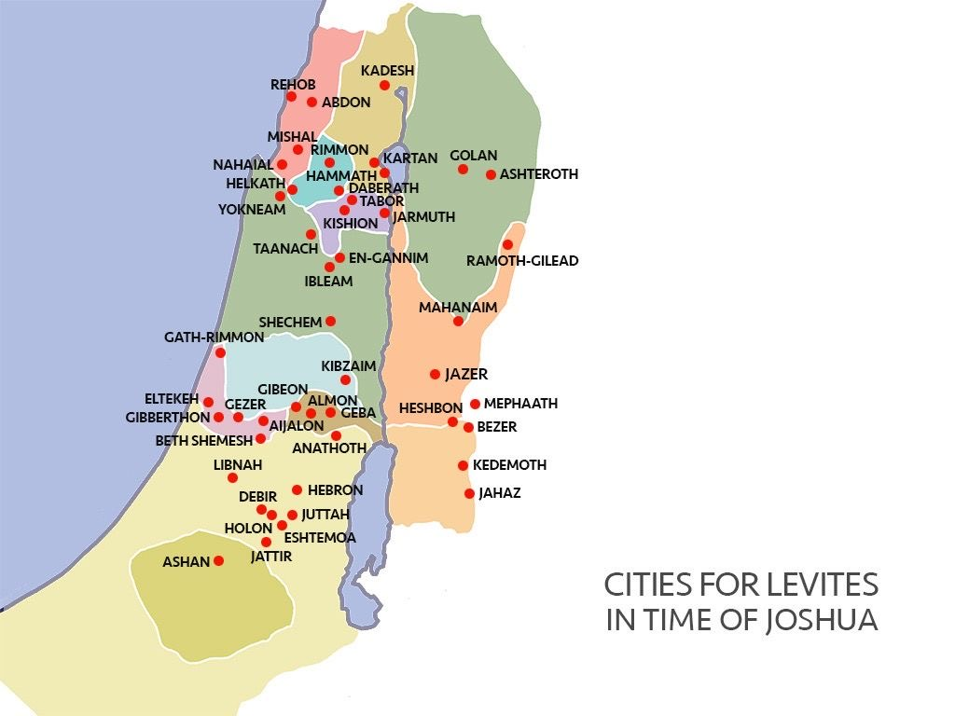

Slide 19
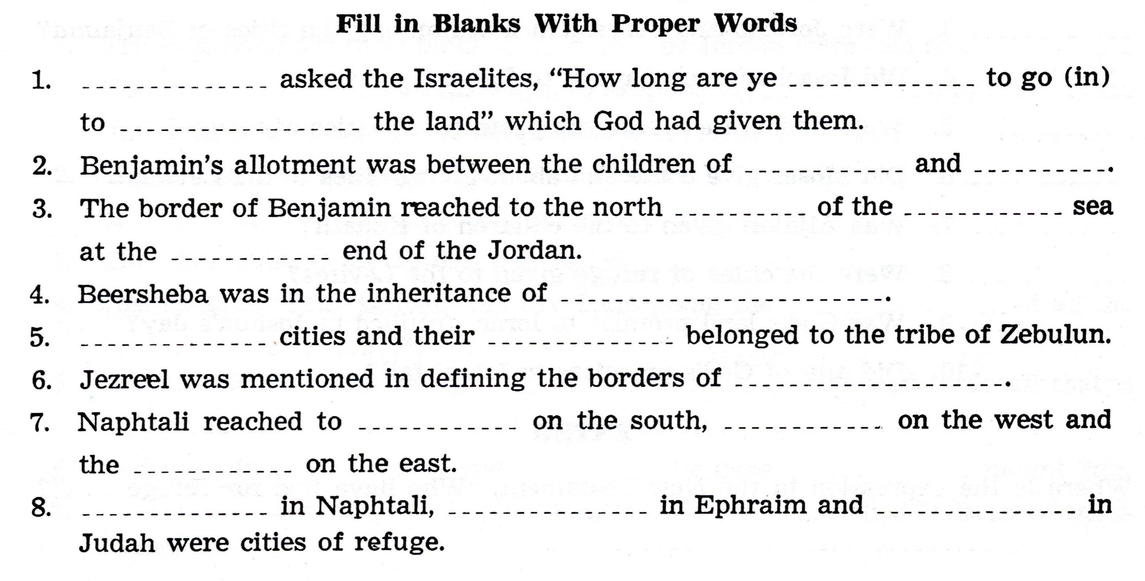

Slide 20
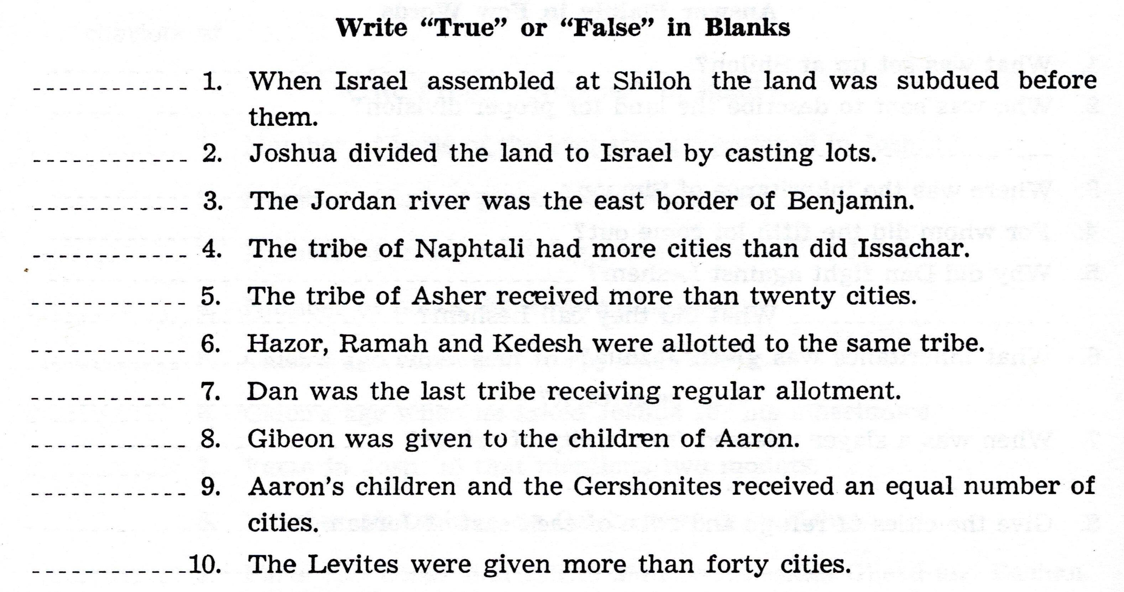

Slide 21
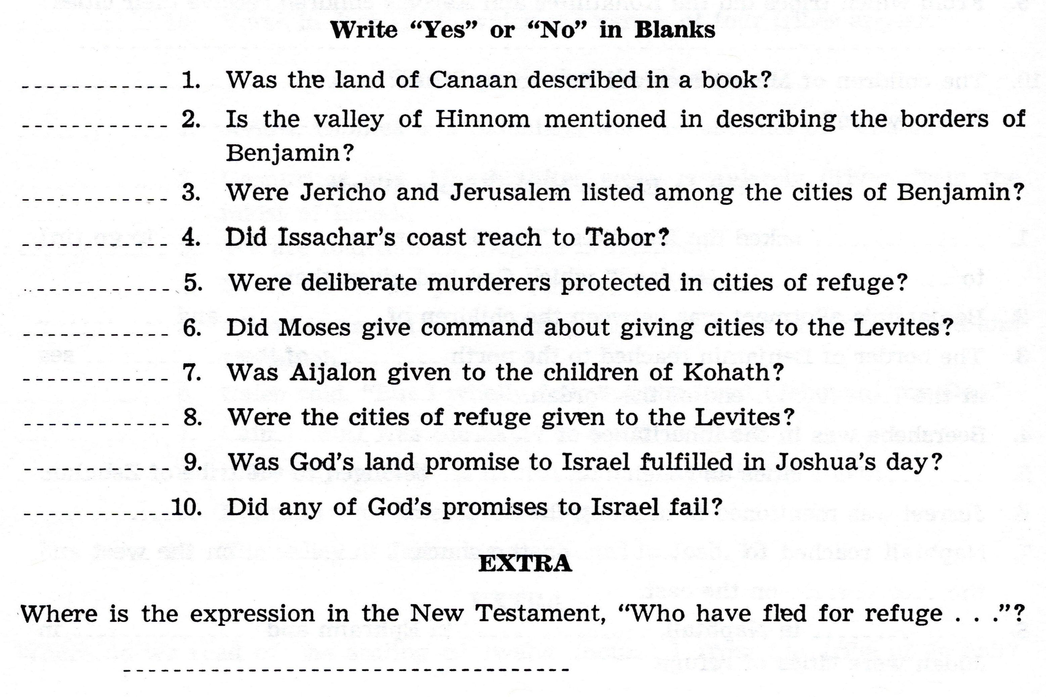

Slide 22
For Sunday (Dec. 19, 2021)
Lesson # 6
Joshua 22 - 24

