Slide 1
Joshua – 1st Samuel
Lesson #6
Joshua 22 - 24

Slide 2
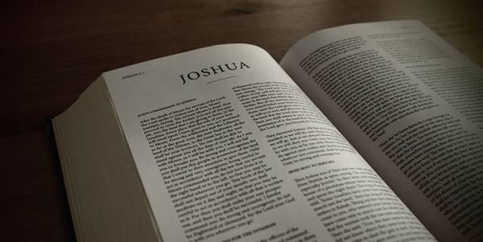
Review
Joshua 1-4 – Joshua takes over as leader, spies sent to Jericho, cross over the Jordan
Joshua 5-8 – Conquer Jericho and Ai
Joshua 9-12 – Conquest of the South and Northland
Joshua 13-21 – Dividing of the land

Slide 3
Overview of the Text
Joshua 22 – Eastern tribes sent home
Joshua 23 – Joshua speaks to the leaders
Joshua 24 – Joshua speaks to all of Israel
“choose for yourselves this day whom you will serve” – Joshua 24:15

Slide 4
Joshua 22
¹Then Joshua called the Reubenites, the Gadites, and half the tribe of Manasseh, ² and said to them: “You have kept all that Moses the servant of the Lord commanded you, and have obeyed my voice in all that I commanded you. ³ You have not left your brethren these many days, up to this day, but have kept the charge of the commandment of the Lord your God. ⁴ And now the Lord your God has given rest to your brethren, as He promised them; now therefore, return and go to your tents and to the land of your possession, which Moses the servant of the Lord gave you on the other side of the Jordan. ⁵ But take careful heed to do the commandment and the law which Moses the servant of the Lord commanded you, to love the Lord your God, to walk in all His ways, to keep His commandments, to hold fast to Him, and to serve Him with all your heart and with all your soul.” ⁶ So Joshua blessed them and sent them away, and they went to their tents.

Slide 5
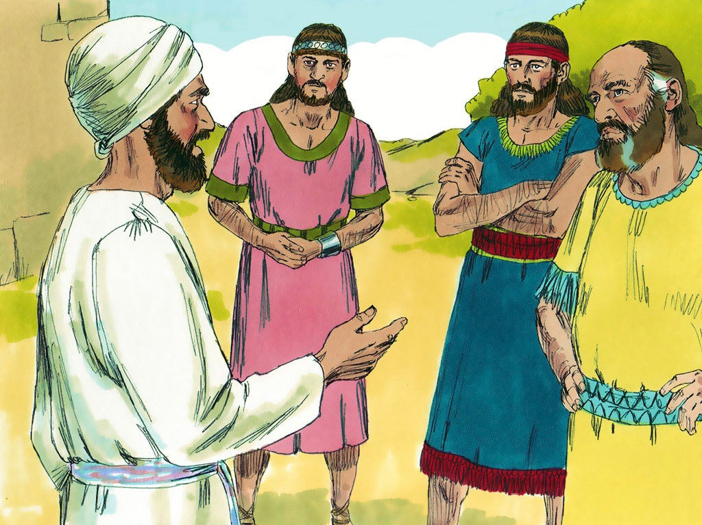
Joshua 22

Slide 6
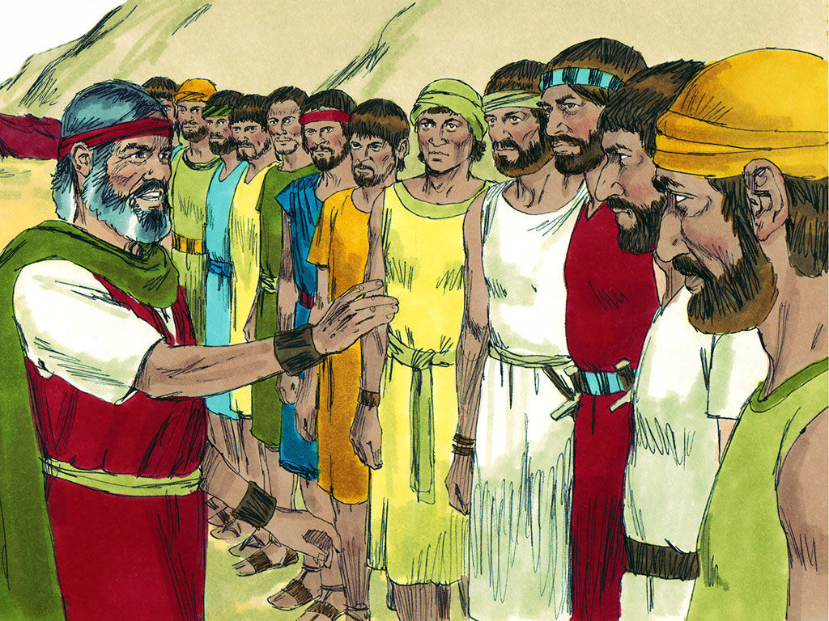
Joshua 23

Slide 7
Joshua 23
³ You have seen all that the Lord your God has done to all these nations because of you, for the Lord your God is He who has fought for you. ⁴ See, I have divided to you by lot these nations that remain, to be an inheritance for your tribes, from the Jordan, with all the nations that I have cut off, as far as the Great Sea westward. ⁵ And the Lord your God will expel them from before you and drive them out of your sight. So you shall possess their land, as the Lord your God promised you….. ⁹ For the Lord has driven out from before you great and strong nations; but as for you, no one has been able to stand against you to this day. ¹⁰ One man of you shall chase a thousand, for the Lord your God is He who fights for you, as He promised you.

Slide 8
Joshua 23
⁶ Therefore be very courageous to keep and to do all that is written in the Book of the Law of Moses, lest you turn aside from it to the right hand or to the left, ⁷ and lest you go among these nations, these who remain among you. You shall not make mention of the name of their gods, nor cause anyone to swear by them; you shall not serve them nor bow down to them, ⁸ but you shall hold fast to the Lord your God, as you have done to this day.

Slide 9
Joshua 23
¹² Or else, if indeed you do go back, and cling to the remnant of these nations—these that remain among you—and make marriages with them, and go in to them and they to you, ¹³ know for certain that the Lord your God will no longer drive out these nations from before you. But they shall be snares and traps to you, and scourges on your sides and thorns in your eyes, until you perish from this good land which the Lord your God has given you…. ¹⁵ Therefore it shall come to pass, that as all the good things have come upon you which the Lord your God promised you, so the Lord will bring upon you all harmful things, until He has destroyed you from this good land which the Lord your God has given you. ¹⁶ When you have transgressed the covenant of the Lord your God, which He commanded you, and have gone and served other gods, and bowed down to them, then the anger of the Lord will burn against you, and you shall perish quickly from the good land which He has given you.”

Slide 10
Joshua 23
¹⁴ “Behold, this day I am going the way of all the earth. And you know in all your hearts and in all your souls that not one thing has failed of all the good things which the Lord your God spoke concerning you. All have come to pass for you; not one word of them has failed.

Slide 11
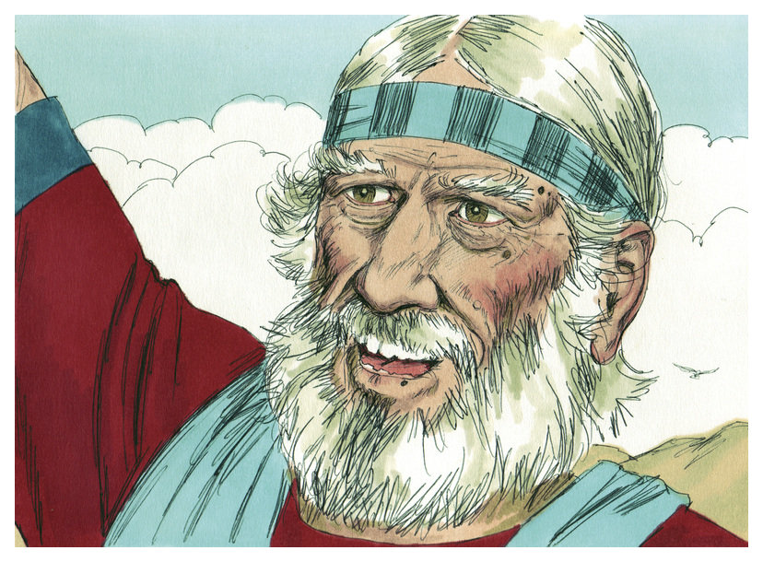
Joshua 24

Slide 12
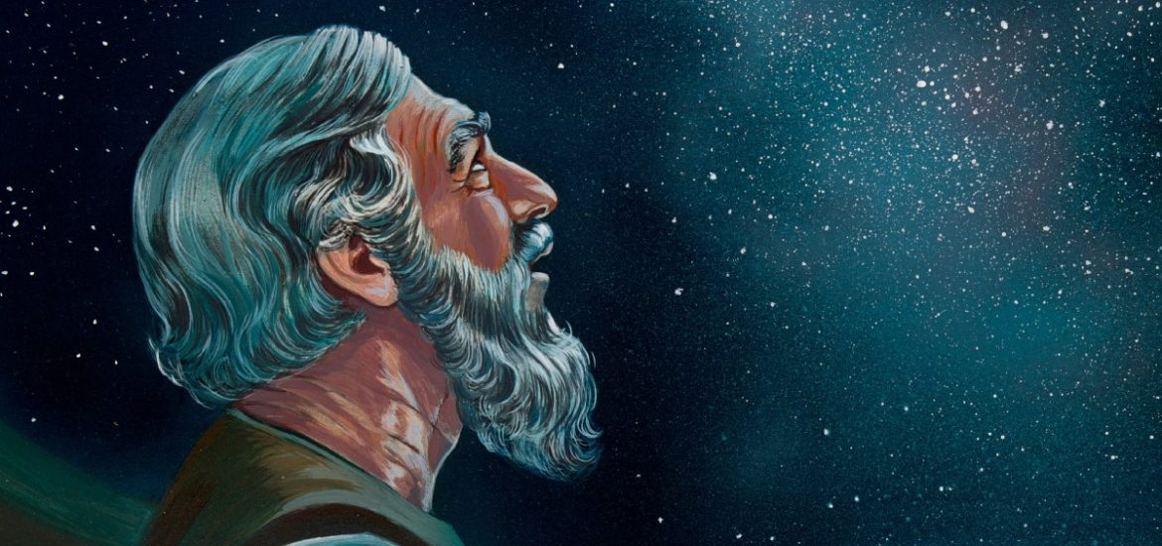
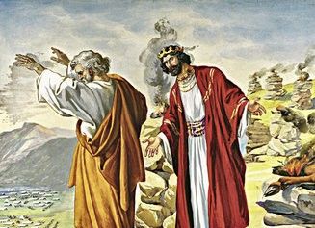
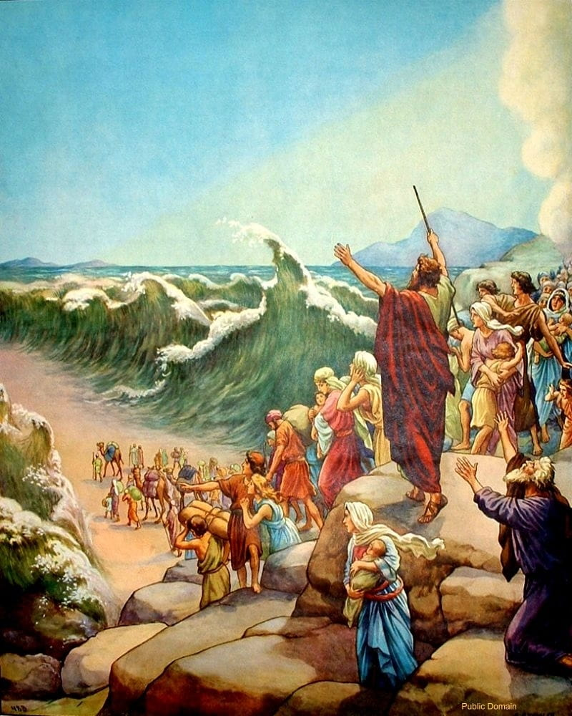
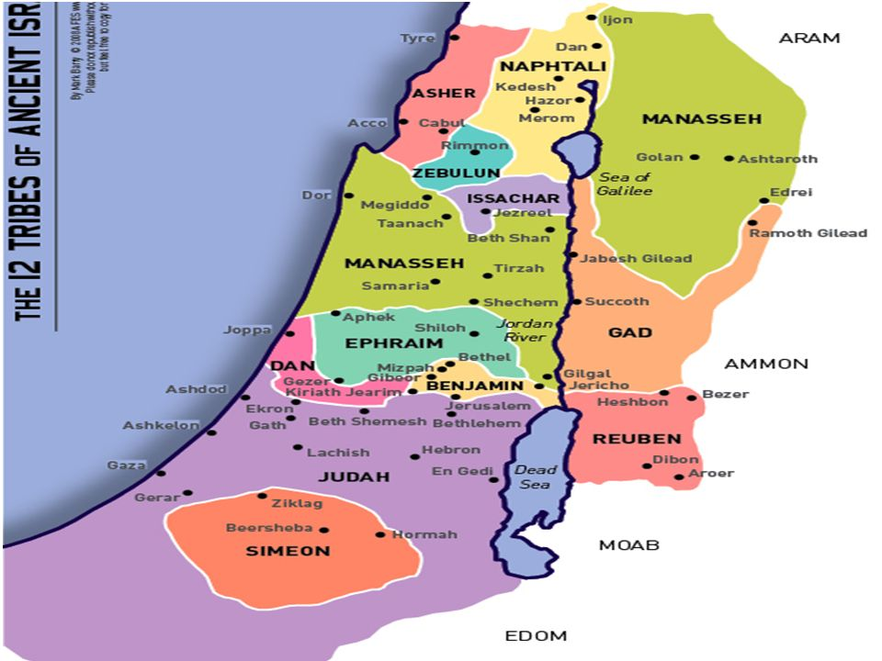
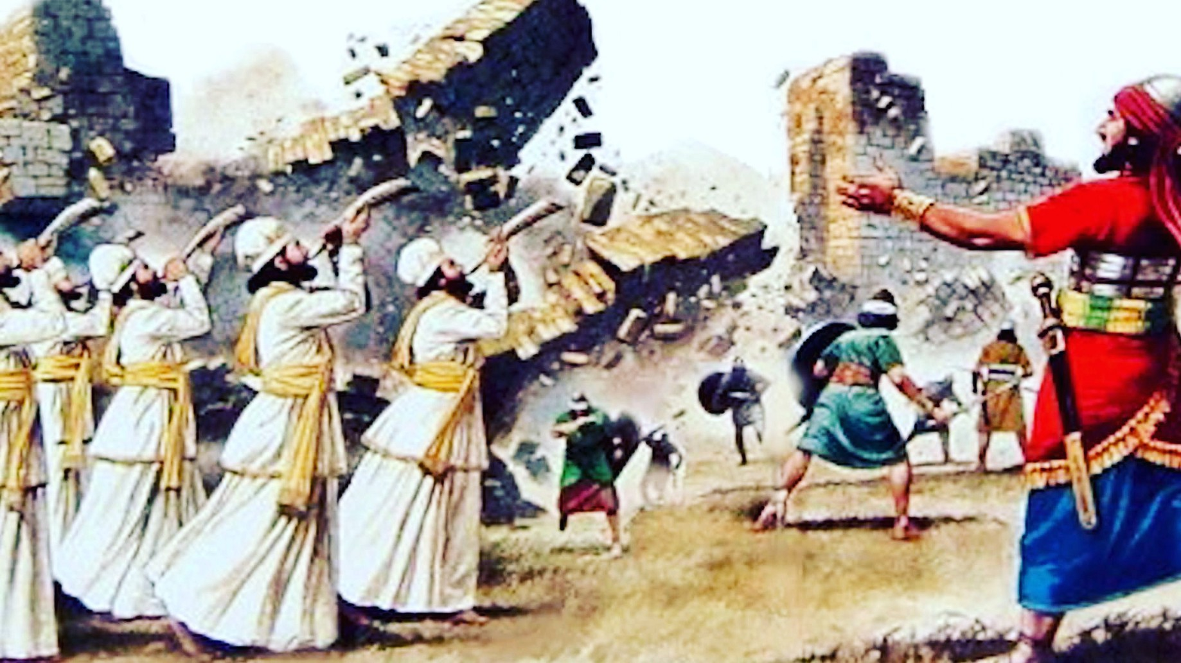
Joshua 24

Slide 13
Joshua 24
¹⁴ “Now therefore, fear the Lord, serve Him in sincerity and in truth, and put away the gods which your fathers served on the other side of the River and in Egypt. Serve the Lord! ¹⁵ And if it seems evil to you to serve the Lord, choose for yourselves this day whom you will serve, whether the gods which your fathers served that were on the other side of the River, or the gods of the Amorites, in whose land you dwell. But as for me and my house, we will serve the Lord.”

Slide 14
Joshua 24
¹⁶ So the people answered and said: “Far be it from us that we should forsake the Lord to serve other gods; ¹⁷ for the Lord our God is He who brought us and our fathers up out of the land of Egypt, from the house of bondage, who did those great signs in our sight, and preserved us in all the way that we went and among all the people through whom we passed. ¹⁸ And the Lord drove out from before us all the people, including the Amorites who dwelt in the land. We also will serve the Lord, for He is our God.”

Slide 15
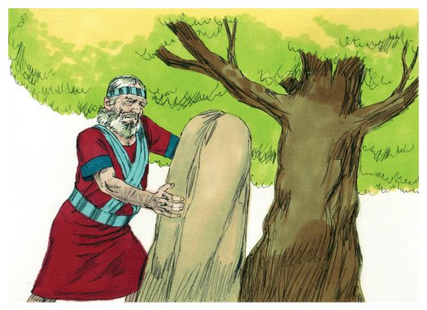
Joshua 24

Slide 16
Joshua 24
³¹ Israel served the Lord all the days of Joshua, and all the days of the elders who outlived Joshua, who had known all the works of the Lord which He had done for Israel.

Slide 17
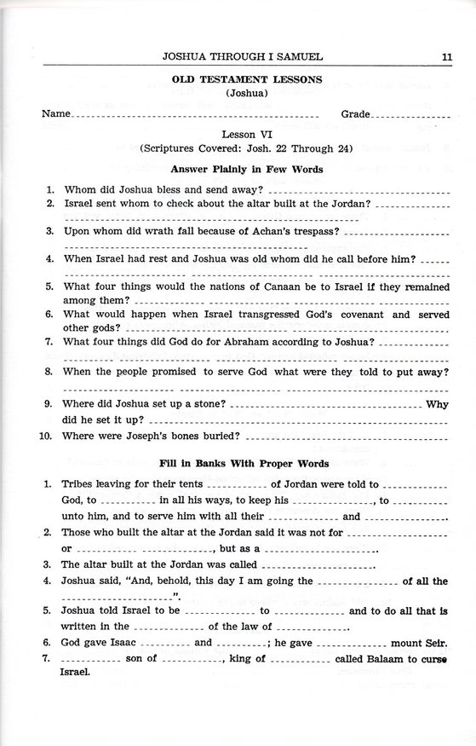

Slide 18
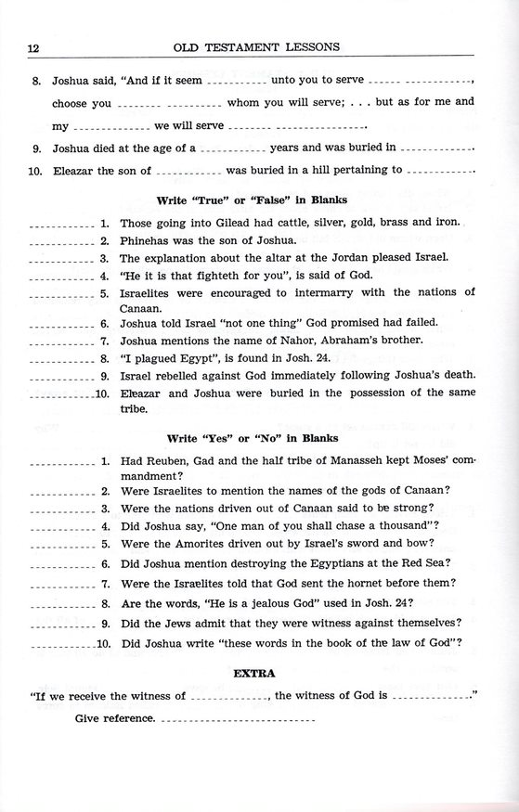

Slide 19
For Wednesday (Dec. 22, 2021)
Lesson #7

