Slide 1
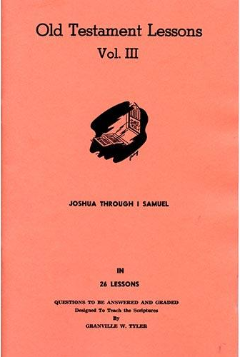
Ruth
Lessons # 14 - 15
Ruth 1 - 4

Slide 2
Introduction to Ruth
Book is the story about honor & selfless devotion of Ruth to her mother-in-law, Naomi, & God’s use of it in His plan
Authorship: Unknown
Widely thought to be written down by Samuel
Date: Unknown
Likely at the beginning of David’s reign since he is mentioned, but could be written earlier with the last part being a prophetic addition like was done in Kings & Chronicles
Historical Setting: “…in the days when the judges ruled” (1:1)
Times of the judges were often troubled as Israel repeatedly wondered away from God
Numerous famines were part of time during judges as here (1:1)
Interesting to see the faithfulness & fidelity of the Gentile Ruth in a time when Israelites were more often the opposite

Slide 3
Outline of Ruth
I. Naomi Widowed and Ruth Comes into Israel............................1:1-1:22
A. Deaths of Elimelech, Mahlon, Chilion in Moab ..........................1:1-5
B. Orpah Returns; Ruth Stays with Naomi......................................1:6-18
C. Naomi and Ruth Return to Bethlehem .....................................1:19-22
Boaz Shows Kindness to Ruth and Naomi....................................2:1-23
Ruth Happens Upon the Field of Boaz.........................................2:1-7
Kindness of Boaz to Ruth...........................................................2:8-16
C. Naomi Advises Ruth ................................................................2:17-23
The Marriage Proposal .................................................................3:1-18
Naomi Advises Ruth Again..........................................................3:1-5
B. Ruth Discreetly Proposes Levirate Responsibility to Boaz .........3:6-9
C. Boaz Takes Responsibility, If Nearer Relative Will Not..........3:10-18
IV. The Redemption of Ruth.................................................................4:1-21
A. Boaz Makes Arrangements Before the City Elders ...................4:1-12
B. Boaz Marries Ruth and They Have a Son, Obed ......................... 4:13
C. Blessedness of Naomi ..............................................................4:14-17
D. The Lineage of David the King .............................................. 4:18-22

Slide 4
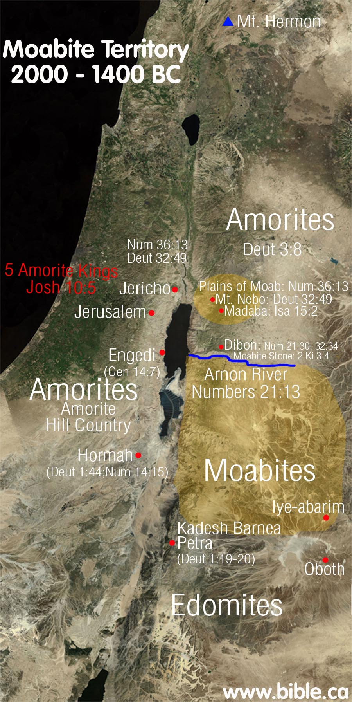
Geography of Moab
Borders lower half of Dead Sea of eastern shore
Between Arnon River & Zered
Land area is about 25 miles wide & 35 miles in length (north to south)
That is about 10% > Oklahoma County
20% < Grady County
Average 3,000 ft. above sea level -- 4,300 ft. above level of Dead Sea
It is essentially rises as mountains from the Dead Sea, but the elevation fairly constant in the interior
Deep chasms lead down from tableland to Dead Sea shore, the steepest one being the gorge of the Arnon River -- about 1,700 ft. deep

Slide 5
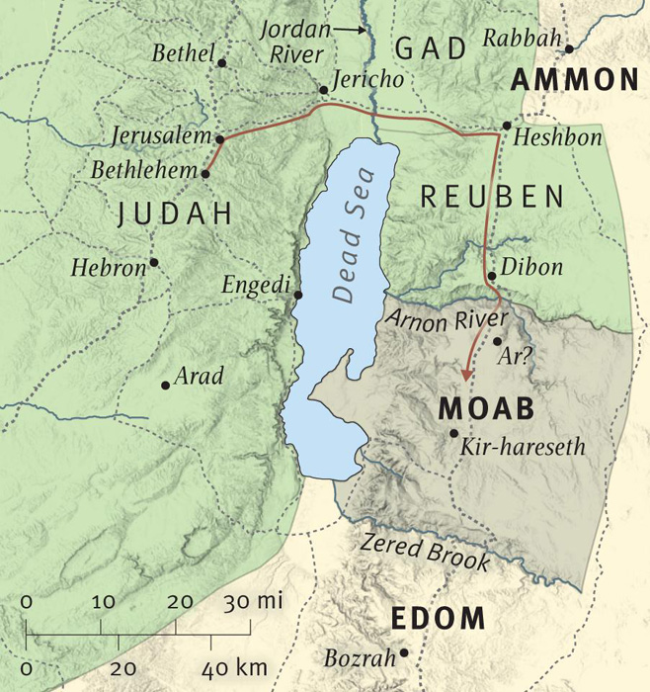

Slide 6
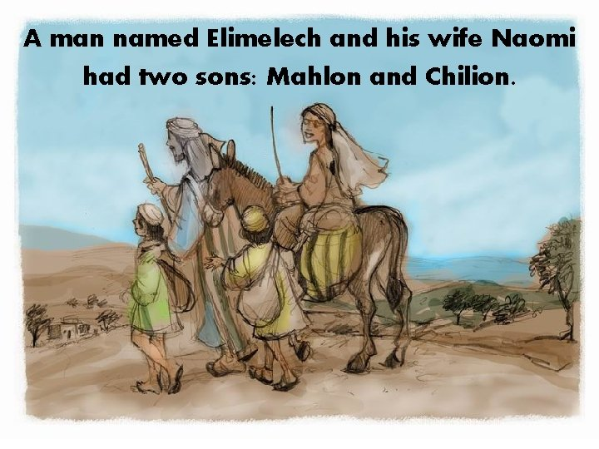
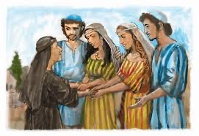
Ruth 1

Slide 7
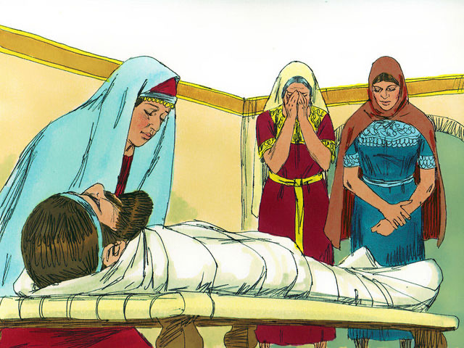
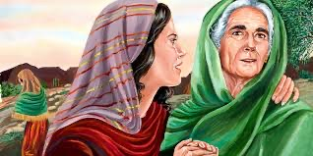
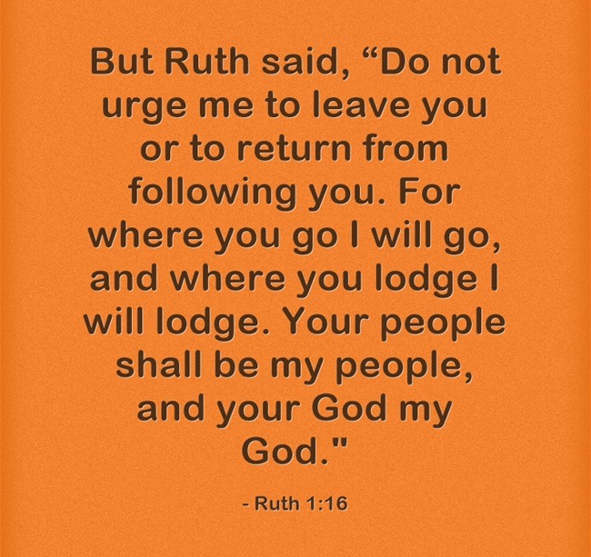
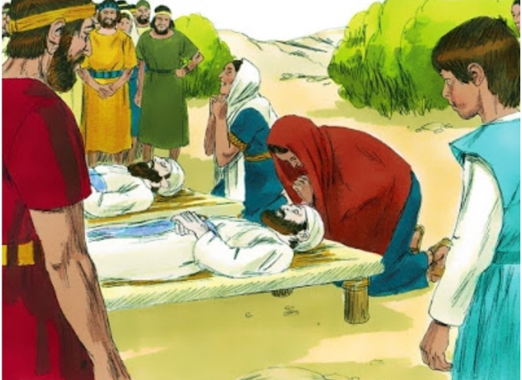
Ruth 1

Slide 8
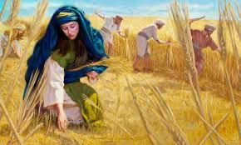
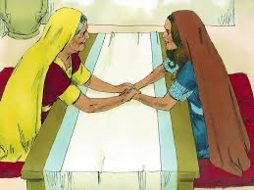
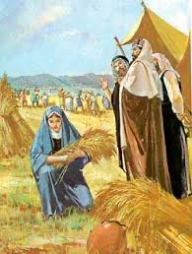
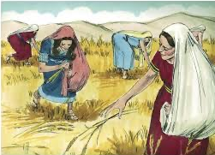
Ruth 2
Boaz

Slide 9
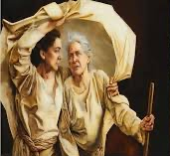
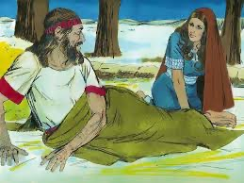
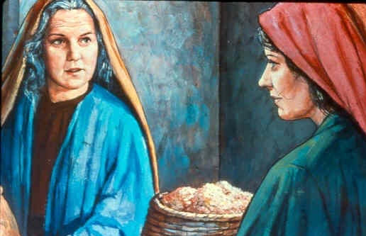
Ruth 3

Slide 10
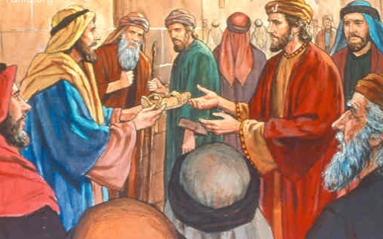
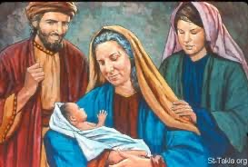
Ruth 4

Slide 11
What Are Main Points?

Slide 12
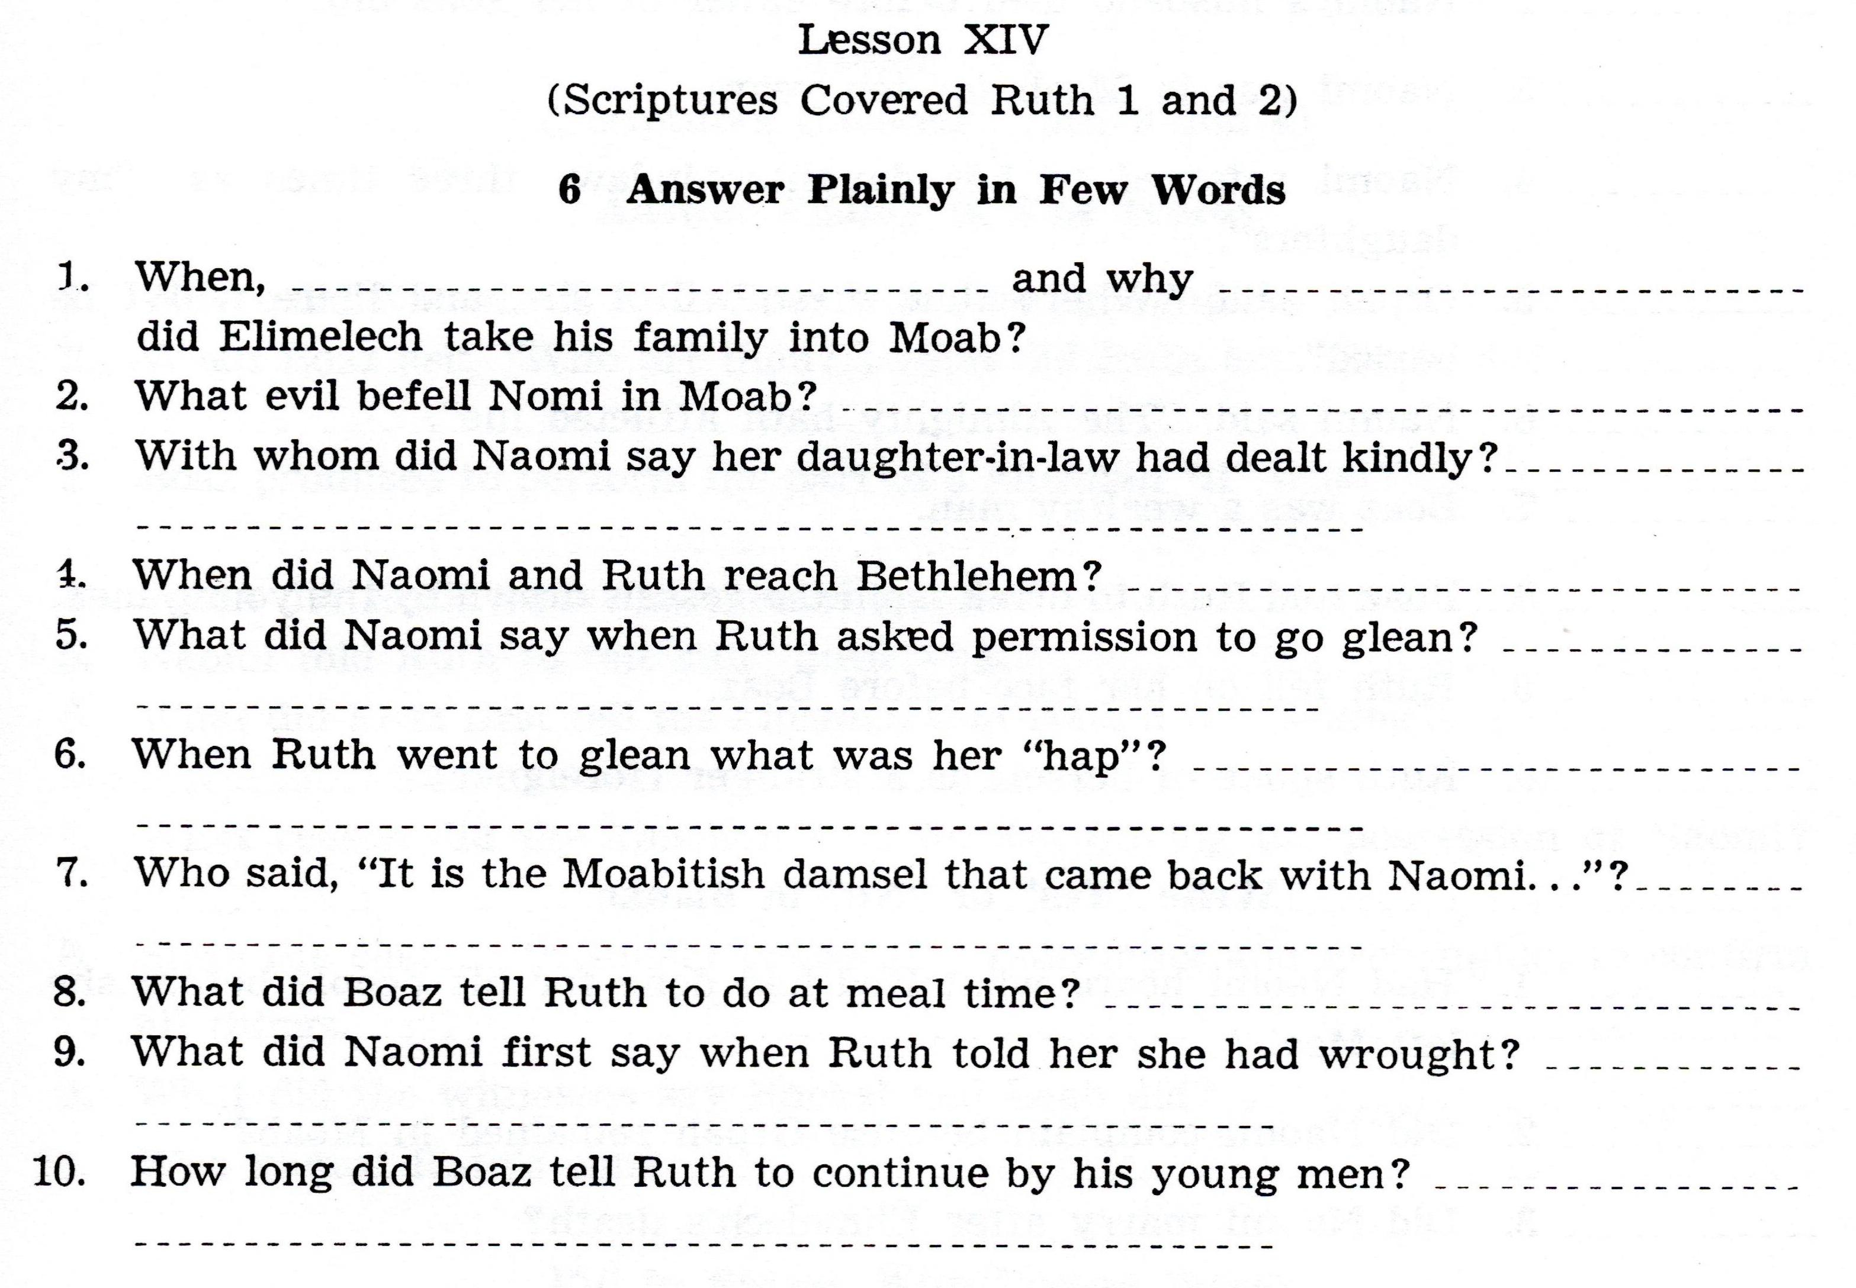

Slide 13
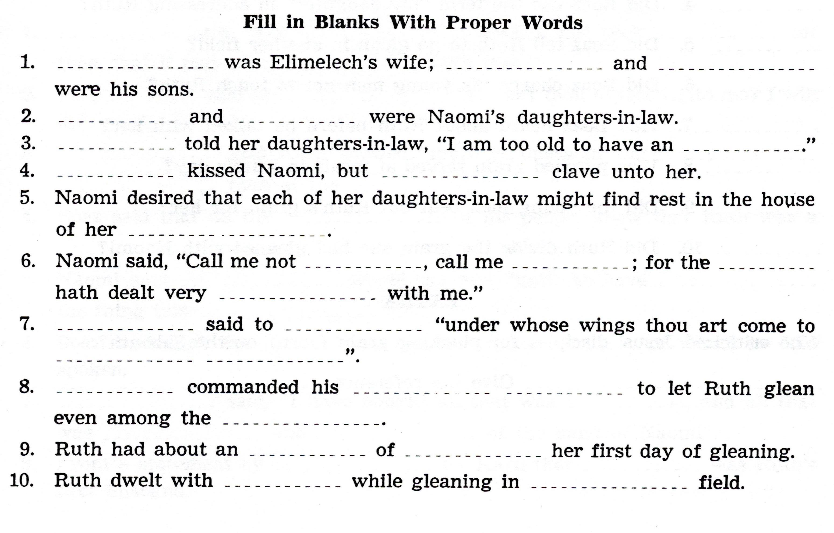

Slide 14
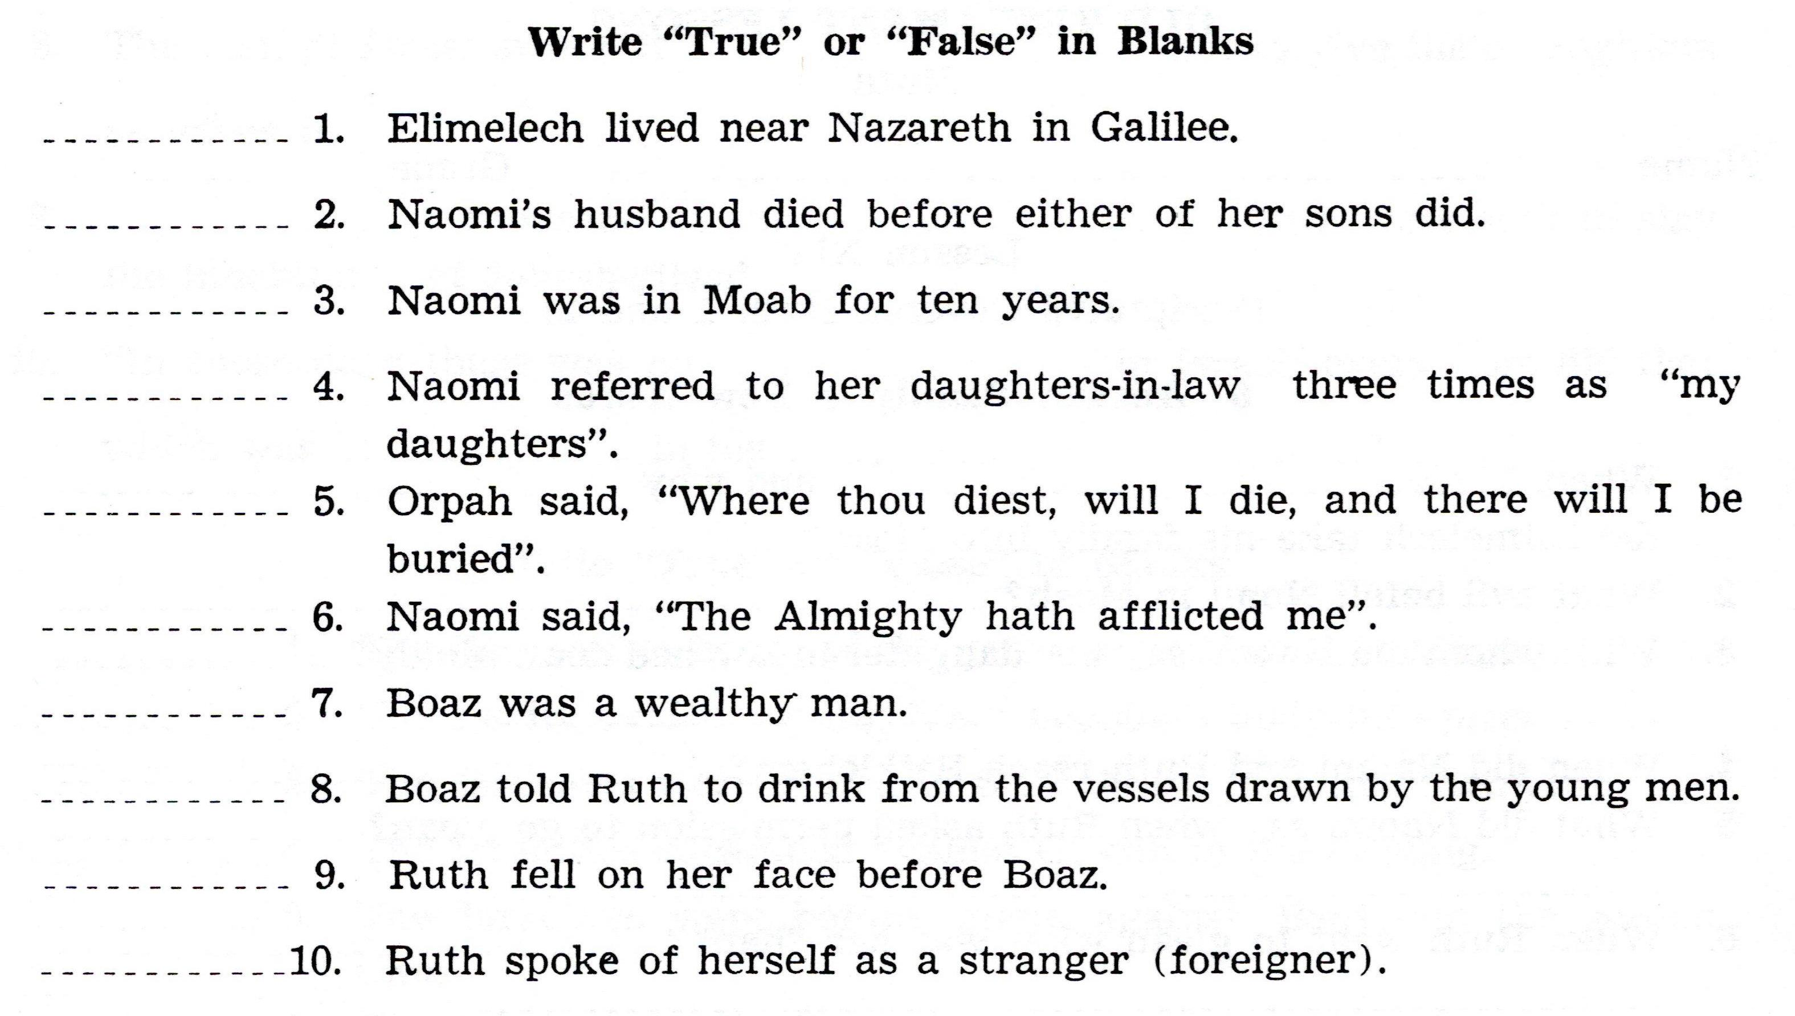

Slide 15
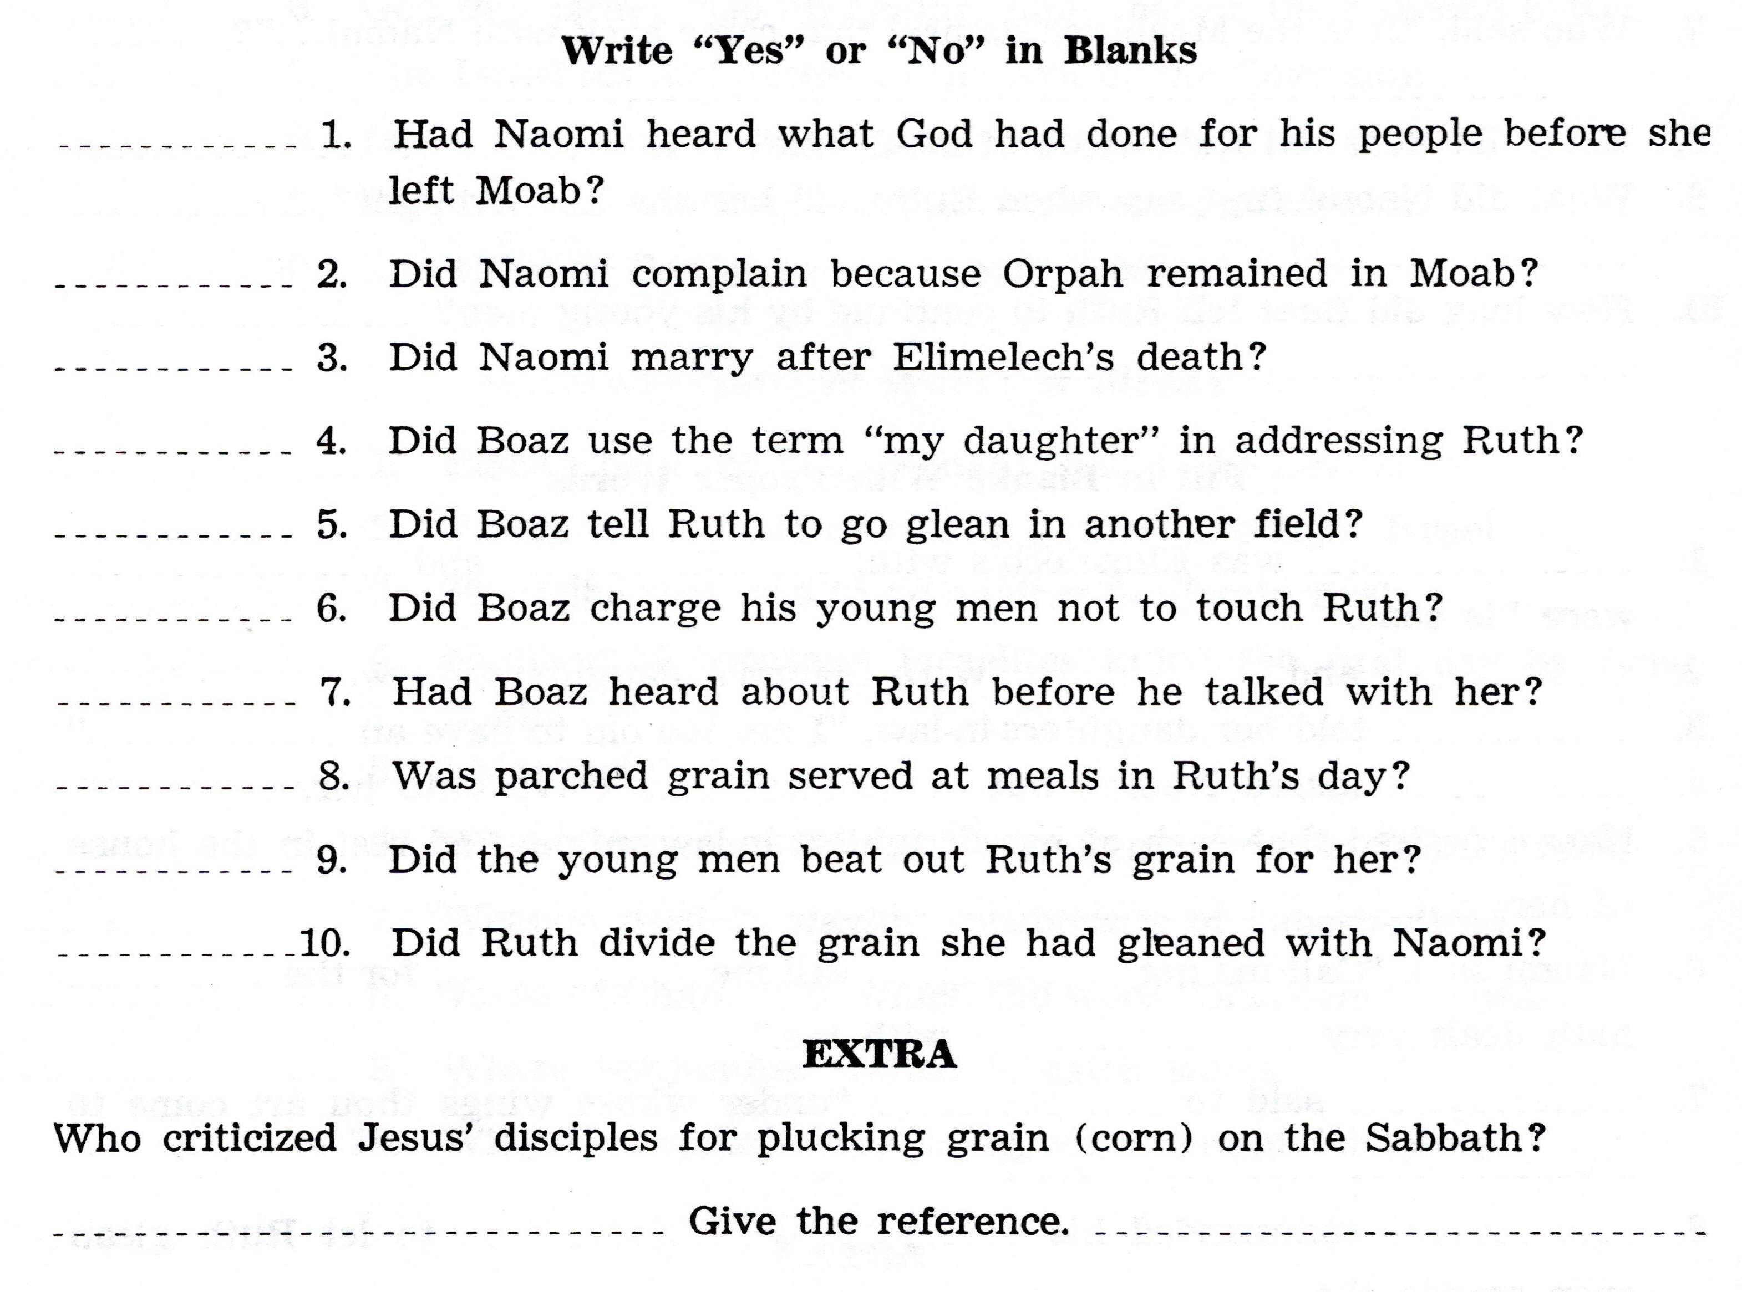

Slide 16
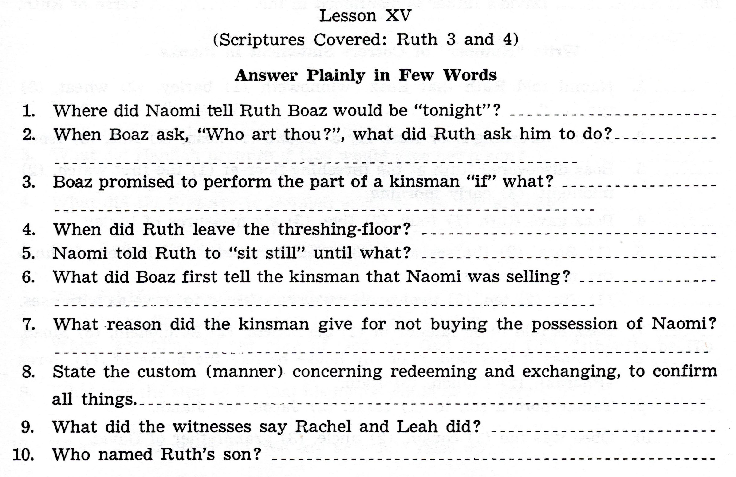

Slide 17
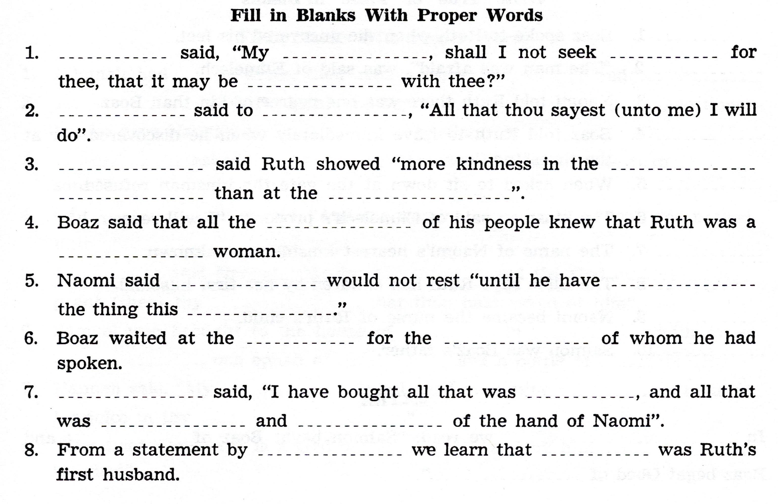

Slide 18
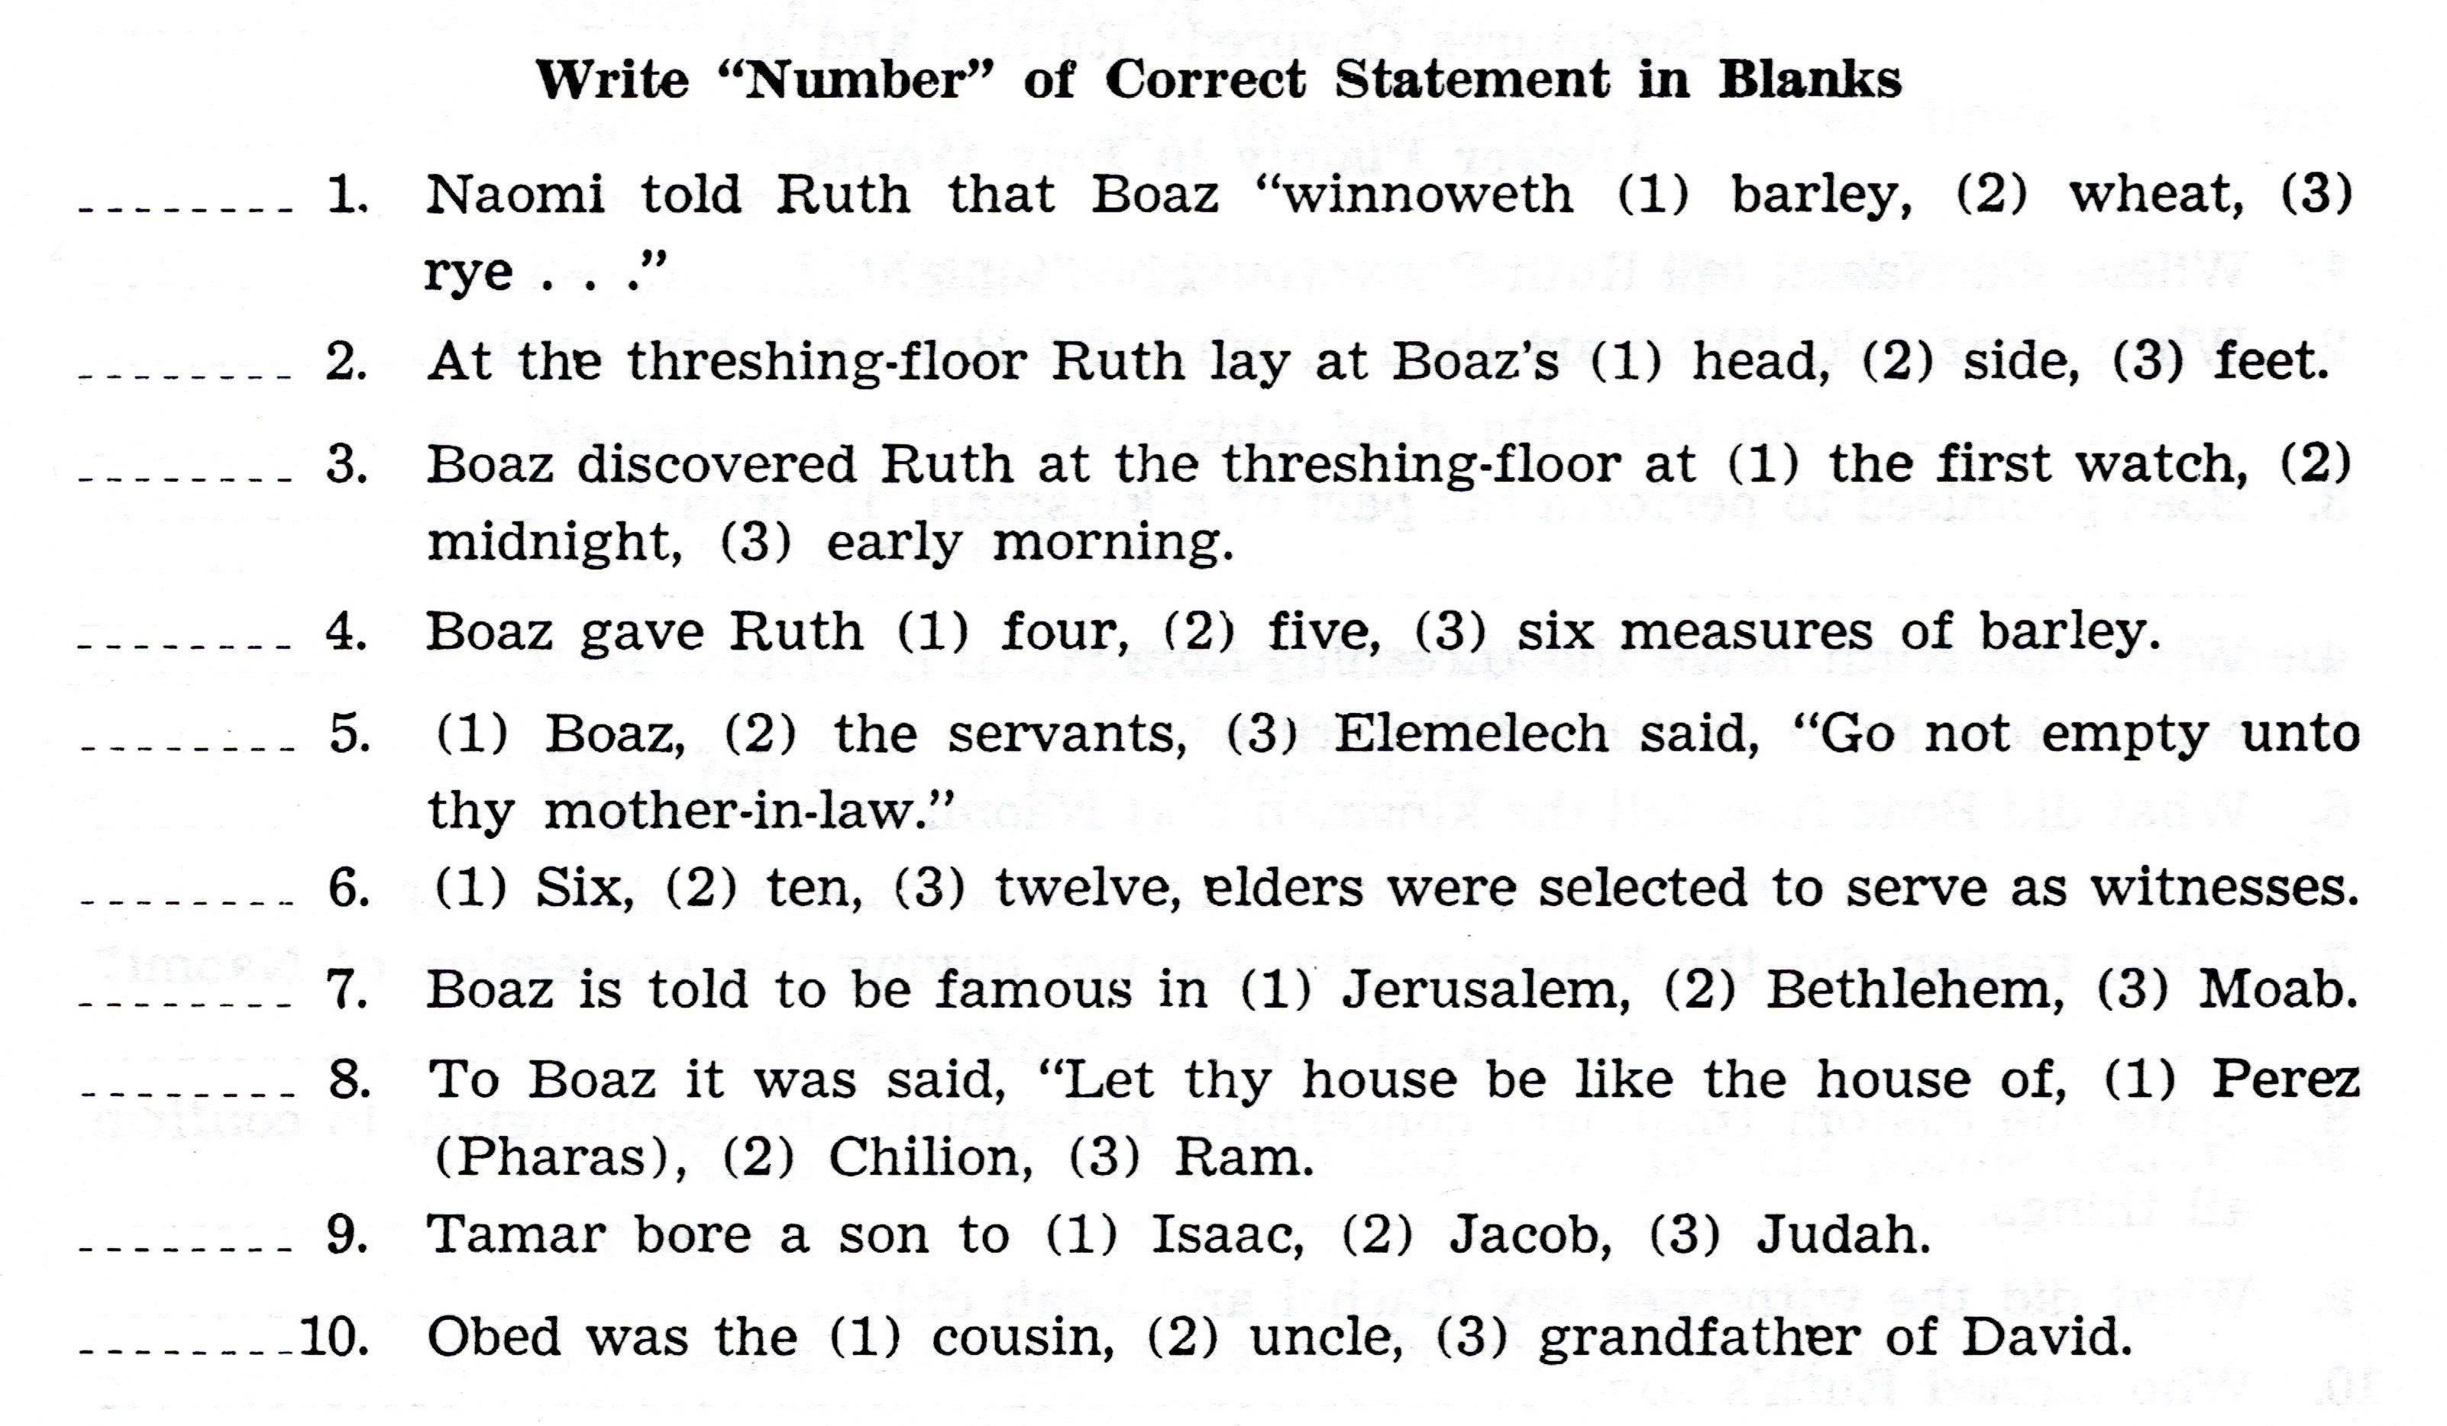

Slide 19
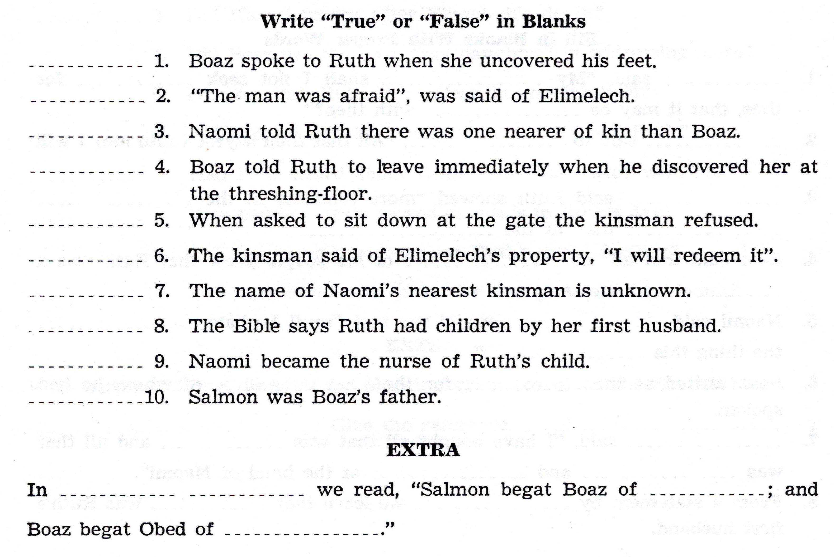

Slide 20
For Sunday (January 23, 2022)
Lessons # 16
1st Samuel 1 - 2

