Slide 1
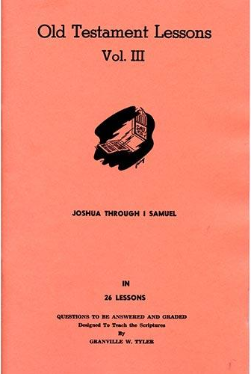
Joshua – 1st Samuel
Lesson #20
1 Samuel 13-15

Slide 2
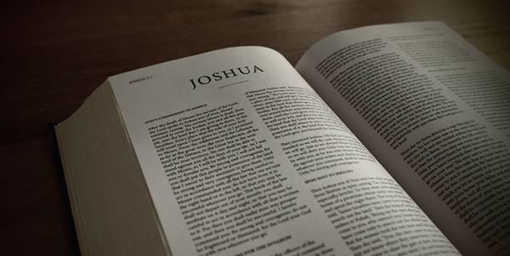
Review
Joshua – Conquest, conquering, and allotment of the promised land
Judges – A cycle of rebellion, oppression, repentance, deliverance, and faithfulness
Samuel 1-12 – Samuel judges Israel and Saul is made King

Slide 3
Overview of the Text
1 Samuel 13 – Saul’s unlawful sacrifice
1 Samuel 14 – Jonathan’s battle with the Philistines and the Lord’s deliverance, Saul’s oath, Saul’s battles
1 Samuel 15 – Saul’s disobedience

Slide 4
Overview of the Text
“When you were little in your own eyes, were you not head of the tribes of Israel? And did not the Lord anoint you king over Israel?”
- 1 Samuel 15:17

Slide 5
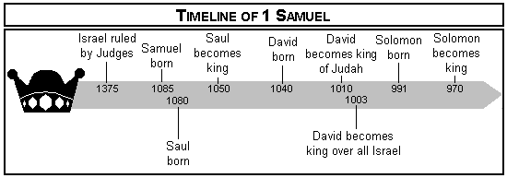
Timeline

Slide 6
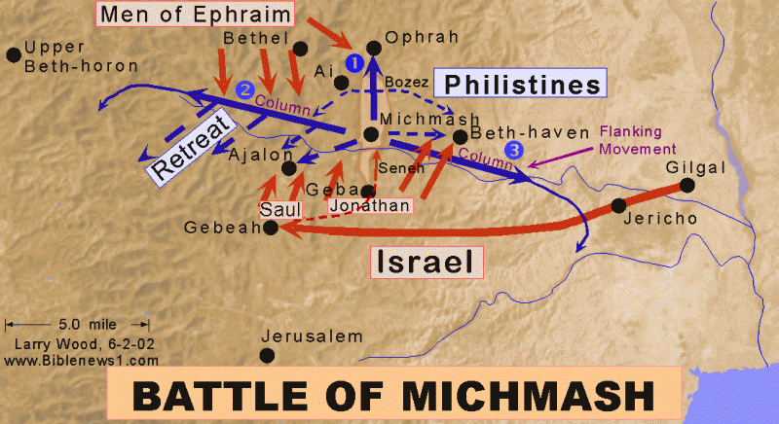
1 Samuel 13

Slide 7
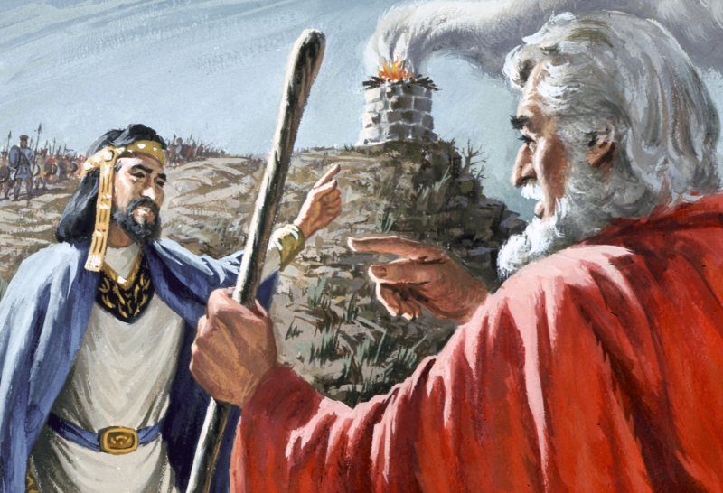
1 Samuel 13
1 Samuel 13:12
‘The Philistines will now come down on me at Gilgal, and I have not made supplication to the Lord.’ Therefore I felt compelled, and offered a burnt offering
1 Samuel 13:13
You have done foolishly. You have not kept the commandment of the Lord your God, which He commanded you.

Slide 8
1 Samuel 13

Slide 9
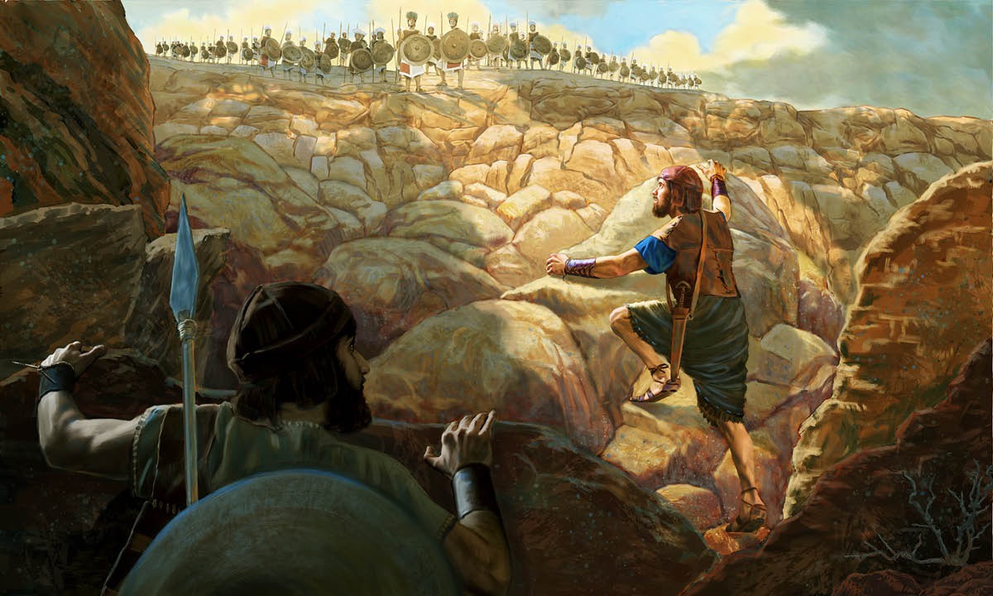
1 Samuel 14
1 Samuel 14:6
“Come, let us go over to the garrison of these uncircumcised; it may be that the Lord will work for us. For nothing restrains the Lord from saving by many or by few.”

Slide 10
1 Samuel 14

Slide 11
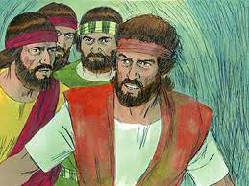
1 Samuel 14
1 Samuel 14:24
“Cursed is the man who eats any food until evening, before I have taken vengeance on my enemies.”
1 Samuel 14:45
But the people said to Saul, “Shall Jonathan die, who has accomplished this great deliverance in Israel? Certainly not! As the Lord lives, not one hair of his head shall fall to the ground, for he has worked with God this day.” So the people rescued Jonathan, and he did not die.

Slide 12
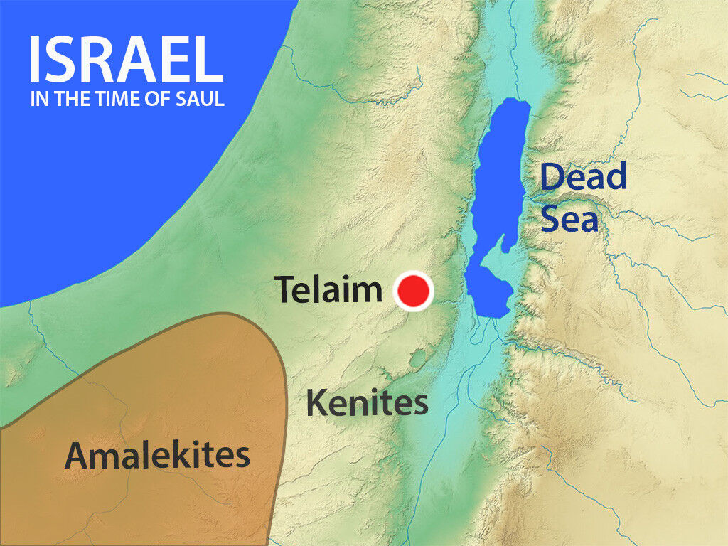
1 Samuel 15
1 Samuel 15:3
Now go and attack Amalek, and utterly destroy all that they have, and do not spare them. But kill both man and woman, infant and nursing child, ox and sheep, camel and donkey.

Slide 13
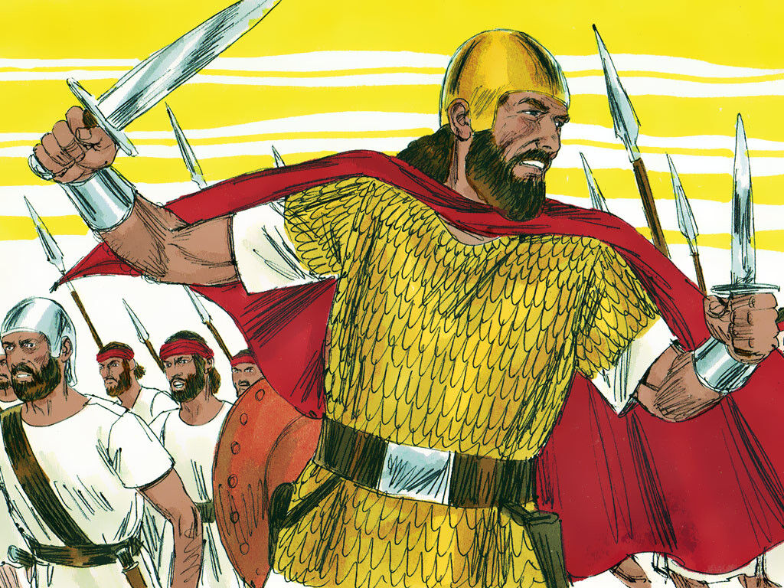
1 Samuel 15
1 Samuel 15:3
Now go and attack Amalek, and utterly destroy all that they have, and do not spare them. But kill both man and woman, infant and nursing child, ox and sheep, camel and donkey.

Slide 14
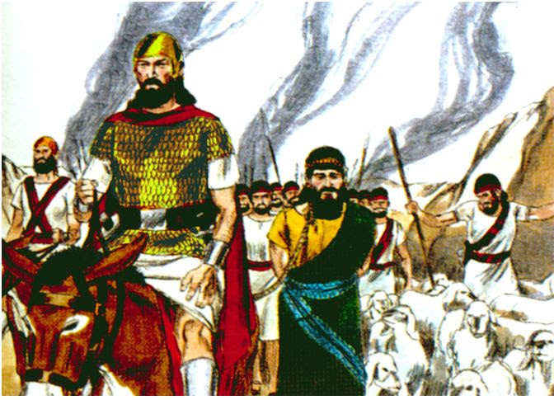
1 Samuel 15
1 Samuel 15:9
But Saul and the people spared Agag and the best of the sheep, the oxen, the fatlings, the lambs, and all that was good, and were unwilling to utterly destroy them

Slide 15
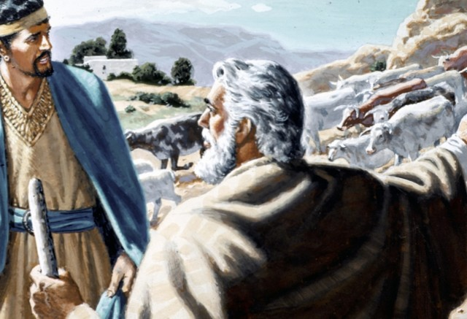
1 Samuel 15
1 Samuel 15:13
“Blessed are you of the Lord! I have performed the commandment of the Lord.”
1 Samuel 15:14
“What then is this bleating of the sheep in my ears, and the lowing of the oxen which I hear?”

Slide 16
1 Samuel 15
1 Samuel 15:13
“Blessed are you of the Lord! I have performed the commandment of the Lord.”
1 Samuel 15:22
“Has the Lord as great delight in burnt offerings and sacrifices, As in obeying the voice of the Lord? Behold, to obey is better than sacrifice, And to heed than the fat of rams.

Slide 17
1 Samuel 15
1 Samuel 15:13
“Blessed are you of the Lord! I have performed the commandment of the Lord.”
1 Samuel 15:23
For rebellion is as the sin of witchcraft, And stubbornness is as iniquity and idolatry. Because you have rejected the word of the Lord, He also has rejected you from being king.”

Slide 18
What do we learn? What application cab we make?
Obedience is desired and required
Be careful of self-promotion
Recognize that we can grow out of humility
Sin can be forgiven but that does not mean earthly consequence are removed
One man’s faithful actions can have an impact

Slide 19
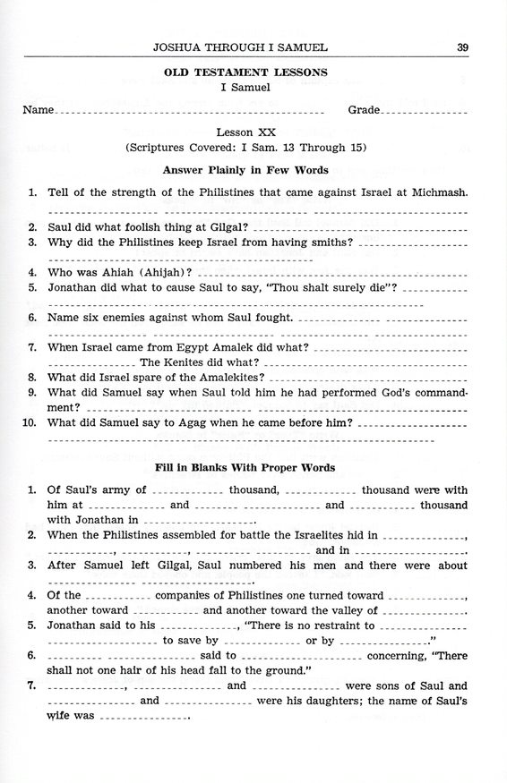

Slide 20
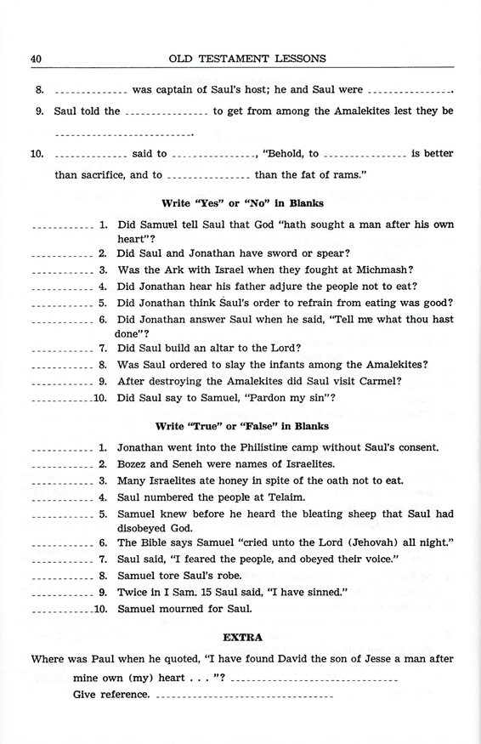

Slide 21
For Wednesday (Feb. 9th, 2022)
Lesson #21

