Slide 1
Joshua – 1st Samuel
Lesson #22
1 Samuel 18:17-20

Slide 2
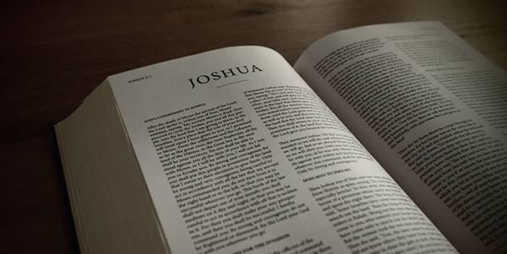
Review
Joshua – Conquest, conquering, and allotment of the promised land
Judges – A cycle of rebellion, oppression, repentance, deliverance, and faithfulness
1 Samuel 1-18:16 – Samuel judges Israel, Saul is made king, David fights the Philistines and is with Saul

Slide 3
Overview of the Text
1 Samuel 18:16-30 – David marries Michal
1 Samuel 19 – Saul attempts to kill David
1 Samuel 20 – Jonathan’s loyalty to David and their friendship

Slide 4
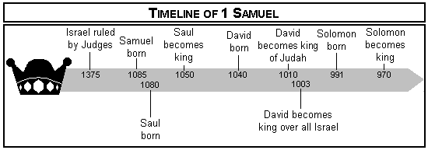
Timeline

Slide 5
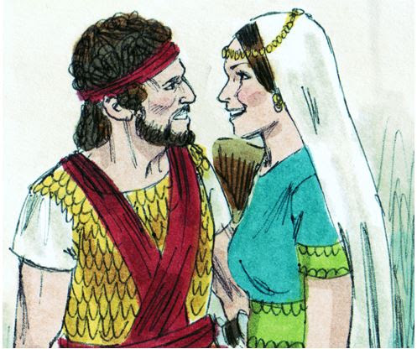
1 Samuel 18
1 Samuel 18:20
Now Michal, Saul’s daughter, loved David. And they told Saul, and the thing pleased him
1 Samuel 18:21
“I will give her to him, that she may be a snare to him, and that the hand of the Philistines may be against him.”

Slide 6
1 Samuel 18
1 Samuel 18:23
“Does it seem to you a light thing to be a king’s son-in-law, seeing I am a poor and lightly esteemed man?”
1 Samuel 18:25
‘The king does not desire any dowry but one hundred foreskins of the Philistines, to take vengeance on the king’s enemies.’

Slide 7
1 Samuel 18
1 Samuel 18:28-29
Thus Saul saw and knew that the Lord was with David, and that Michal, Saul’s daughter, loved him; and Saul was still more afraid of David. So Saul became David’s enemy continually.

Slide 8
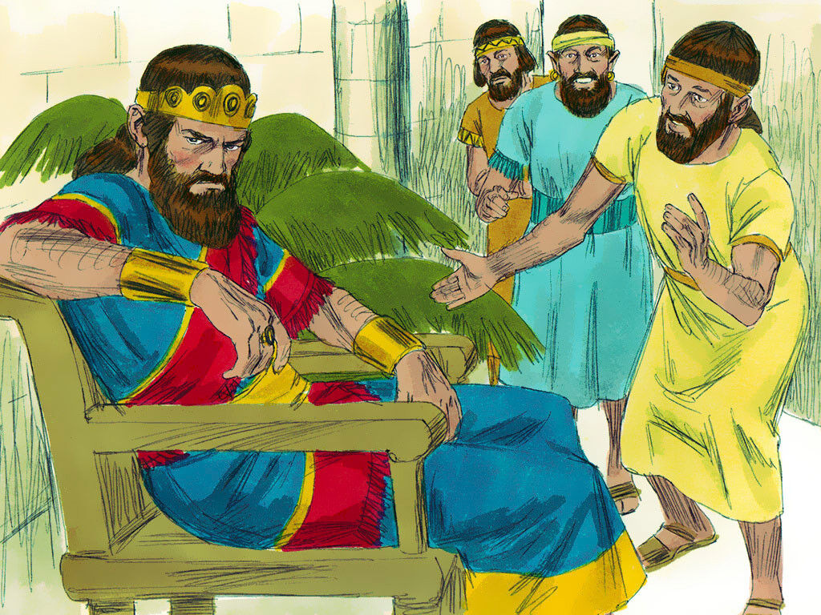
1 Samuel 19
1 Samuel 19:4-5
“Let not the king sin against his servant, against David, because he has not sinned against you, and because his works have been very good toward you. For he took his life in his hands and killed the Philistine, and the Lord brought about a great deliverance for all Israel. You saw it and rejoiced. Why then will you sin against innocent blood, to kill David without a cause?”

Slide 9
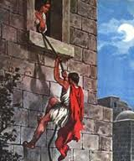
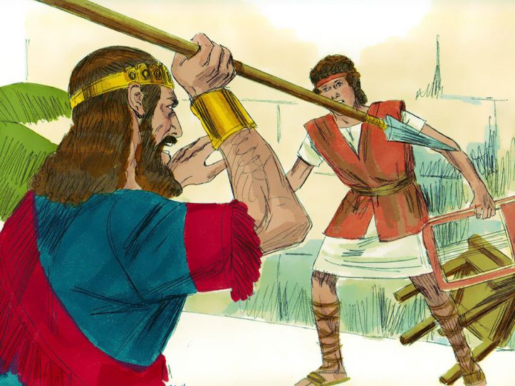
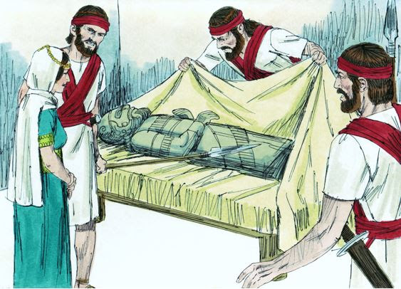
1 Samuel 19

Slide 10
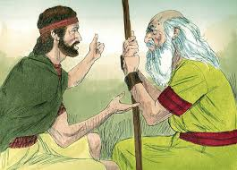
1 Samuel 19
1 Samuel 19:19-20
“Take note, David is at Naioth in Ramah!” Then Saul sent messengers to take David.

Slide 11
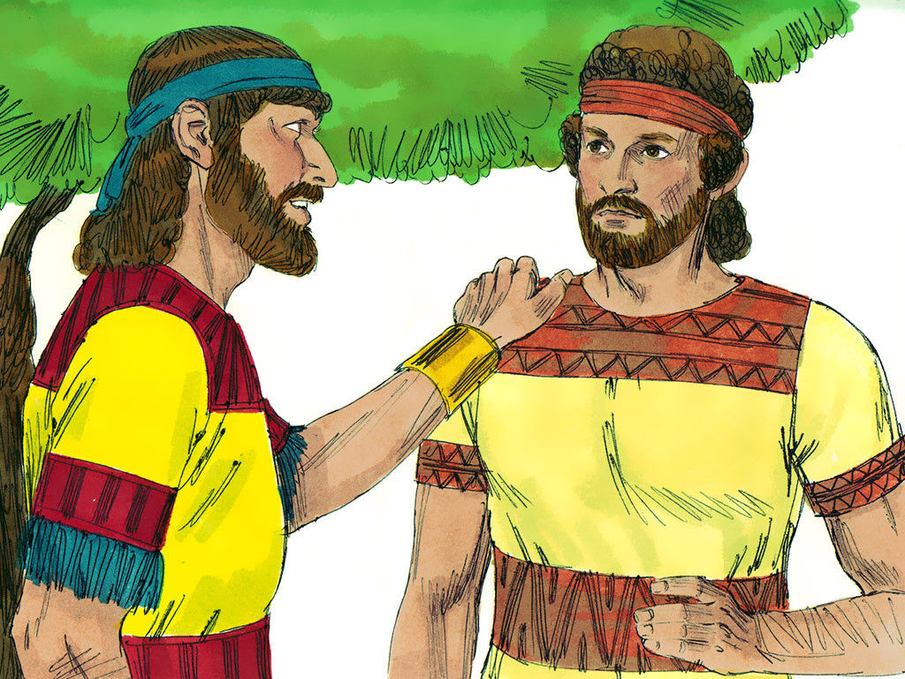
1 Samuel 20
1 Samuel 20:1
“What have I done? What is my iniquity, and what is my sin before your father, that he seeks my life?”
1 Samuel 20:2
“By no means! You shall not die!

Slide 12
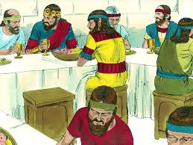
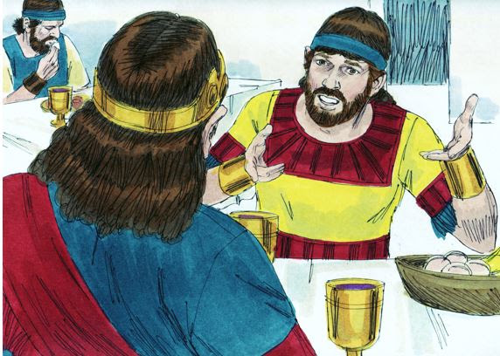
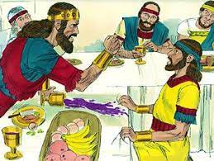
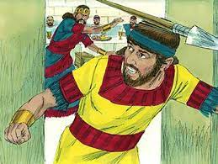
1 Samuel 20

Slide 13
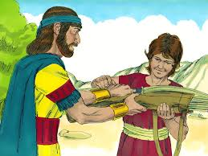
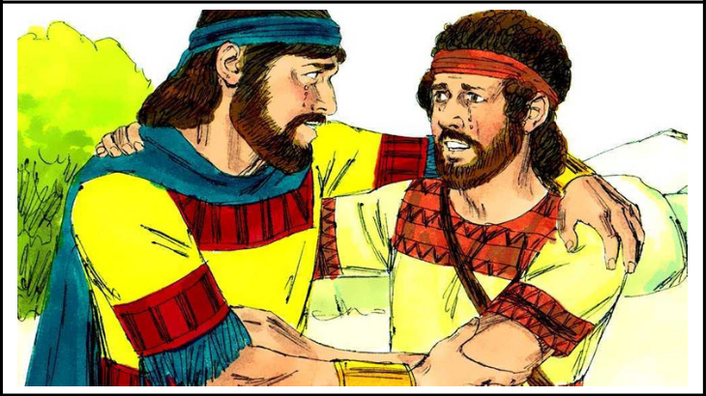
1 Samuel 20

Slide 14
What do we learn? What application can we make?

Slide 15
For Wednesday (Feb. 16th, 2022)
Lesson #23

