Slide 1
David Fleeing Saul
Lesson # 23
1st Samuel 21 – 23
1st Chronicles 12:16-18

Slide 2
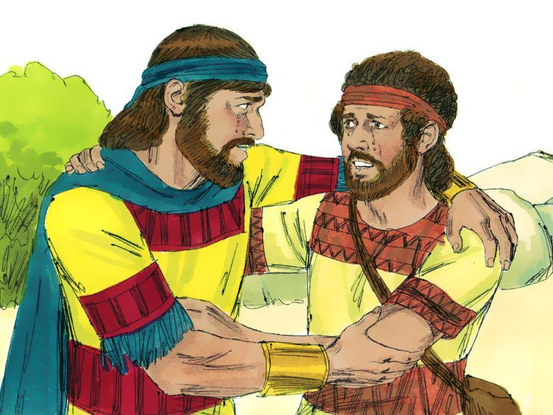
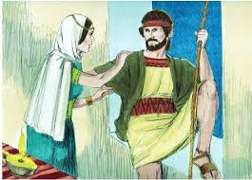
Saul’s Children Favoring David

Slide 3
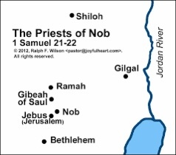
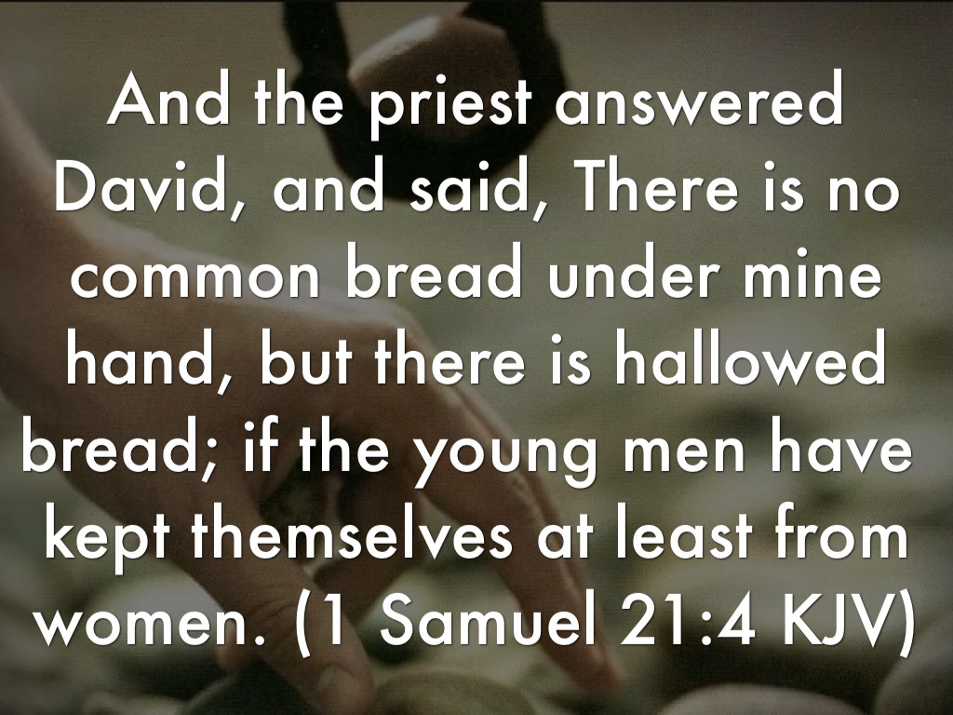
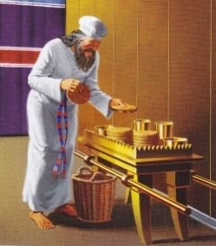
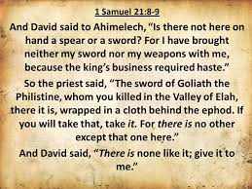
1 Samuel 21
1

Slide 4
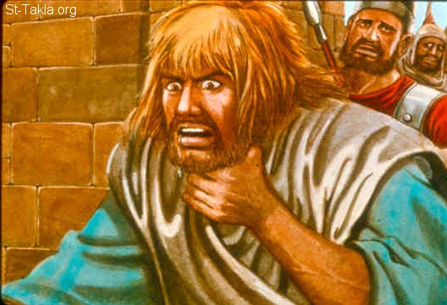
2

Slide 5
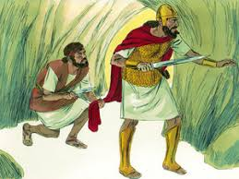
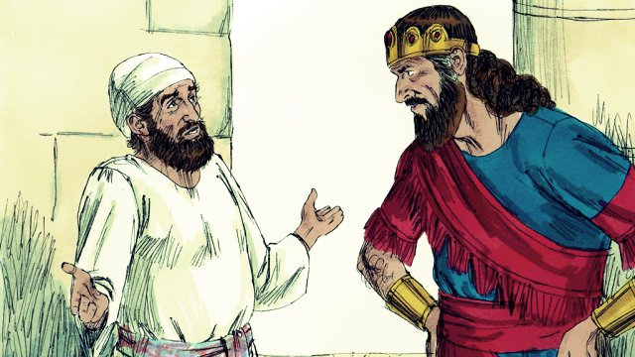
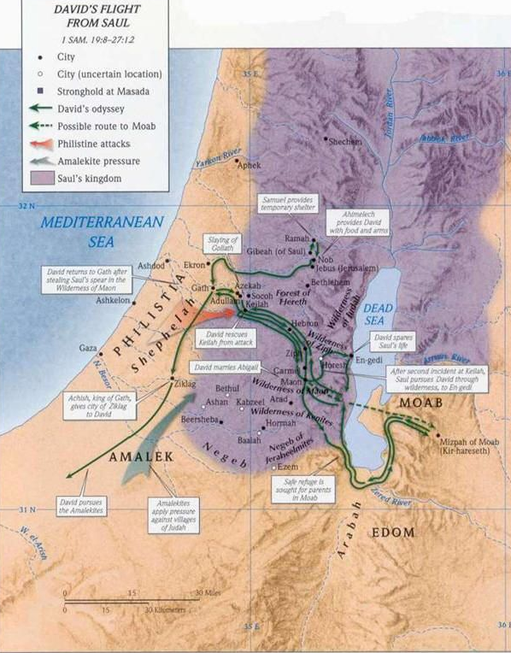
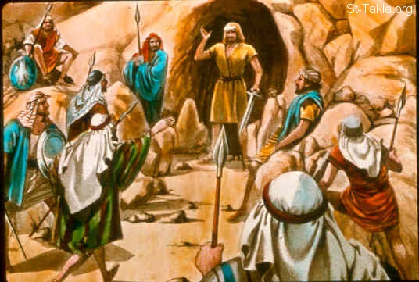
1 Samuel 22

Slide 6
1 Samuel 23
1
¹ Then they told David, saying, “Look, the Philistines are fighting against Keilah, and they are robbing the threshing floors.” ² Therefore David inquired of the Lord, saying, “Shall I go and attack these Philistines?” And the Lord said to David, “Go and attack the Philistines, and save Keilah.” ³ But David’s men said to him, “Look, we are afraid here in Judah. How much more then if we go to Keilah against the armies of the Philistines?” ⁴ Then David inquired of the Lord once again. And the Lord answered him and said, “Arise, go down to Keilah. For I will deliver the Philistines into your hand.” ⁵ And David and his men went to Keilah and fought with the Philistines, struck them with a mighty blow, and took away their livestock. So David saved the inhabitants of Keilah.

Slide 7
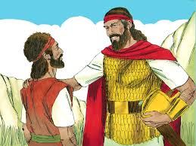
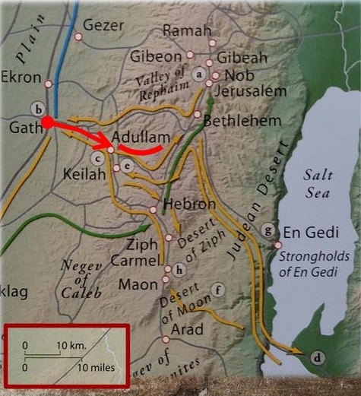
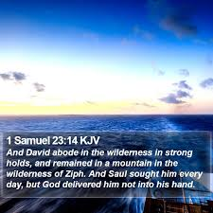
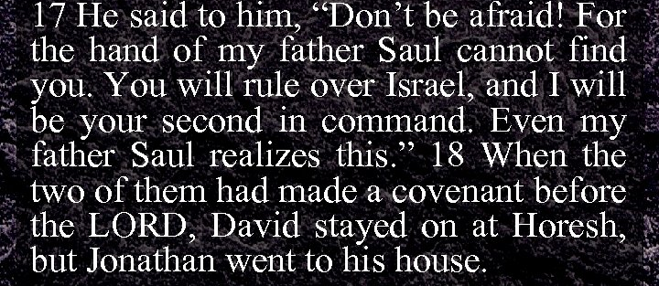
2

Slide 8
1 Chronicles 12:16-18
¹⁶ Then some of the sons of Benjamin and Judah came to David at the stronghold. ¹⁷ And David went out to meet them, and answered and said to them, “If you have come peaceably to me to help me, my heart will be united with you; but if to betray me to my enemies, since there is no wrong in my hands, may the God of our fathers look and bring judgment.” ¹⁸ Then the Spirit came upon Amasai, chief of the captains, and he said: “We are yours, O David; we are on your side, O son of Jesse! Peace, peace to you, and peace to your helpers! For your God helps you.” So David received them, and made them captains of the troop.

Slide 9
What Are Main Points?

Slide 10
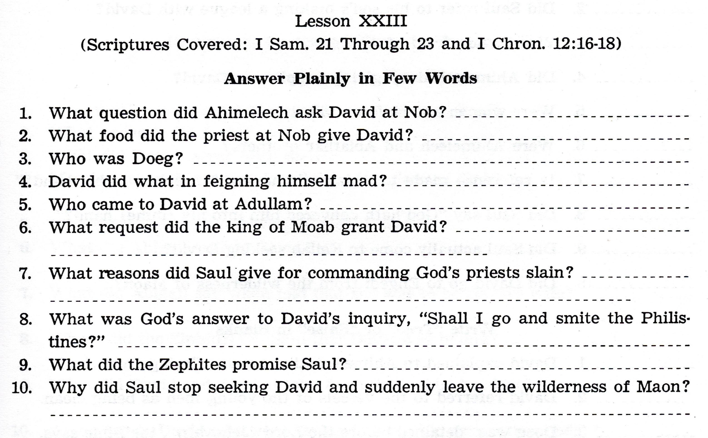

Slide 11
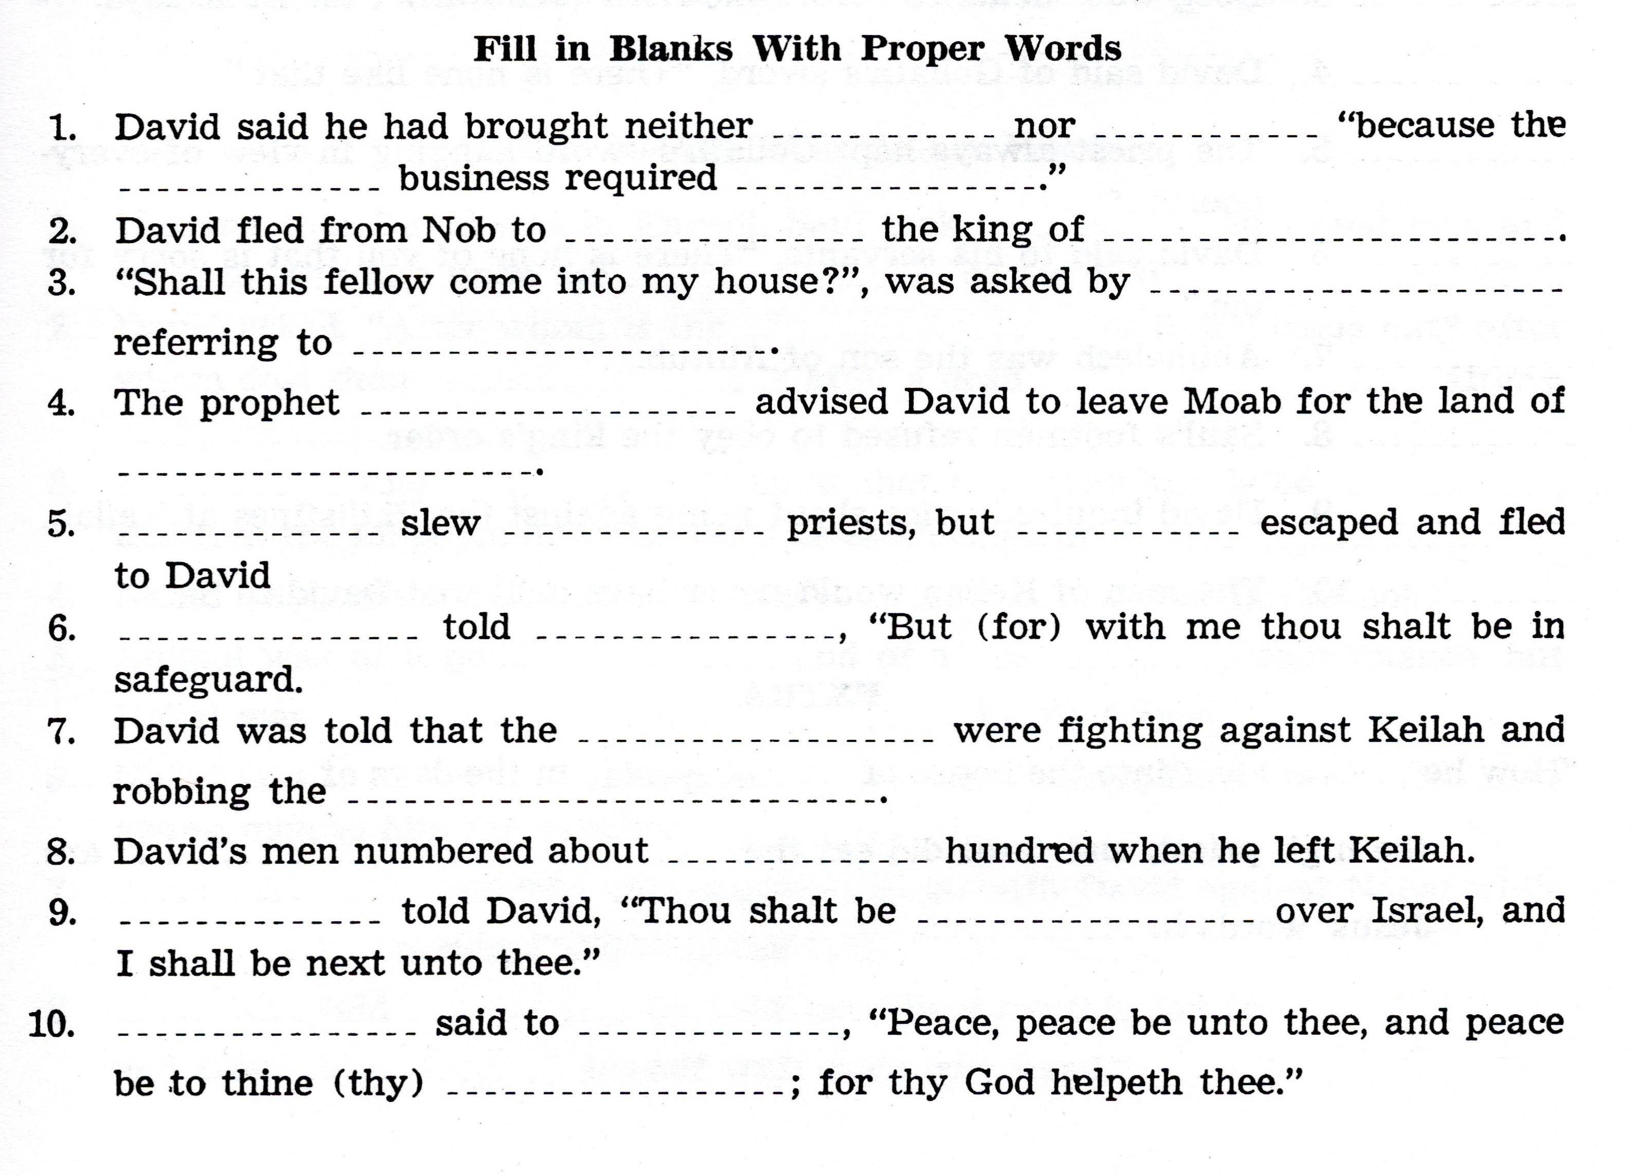

Slide 12
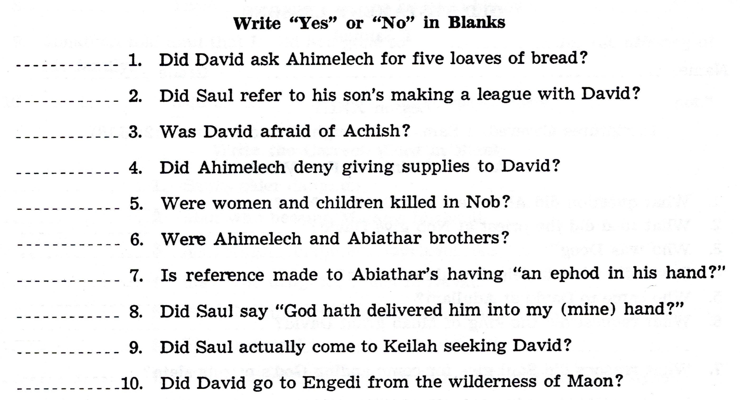

Slide 13
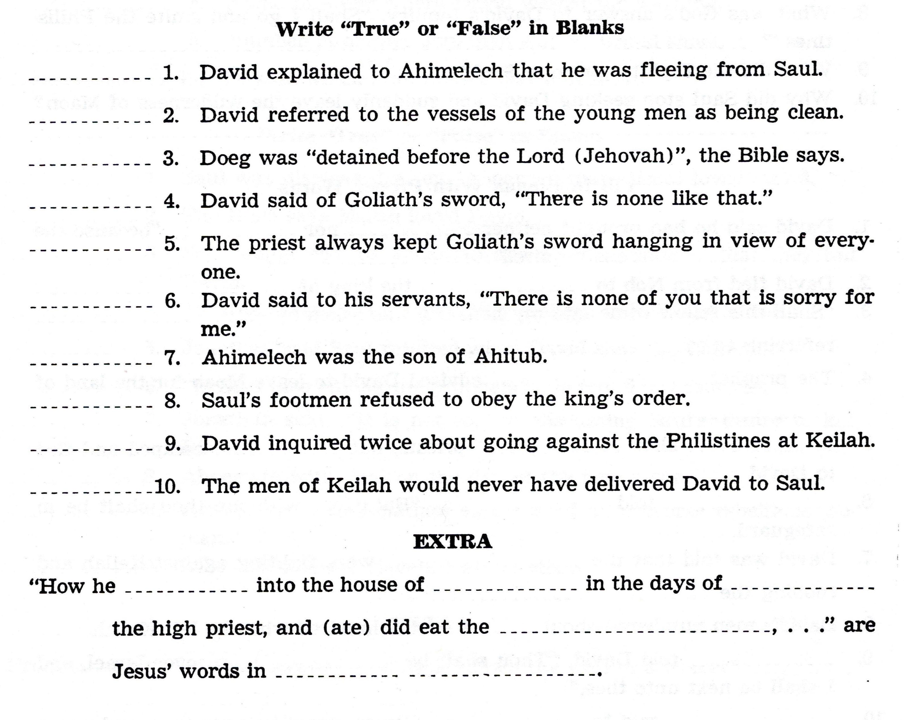

Slide 14
For Sunday (February 20, 2022)
Lessons # 24
1st Samuel 24 - 26

