Slide 1
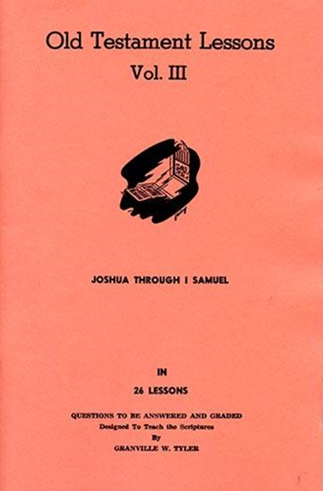
Joshua – 1st Samuel
Lesson #24
1Samuel 24 - 26

Slide 2
Overview of 1 Samuel
First Samuel records:
the birth, life and death of Samuel, the last judge
Israel demanding a king like the other nations
the establishment of Israel's monarchy
the rise and fall of Saul
the rise of David and his kingdom
Authorship: Unknown
Portions thought to be written by Samuel (1 Chron. 29:29)
Date span: 1105-970 B.C.

Slide 3
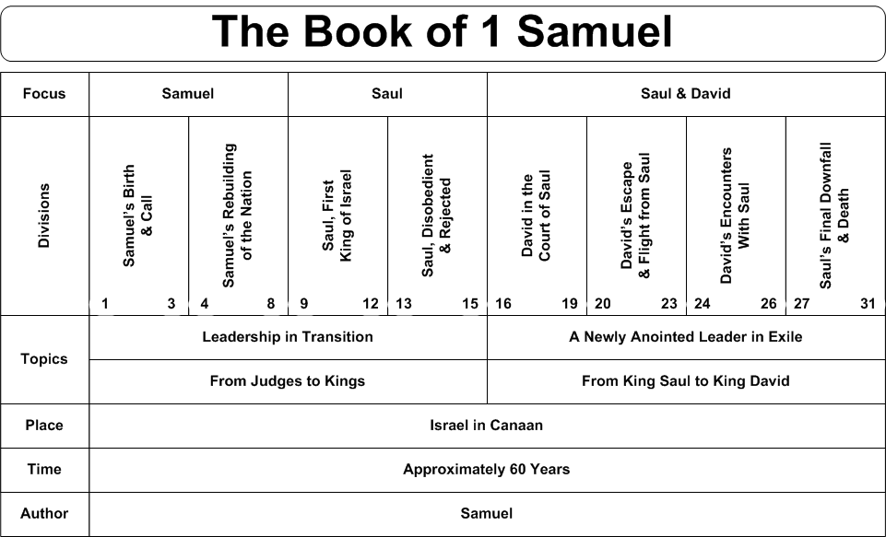
Overview of 1 Samuel

Slide 4
2 Samuel 1:1-16
¹Now it came to pass after the death of Saul, when David had returned from the slaughter of the Amalekites, and David had stayed two days in Ziklag, ²on the third day, behold, it happened that a man came from Saul’s camp with his clothes torn and dust on his head. So it was, when he came to David, that he fell to the ground and prostrated himself.
³And David said to him, “Where have you come from?”
So he said to him, “I have escaped from the camp of Israel.”
⁴Then David said to him, “How did the matter go? Please tell me.”
And he answered, “The people have fled from the battle, many of the people are fallen and dead, and Saul and Jonathan his son are dead also.”
⁵So David said to the young man who told him, “How do you know that Saul and Jonathan his son are dead?”
⁶Then the young man who told him said, “As I happened by chance to be on Mount Gilboa, there was Saul, leaning on his spear; and indeed the chariots and horsemen followed hard after him. ⁷Now when he looked behind him, he saw me and called to me. And I answered, ‘Here I am.’ ⁸And he said to me, ‘Who are you?’ So I answered him, ‘I am an Amalekite.’ ⁹He said to me again, ‘Please stand over me and kill me, for anguish has come upon me, but my life still remains in me.’ ¹⁰So I stood over him and killed him, because I was sure that he could not live after he had fallen. And I took the crown that was on his head and the bracelet that was on his arm, and have brought them here to my lord.”
¹¹Therefore David took hold of his own clothes and tore them, and so did all the men who were with him. ¹²And they mourned and wept and fasted until evening for Saul and for Jonathan his son, for the people of the Lord and for the house of Israel, because they had fallen by the sword.
¹³Then David said to the young man who told him, “Where are you from?”
And he answered, “I am the son of an alien, an Amalekite.”
¹⁴So David said to him, “How was it you were not afraid to put forth your hand to destroy the Lord’s anointed?” ¹⁵Then David called one of the young men and said, “Go near, and execute him!” And he struck him so that he died. ¹⁶So David said to him, “Your blood is on your own head, for your own mouth has testified against you, saying, ‘I have killed the Lord’s anointed.’”

Slide 5
What Are the Highlights?
Chapter 24
David spares Saul’s life in the cave
Saul repents and goes home
Chapter 25
Samuel dies. Israel mourns and buries him
Abigail spares David from shedding blood
David takes two more wives, Abigail and Ahinoam
Chapter 26
Saul pursues David again. David spares Saul again
Saul repents again. Does David trust him?

Slide 6
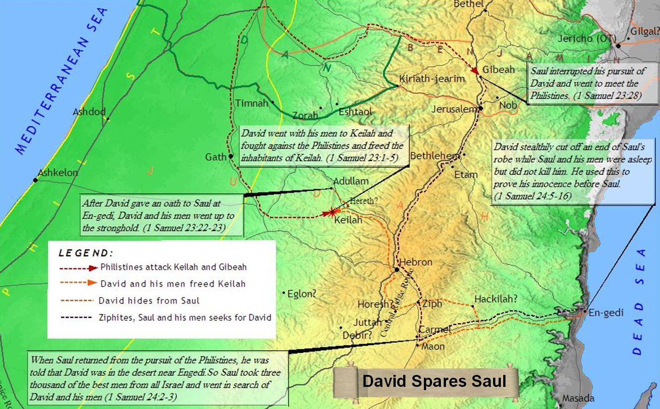
Chapter 24

Slide 7
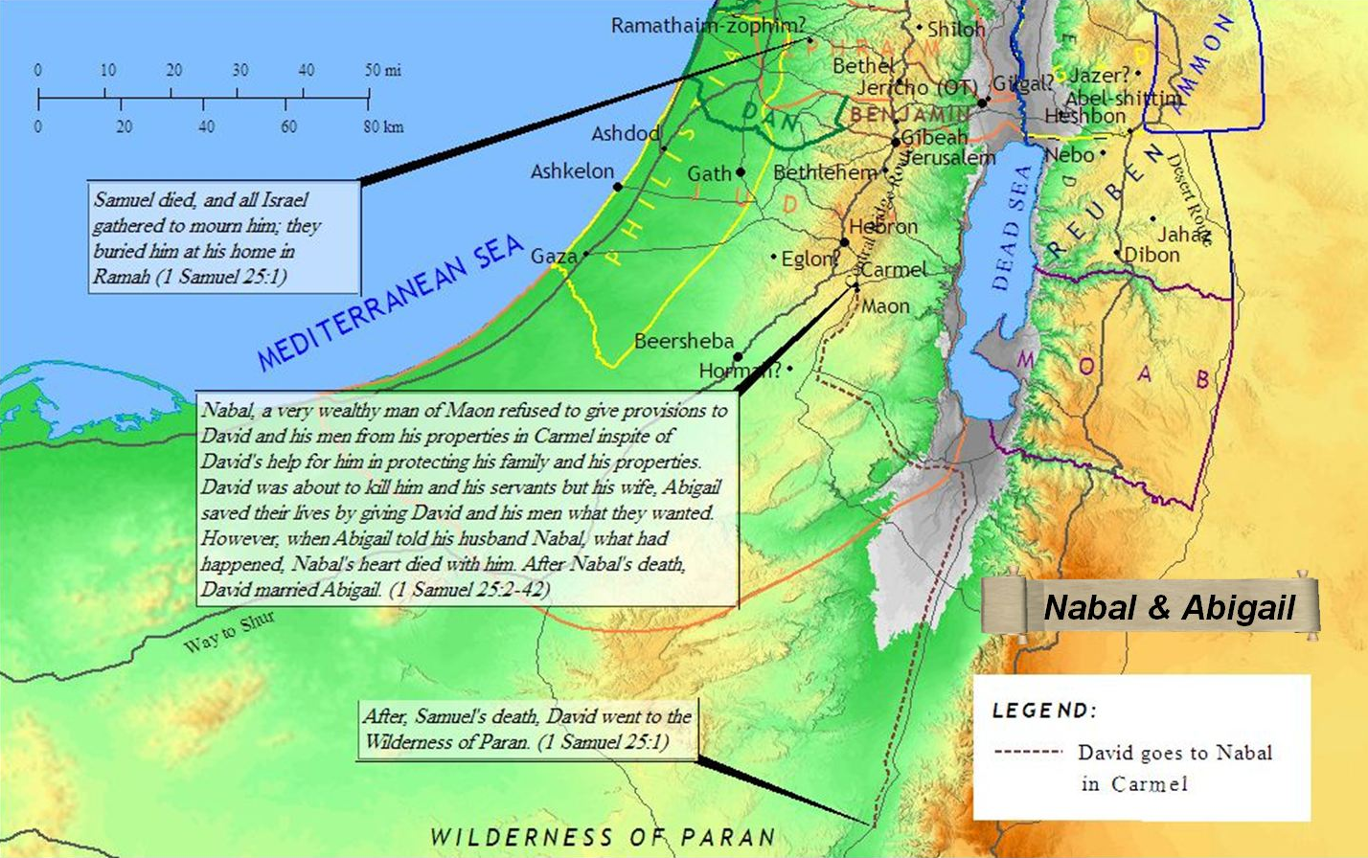
Chapter 25

Slide 8
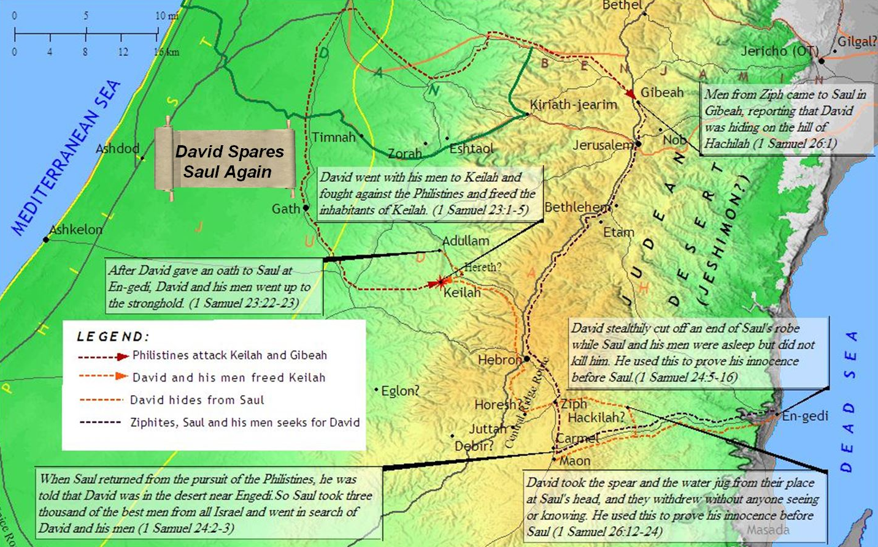
Chapter 26

Slide 9
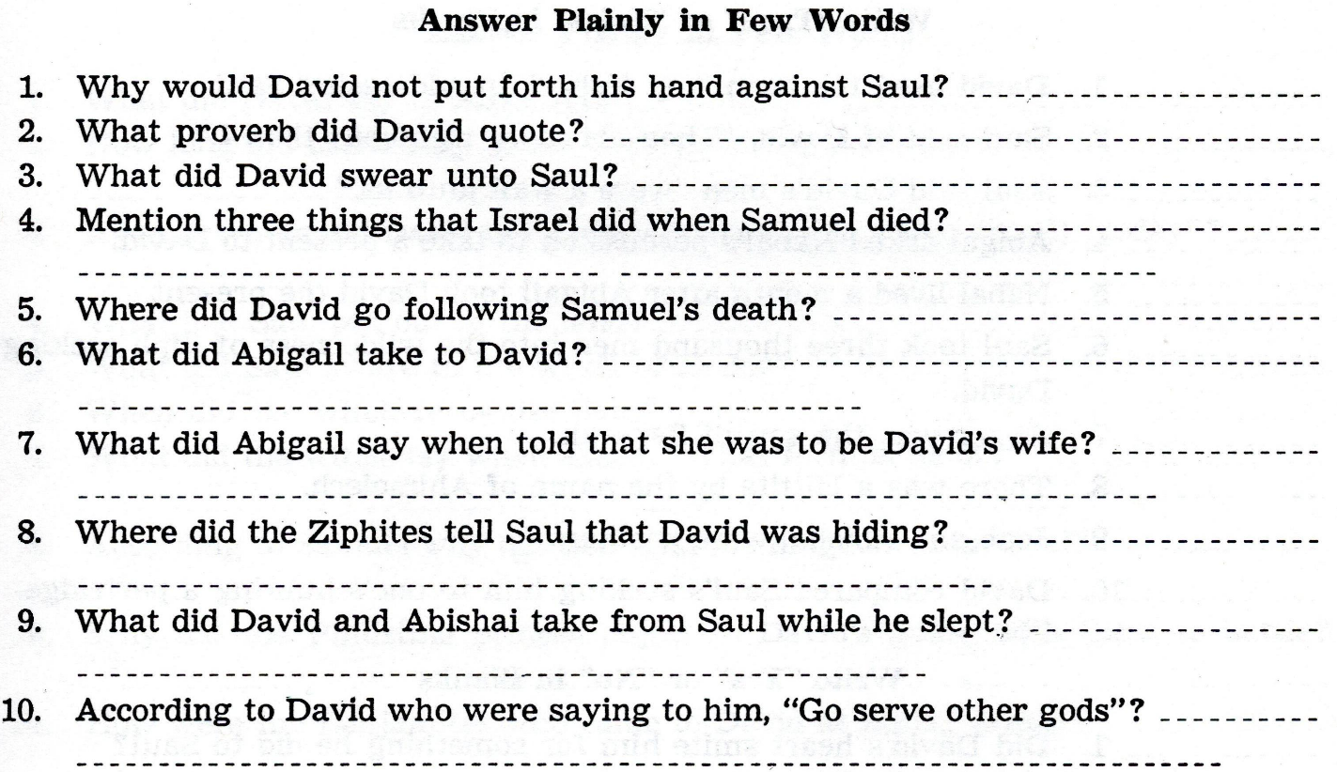

Slide 10
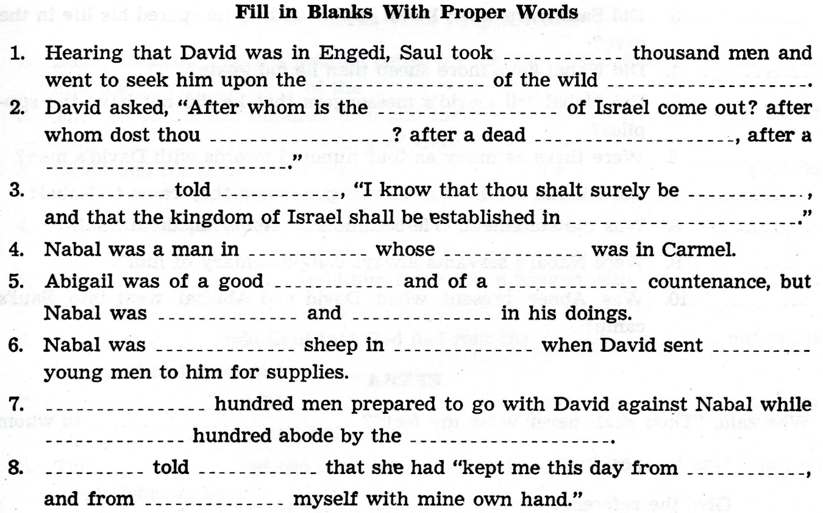

Slide 11
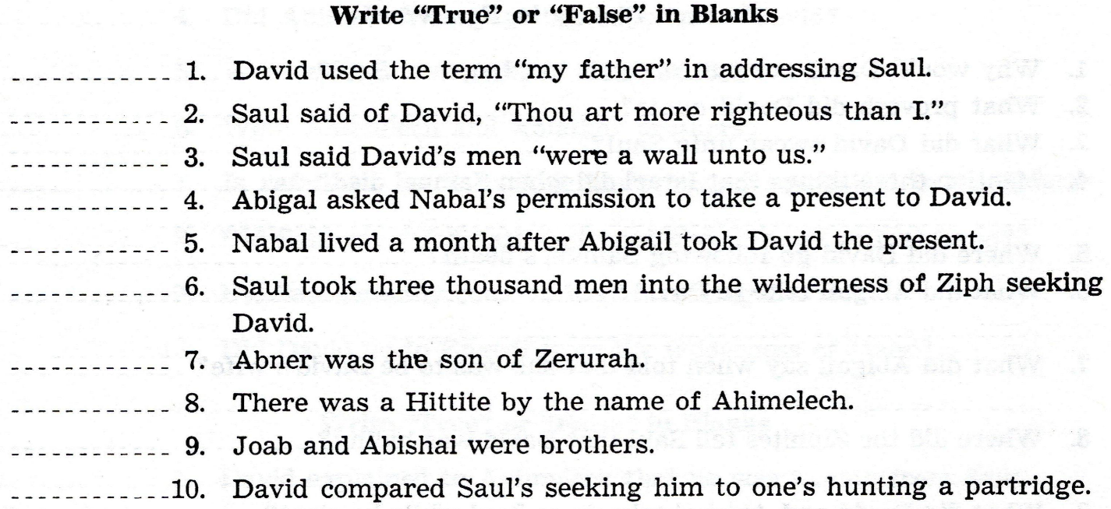

Slide 12
