Slide 1
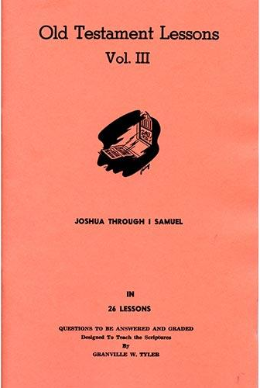
Joshua – 1st Samuel
Lesson #26
1 Samuel 31-30; 1 Chronicles 10

Slide 2
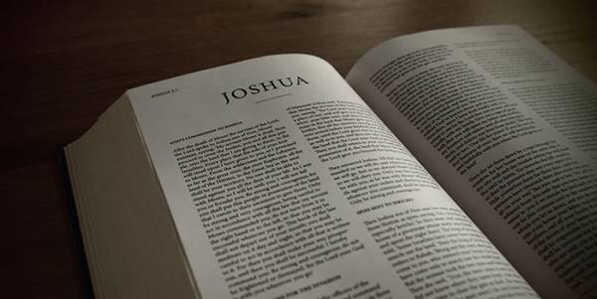
Review
Joshua – Conquest, conquering, and allotment of the promised land
Judges – A cycle of rebellion, oppression, repentance, deliverance, and faithfulness
1 Samuel 1-29 – Samuel judges Israel, Saul is made king, David fights the Philistines, Saul chases David

Slide 3
Overview of the Text
1 Samuel 30 – David battles the Amalekites
1 Samuel 31; 1 Chronicles 10 – Saul and his sons die in battle against the Philistines

Slide 4
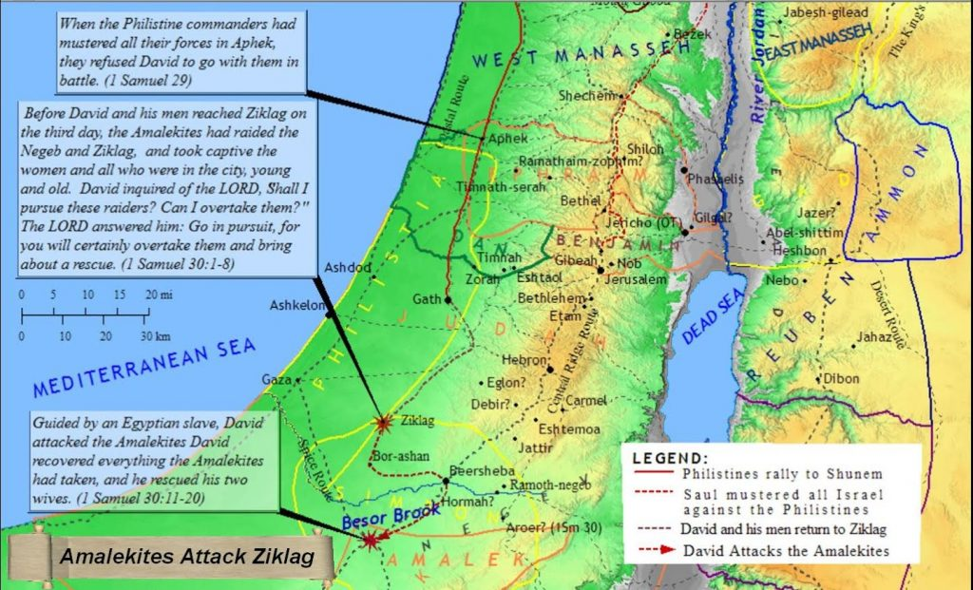
1 Samuel 30

Slide 5
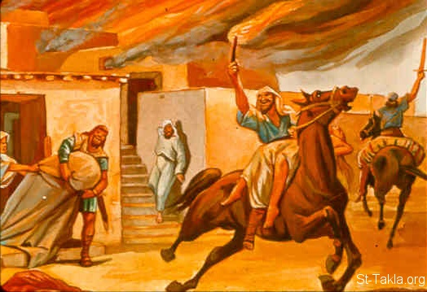
1 Samuel 30
1 Samuel 30:6
Now David was greatly distressed, for the people spoke of stoning him, because the soul of all the people was grieved, every man for his sons and his daughters. But David strengthened himself in the Lord his God.

Slide 6
1 Samuel 30
1 Samuel 30:6
Now David was greatly distressed, for the people spoke of stoning him, because the soul of all the people was grieved, every man for his sons and his daughters. But David strengthened himself in the Lord his God.

Slide 7
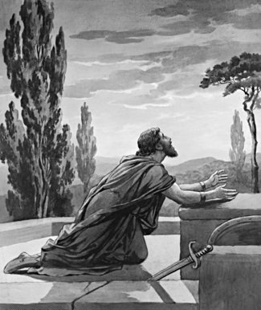
1 Samuel 30
1 Samuel 30:8
David inquired of the Lord, saying, “Shall I pursue this troop? Shall I overtake them?” And He answered him, “Pursue, for you shall surely overtake them and without fail recover all.”

Slide 8
1 Samuel 30
1 Samuel 30:8
David inquired of the Lord, saying, “Shall I pursue this troop? Shall I overtake them?” And He answered him, “Pursue, for you shall surely overtake them and without fail recover all.”

Slide 9
1 Samuel 30

Slide 10
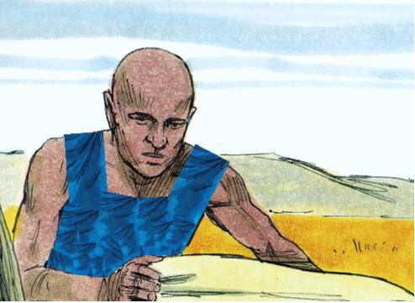
1 Samuel 30
1 Samuel 30:13
“I am a young man from Egypt, servant of an Amalekite; and my master left me behind, because three days ago I fell sick.”
1 Samuel 30:15
“Swear to me by God that you will neither kill me nor deliver me into the hands of my master, and I will take you down to this troop.”

Slide 11
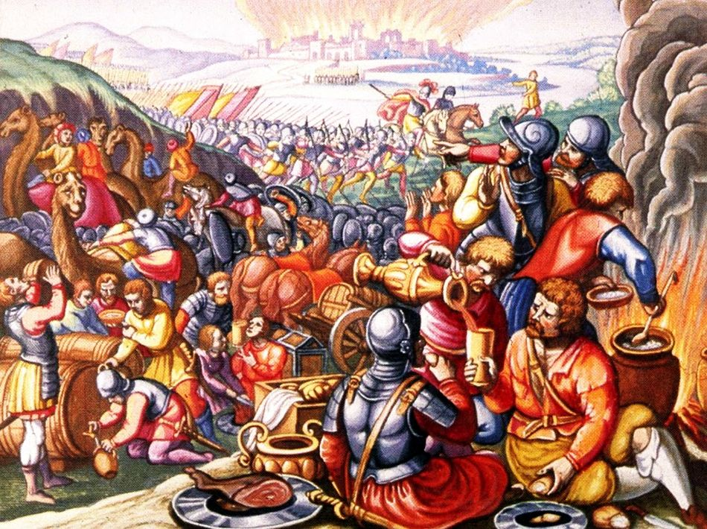
1 Samuel 30
1 Samuel 30:18-19
David recovered all that the Amalekites had carried away, and David rescued his two wives. And nothing of theirs was lacking, either small or great, sons or daughters, spoil or anything which they had taken from them; David recovered all.

Slide 12
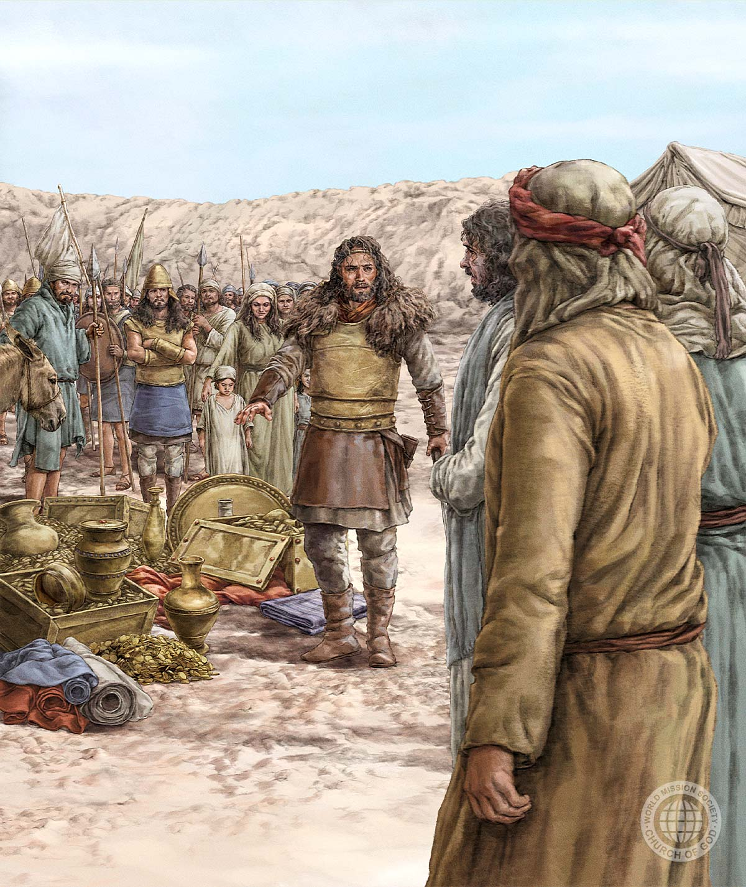
1 Samuel 30
1 Samuel 30:22
“Because they did not go with us, we will not give them any of the spoil that we have recovered, except for every man’s wife and children, that they may lead them away and depart.”

Slide 13
1 Samuel 30
1 Samuel 30:23-24
“My brethren, you shall not do so with what the Lord has given us, who has preserved us and delivered into our hand the troop that came against us. For who will heed you in this matter? But as his part is who goes down to the battle, so shall his part be who stays by the supplies; they shall share alike.”

Slide 14
1 Samuel 30
1 Samuel 30:23-24
“My brethren, you shall not do so with what the Lord has given us, who has preserved us and delivered into our hand the troop that came against us. For who will heed you in this matter? But as his part is who goes down to the battle, so shall his part be who stays by the supplies; they shall share alike.”

Slide 15
1 Samuel 30
1 Samuel 30:23-24
“My brethren, you shall not do so with what the Lord has given us, who has preserved us and delivered into our hand the troop that came against us. For who will heed you in this matter? But as his part is who goes down to the battle, so shall his part be who stays by the supplies; they shall share alike.”

Slide 16
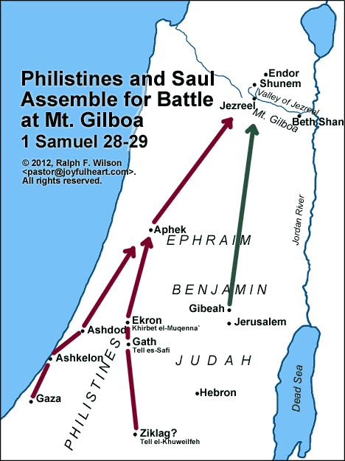
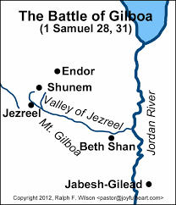
1 Samuel 31; 1 Chronicles 10

Slide 17
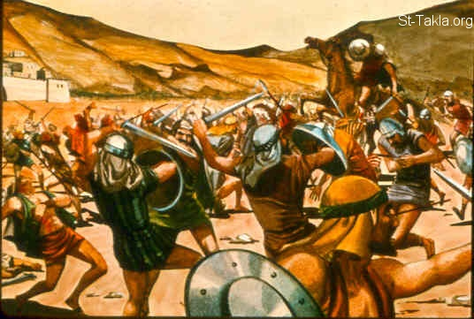
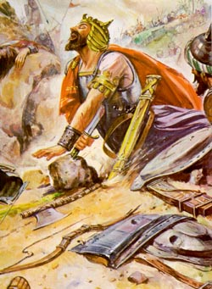
1 Samuel 31; 1 Chronicles 10

Slide 18
1 Samuel 31; 1 Chronicles 10
1 Samuel 31:7
when the men of Israel who were on the other side of the valley, and those who were on the other side of the Jordan, saw that the men of Israel had fled and that Saul and his sons were dead, they forsook the cities and fled; and the Philistines came and dwelt in them.

Slide 19
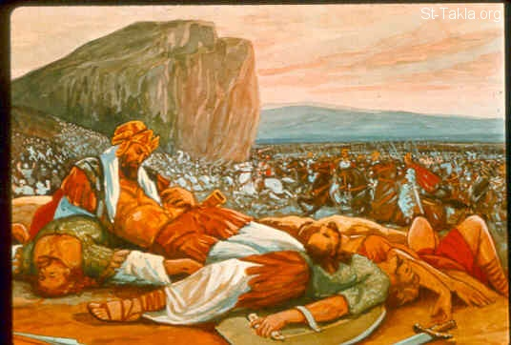
1 Samuel 31; 1 Chronicles 10
They cut off his head and put it in the temple of Dagon (1 Chronicles 10:10)
They took his armor and put it in the temple of the Ashtoreths (1 Samuel 31:10)
They fastened his body to the wall of Beth Shan (1Samuel 31:10)

Slide 20
1 Samuel 31; 1 Chronicles 10
1 Samuel 31:12
All the valiant men arose and traveled all night, and took the body of Saul and the bodies of his sons from the wall of Beth Shan; and they came to Jabesh and burned them there. Then they took their bones and buried them under the tamarisk tree at Jabesh, and fasted seven days.

Slide 21
1 Samuel 31; 1 Chronicles 10
1 Chronicles 10:13-14
So Saul died for his unfaithfulness which he had committed against the Lord, because he did not keep the word of the Lord, and also because he consulted a medium for guidance. But he did not inquire of the Lord; therefore He killed him, and turned the kingdom over to David the son of Jesse.

Slide 22
1 Samuel 31; 1 Chronicles 10
1 Chronicles 10:13-14
So Saul died for his unfaithfulness which he had committed against the Lord, because he did not keep the word of the Lord, and also because he consulted a medium for guidance. But he did not inquire of the Lord; therefore He killed him, and turned the kingdom over to David the son of Jesse.

Slide 23
1 Samuel 31; 1 Chronicles 10
1 Chronicles 10:13-14
So Saul died for his unfaithfulness which he had committed against the Lord, because he did not keep the word of the Lord, and also because he consulted a medium for guidance. But he did not inquire of the Lord; therefore He killed him, and turned the kingdom over to David the son of Jesse.

Slide 24
1 Samuel 31; 1 Chronicles 10
1 Chronicles 10:13-14
So Saul died for his unfaithfulness which he had committed against the Lord, because he did not keep the word of the Lord, and also because he consulted a medium for guidance. But he did not inquire of the Lord; therefore He killed him, and turned the kingdom over to David the son of Jesse.

Slide 25
1 Samuel 31; 1 Chronicles 10
1 Chronicles 10:13-14
So Saul died for his unfaithfulness which he had committed against the Lord, because he did not keep the word of the Lord, and also because he consulted a medium for guidance. But he did not inquire of the Lord; therefore He killed him, and turned the kingdom over to David the son of Jesse.

Slide 26
1 Samuel 31; 1 Chronicles 10
1 Chronicles 10:13-14
So Saul died for his unfaithfulness which he had committed against the Lord, because he did not keep the word of the Lord, and also because he consulted a medium for guidance. But he did not inquire of the Lord; therefore He killed him, and turned the kingdom over to David the son of Jesse.

Slide 27
What do we learn? What application can we make?

