Slide 2
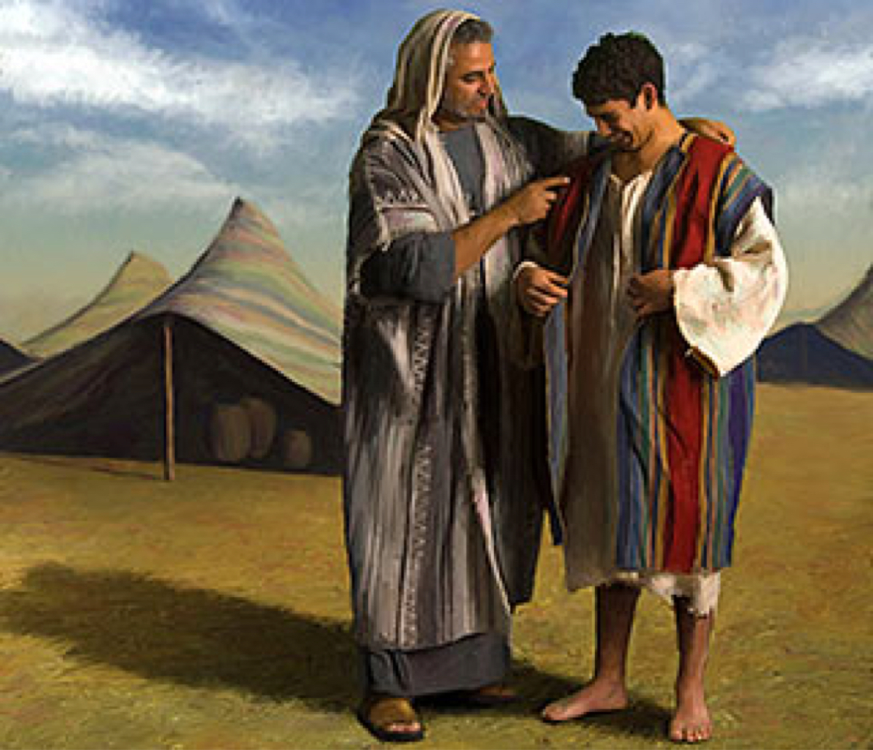
The Story of Joseph - Genesis 37-50

Slide 3
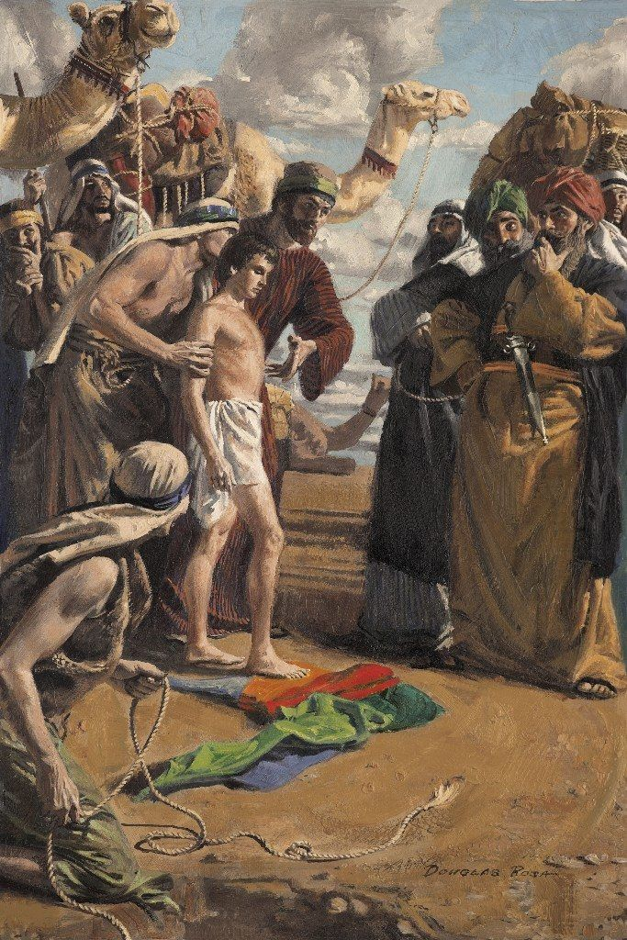

Slide 4
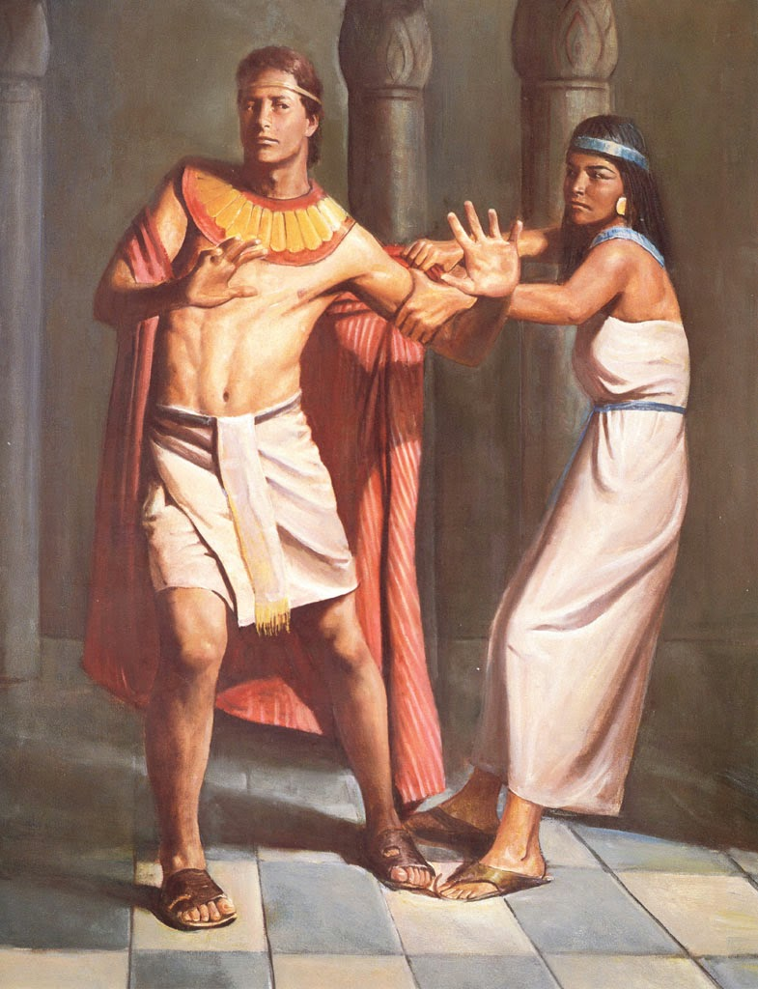

Slide 5
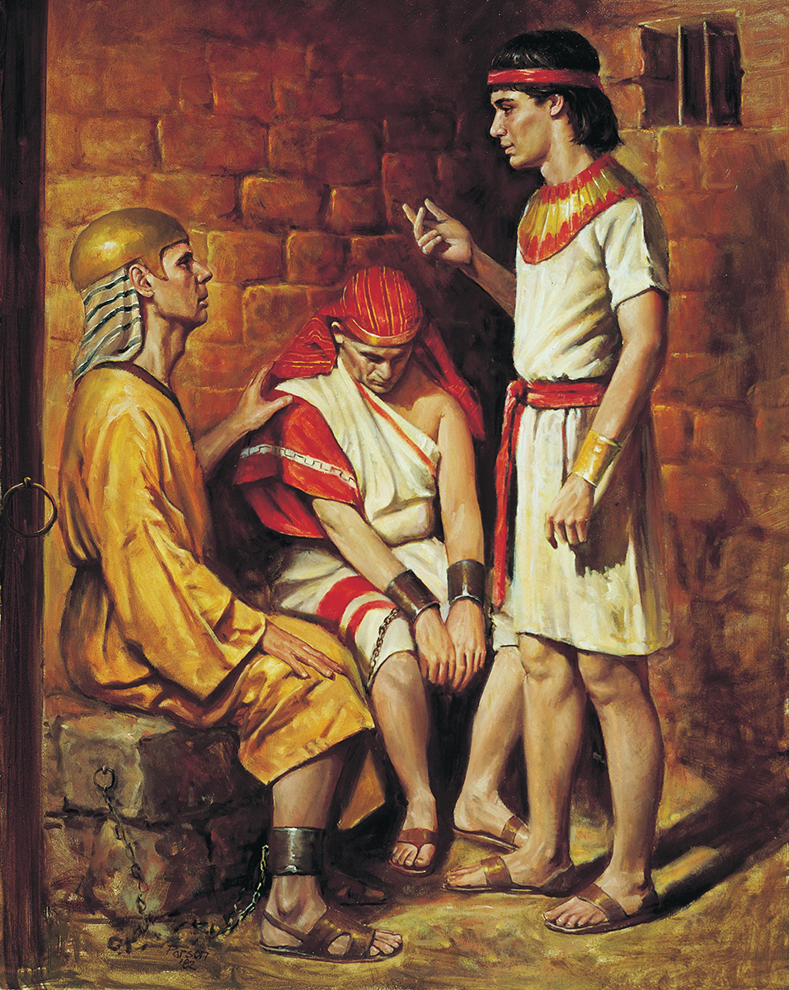

Slide 6
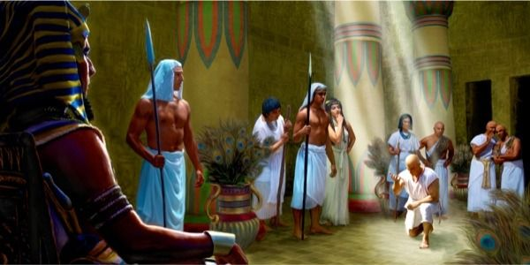

Slide 7
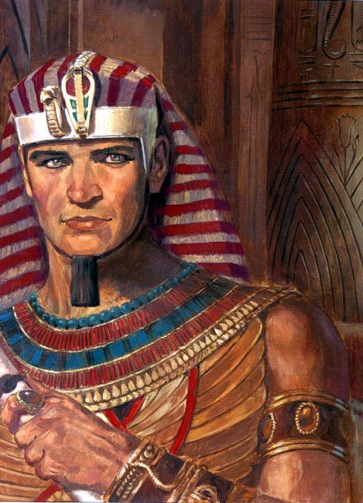

Slide 8
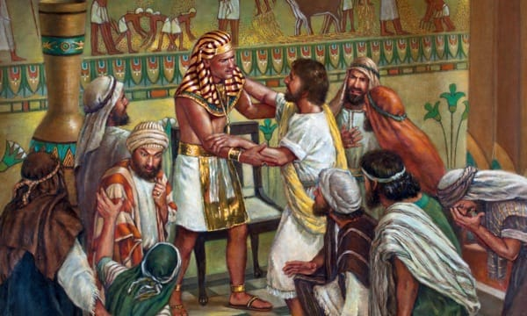

Slide 9
God is in Control
Gen 40:15
Gen 40:8
Rom 8:28
Acts 8:1-5
God Sees All
Heb 4:13
Luke 8:17-18
Rev 2:1-7
Acts 8:1-5

Slide 10
How to handle the
Temptations of the Flesh
Gen 39:7-10
1 Cor 6:18
Eph 5:3-4

Slide 11
How to handle the
Temptation of Pride
Gen 45:4-11
Est 3:1-6
How to handle the
Temptation of Revenge

Slide 12
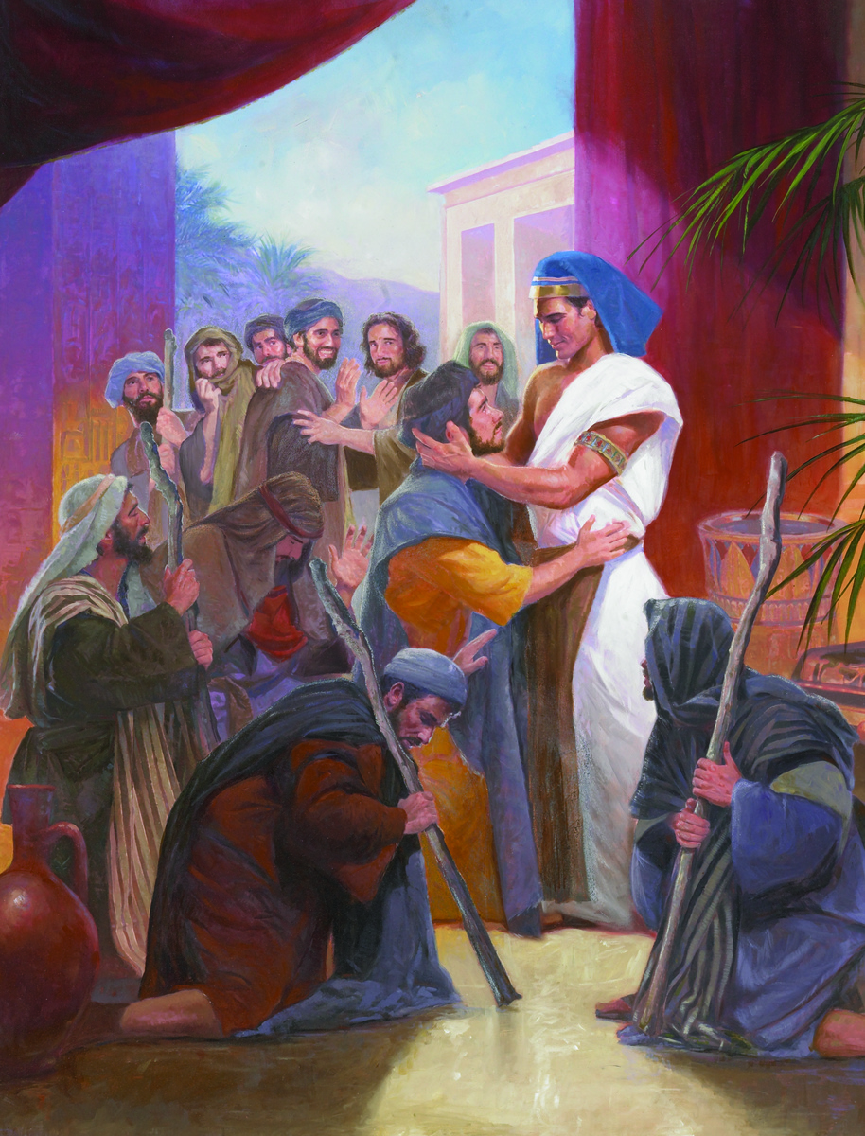

Slide 13
Believe
(Heb 11:6)
Hear
(Rom 10:17)
Repent
(Acts 2:38)
Plan of
Salvation
Be Faithful
( Rev 2:10)
Confess
(Rom 10:10)
Be Baptized
(Mark 16:16)

