Slide 1
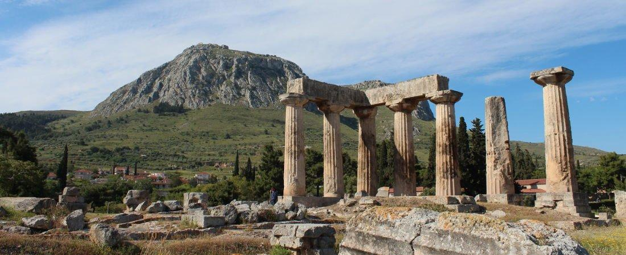
Paul’s Epistle of 1st Corinthians
84th Street church of Christ – March - May, 2022

Slide 2
Outline
I. Introduction (1:1- 9)
II. Dealing with Problems Reported to Paul (1:10 – 6:20)
A. Problem of Factionalism (1:10 – 3:23)
B. Problem of Rejecting Paul’s Work (4:1-21)
C. Problem of the Fornicator and Church Discipline (5:1-13)
D. Taking Problems between Brethren to Civil Courts (6:1-11)
E. Responsibility to Glorify God with the Body (6:12-20)

Slide 3
III. Dealing with Questions Asked by the Corinthians (7:1 – 16:9)
A. “Now Concerning” – Marriage and Present Distress (7:1-40)
B. “Now Concerning” – Idolatry and Personal Liberty (8:1 – 11:1)
C. “Now… Remember Me” and Apostolic Tradition
1. Submission and Customs (11:2-16)
2. Pattern for Lord’s Supper (11:17-34)
D. “Now Concerning” – Spiritual Gifts (12:1 – 14:40)
E. “Now…” Concerning – The Resurrection (15:1-58)
F. “Now Concerning” – The Collection (16:1-9)
IV. Concluding Remarks (16:10-24)

Slide 4
1 Corinthians 12:15-26 – The body and its members
V.15 – The foot cannot say because it is not a hand that it is not a part of the body
V.16 – The ear cannot say because it is not an eye that it is not a part of the body
V.17 – All parts are needed in their function to make up the body
If the whole body is an eye where would the hearing be?
If the whole body were hearing where would the smelling be?
V.18 – God put each member in its place just as he pleases (wills)
V.19 – If all were one member there would be no body but one member

Slide 5
1 Corinthians 12:15-26 – The body and its members
V.20 – But there are many members yet one body
V.21 – Parts of the body cannot tell other parts they are in no need of them
Eye to the hand or head to the feet
V.22-24 – The parts of the body many view as unneeded or less significant have a greater role than they think
Weaker, Less honorable, Unpresentable - NKJV
V.24-25 – God composed the body so there would be no schism and all would have the same care for one another
V.26 – If one part of the body suffers all will suffer, if one is honored all will rejoice

Slide 6
1 Corinthians 12:27-31 – God has given each a gift to be used for the working of the body
V.27 – Body of Christ and members individually
V.28-30 – God setup and distributed various gifts in the church but not all possess every gift, nor is the whole made up of one gift
V.31 – Earnestly desiring the greater gifts but Paul is about to show them a more excellent way

