Slide 1
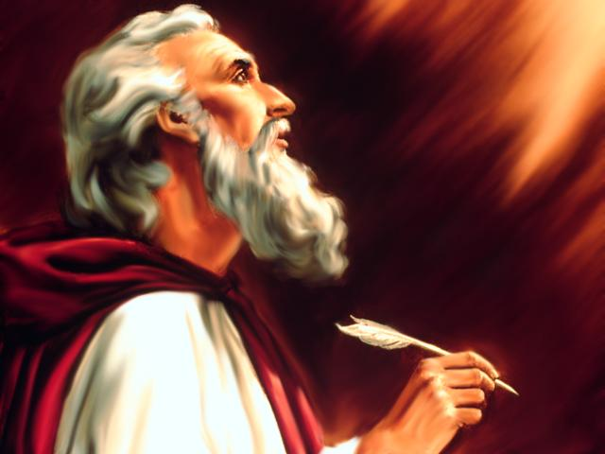
Studies in the Book of
Isaiah

Slide 2
Isaiah
How Can People Have Confidence In
Message Of The Prophet?
Distant Future Prophecy (Messianic)
Time of Prophet
Near Future Prophecy
Fulfillment
Fulfillment

Slide 3
Historical Outline of Book of Isaiah
ASSYRIAN PERIOD - CONFLICT & VICTORY (1-39)
  Prophecies Concerning Judah and Jerusalem (1-12)
  Prophecies Concerning the Nations (13-27)
  The Source of True Deliverance (28-35)
  Historical Interlude (36-39)
II. BABYLONIAN PERIOD - HOPE FOR TROUBLED TIMES (40-66)
  The One True God Versus Idols (40-48)
  Salvation through the Suffering Servant (49-53)
  The Future Glory for God’s People (54-66)

Slide 4
Isaiah
Discourses and Prophecies centering in Jerusalem and Judaea, (Chs. 1-12).
  Judah's social sins, (Chs. 1-5).
  B. The Prophet's inaugural vision and commission (ca. 740), (Ch. 6).
  C. Judah's political entanglements – Isaiah as statesman, (Chs. 7-12).
    Immanuel – history and prediction intermingled, (7:1-10:4).
    Assyria – the rod of Jehovah's anger, (10:5-34).
    The Messianic age, (Chs. 11-12).
Prophetic discourses directed against Foreign Nations, (Chs.13-23).
  Downfall of Babylon, heir of the Assyrians, (13:1-14:27).
  A series of short prophecies against the Nations, (14:28-21:17).
    (Nations included Philistia, Moab, Damascus, Israel, Assyria, Ethiopia, Egypt, Ethiopia, Babylon, Edom, Arabia, Jerusalem and Tyre)

Slide 5
World Judgment and the salvation of Jehovah's people (Chs. 24-27).
  Imminence of a general world judgment, (Ch. 24).
  Hymns of thanksgiving for the divine mercy, (25:1-26:19).
  Salvation of the people of Jehovah – Israel's chastisements are salutary, (26:20-27:13).
Prophetic discourses on relation of Judah with Egypt & Assyria; Edom; and a promise of Israel’s ransom (Deals with the reign of Hezekiah as Chs. 7-12 deals with that of Ahaz), (Chs. 28-35).
  A series of six woes, (Chs. 28-33).
    Woe to the drunken, scoffing politicians of Samaria and Judah, (Ch. 28).
    Woe to the formalists in religion, (29:1-14). ("Ariel: the altar-hearth of God, i.e. Jerusalem, the sacrificial center of Israel's worship." – Robinson)
    Woe to those who hide their plans from God, (29:15-24).
    Woe to the pro-Egypt party, (Ch. 30).
    Woe to those who trust in horses and chariots, (Chs. 31-32).
    Woe to the Assyrian destroyer, (Ch. 33).
  Contrast between the destiny of Edom and of Israel, (Chs. 34, 35).

Slide 6
IV. Prophetic discourses Judah, nations & promise of Israel’s ransom (Reign of Hezekiah - Chs. 7-12 -- Reign of Ahaz - Chs. 28-35)
  A series of six woes, (Chs. 28-33).
    Woe to the drunken, scoffing politicians of Samaria and Judah, (Ch. 28).
    Woe to the formalists in religion, (29:1-14). ("Ariel: the altar-hearth of God, i.e. Jerusalem, the sacrificial center of Israel's worship." – Robinson)
    Woe to those who hide their plans from God, (29:15-24).
    Woe to the pro-Egypt party, (Ch. 30).
    Woe to those who trust in horses and chariots, (Chs. 31-32).
    Woe to the Assyrian destroyer, (Ch. 33).
      Judgment upon the oppressor: Assyria, (vv. 1-16).
        General, (vv. 1-6).
        Particular, (vv. 7-16).
      Glory of Jehovah's reign – the Messianic age, (vv. 17-24).
  Contrast between the destiny of Edom and of Israel, (Chs. 34 - 35).
    Terrors of impending world judgment upon the nations, (34:1-4).
    Desolation and destruction of Edom in Particular: falls, never again to rise, (34:5-17).
    Exaltation and glory of Israel in contrast to Edom, (Ch. 35).

Slide 7
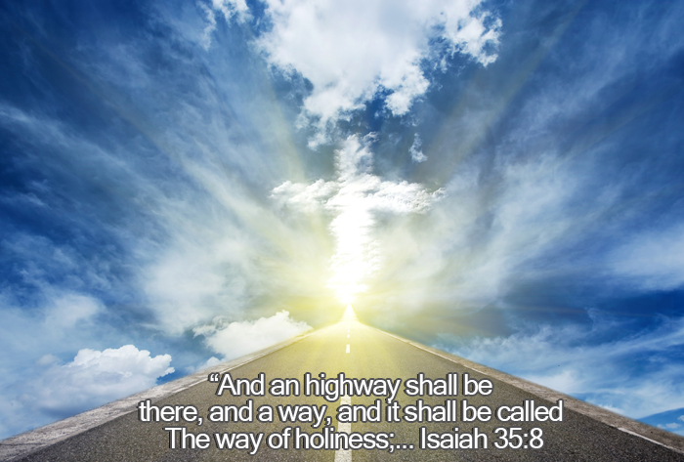

Slide 8
Questions
1. “When you cease ________________, you will be ________________; When you make an __________ of dealing ______________________, they will deal ____________________ with you.”
2. With what two principles does God say He has filled Zion? ______________ ________________________________________________________________
3. In Isaiah 33:14-16, as the wicked are fearful of the fire of judgment, who does the text say will survive? ___________________________________________ ________________________________________________________________
4. Is the future promised in Isaiah 33:20-24 made of physical Jerusalem in Old Testament times or of spiritual Jerusalem of Messianic times? ______________
5. Against whom does Isaiah 34 say the indignation of Lord was aimed? _______

Slide 9
Questions
6. Why is Edom specified as a target of God’s judgment? ___________________ _________________________________________________________________
7. Would the result of the Lord’s vengeance be temporary or permanent? Prove your answer. _____________________________________________________
8. “Say to those who are ___________-___________, ‘Be _____________, do not _________! Behold, your God will come with ___________________, with the _______________ of God; He will come and _______________ you.’”
9. Are the changes in the land and its inhabitants pictured in Isaiah 35:5-7 meant literally or figuratively? ____________________________________________
Thought Question: In Isaiah 35:8-10, God’s redeemed people are said to travel a “Highway of Holiness” in their return to Zion where they will be protected and blessed. We may clearly see this is a prophecy of Messianic times. What is that Highway of Holiness and what part does it play in the salvation of God’s people?

Slide 10
ISAIAH
Next Class
Studies in the Book of
36:1 – 37:38

