Slide 1
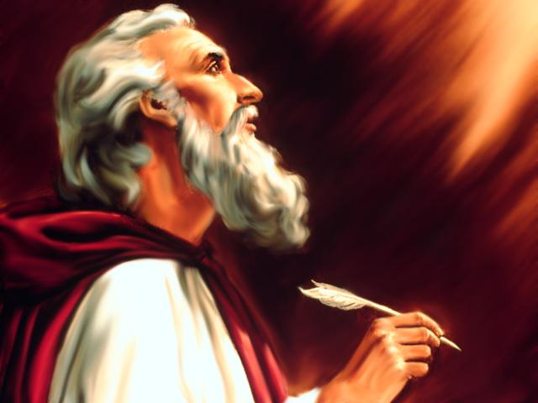
Studies in the Book of
Isaiah

Slide 2
Historical Outline of Book of Isaiah
ASSYRIAN PERIOD - CONFLICT & VICTORY (1-39)
Prophecies Concerning Judah and Jerusalem (1-12)
Prophecies Concerning the Nations (13-27)
The Source of True Deliverance (28-35)
Historical Interlude (36-39)
II. BABYLONIAN PERIOD - HOPE FOR TROUBLED TIMES (40-66)
The One True God Versus Idols (40-48)
Salvation through the Suffering Servant (49-53)
The Future Glory for God’s People (54-66)

Slide 3
ISAIAH: Part 2
"The theme of the whole (part two) is the comforting announcement of the approaching deliverance, and its attendant summons to repentance. For the deliverance itself was for the Israel which remained true to the confession of Jehovah in the midst of affliction and while redemption was delayed, and not for the rebellious, who denied Jehovah in word and deed, and thus placed themselves on the level of the heathen.” – Delitzsch, Isaiah, Vol. II., p. 128.
Jehovah and the Idols – A Contrast. Deliverance from captivity and restoration of the Exiles, (Chs. 40-48).
The Mission of the Servant of Jehovah – Contrast between His present suffering and future glory, (Chs. 49-57).
Future Glory of the People of God and the Doom of Apostates – (a contrast between the faithful and the hypocrites in Israel). (Chs. 58-66).

Slide 4
Isaiah (Part 2 – 40-66)
Jehovah and the Idols – A Contrast. Deliverance from captivity and restoration of the Exiles, (Chs. 40-48).
Comfort – The basis of comfort: Israel's incomparable God, (Ch. 40).
Prologue – four voices are heard, (vv. 1-11).
Of grace – pardon, (vv. 1-2).
Of prophecy – providence, (vv. 3-5).
Of faith – promise, (vv. 6-8).
Of evangelism – power, (vv. 9-11). (Robinson, Eerdman).
Judah's God – His unique character and greatness – is able to meet the need of despondency in captivity, (vv. 12-36).
Compared to creation, (vv. 12-17).
Contrasted with the idols, (vv. 18-26).
Therefore let no man suppose Jehovah is ignorant of Israel's misery, or unable to cope with it, (vv. 27-31).

Slide 5
Isaiah (Part 2)
Jehovah's power to predict, proof of His sole deity, (Ch. 41). (This chapter is a challenge to the idols of the nations to predict the future)
Announcement of the deliverer (Cyrus, cf. 44:28; 45:1), and the effect on the surrounding nations, (vv. 1-7).
God's promise to Israel to protect and support through coming trouble, (vv. 8-20).
Jehovah's controversy with nations & their idol-gods, (vv. 21-29).
Jehovah's constant care for Israel – A "Servant" besides Cyrus, (42:1-43:13).
The Spiritual Servant – Messiah – and His work, (42:1-9).
Hymn of thanksgiving for their deliverance (in prospect) Jehovah’s glory is at stake, (42:10-17).
Jehovah’s “blind, deaf” servant, Israel, to be punished, (vv. 18-25).
Jehovah alone is their Savior – they are His witnesses, (43:1-13).
A renewed promise to Israel of protection and deliverance, (vv. 1-7).
A renewed challenge to the nations, (vv. 8-13).

Slide 6
Isaiah (Part 2)
Israel's deliverance and restoration to be an act of Jehovah's mercy, (43:14-45:25).
Israel shall be delivered – redeemed, (43:14-28).
The fate of Babylon – she shall no more thwart Jehovah's plan than did Egypt, (vv. 14-21).
Though unworthy Jehovah would redeem Jacob, (vv. 22-28).
Jehovah, the only God, is able to deliver and redeem, (44:1-23).
Israel's spiritual recovery and regeneration, (vv. 1-5).
God alone can declare events to come, (vv. 6-8).
The folly of idolatry – a scathing rebuke against the idol manufacturers, (vv. 9-20).
Jehovah formed Israel, not they Him, (vv. 21-23).
Cyrus, the anointed of Jehovah, Jehovah’s agent in Israel’s deliverance, (44:24-45:25).

Slide 7
Questions
1. Give at least 5 major themes that you see stated in the chapters to be covered in this class. ________________________________________________________ ________________________________________________________________ ________________________________________________________________
2. What difference in content and tone do you see between the overall emphasis of the first 39 chapters of the book and Isaiah 40:1-5? _______________________ ________________________________________________________________
3. Where in the New Testament is reference made to Isaiah 40:6-8? Compare the main point made with its use in each place. _____________________________ ________________________________________________________________
4. Of what “Zion” does Isaiah refer in 40:9 – spiritual or physical Jerusalem? Why? ___________________________________________________________ ________________________________________________________________
5. To whom should one liken God? _____________________________________

Slide 8
Questions
6. What will be the result of those who oppose God’s will? __________________
7. What will happen to the effort God promises His help? ___________________
8. God challenges the idols to match His knowledge by showing the “__________ ___________” or declaring “____________ to ____________.” What is meant by this challenge? _________________________________________________
9. Who gave Jacob for plunder and Israel to robbers? ____________ Why? _____ ________________________________________________________________
Thought Question: Consider Isaiah 43 and its plea to God’s people. Why should God’s people be assured of His deliverance and a “redeemer” to promised come?

Slide 9
ISAIAH
Next Class
Studies in the Book of
44:1 – 45:25

