Slide 1
Vocabulary of Salvation: Sin – The Problem
Isaiah 59:1-3
Isaiah 59:1-3

Slide 2
Sin
The Fundamental Problem
Isaiah 59:1-3

Slide 3
Isaiah 59:1-3
¹ Behold, the Lord’s hand is not shortened, that it cannot save; nor His ear heavy, that it cannot hear. ² But your iniquities have separated you from your God; and your sins have hidden His face from you, so that He will not hear. ³ For your hands are defiled with blood, and your fingers with iniquity; your lips have spoken lies, your tongue has muttered perversity.

Slide 4
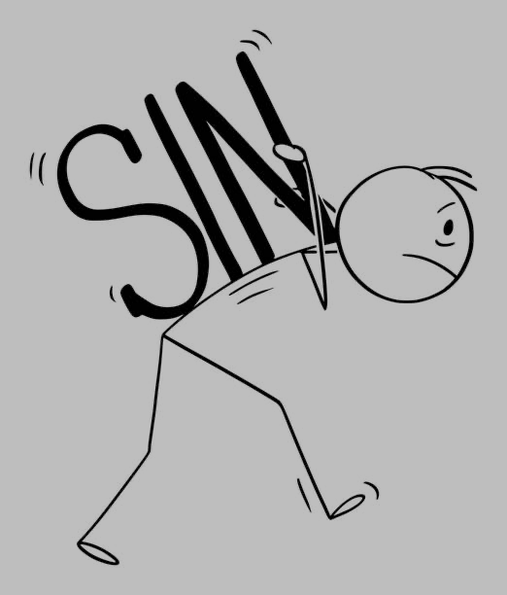
Sin: The Fundamental Problem
Sin: The Beginning of the Problem
Genesis 3:1-6 Sin began in Garden (James 1:13-15)
Romans 5:12 Sin & death passed to others when they sinned
Sin: The Definition of the Problem
1 John 3:4 Sin is lawlessness – lacks law’s approval (1 Jn. 5:17)
James 4:17 Knows to do good, but will not (Romans 14:23)
Sin: The Perception of the Problem
Deuteronomy 25:16 Abomination to the Lord – See as God sees
Psalm 11:4-5 Nature of God necessitates hatred of sin
Zechariah 8:17 “All these things I [God] hate”
Sin: The Cessation of the Problem
1 Corinthians 15:34 “Do not sin” – some lack knowledge of God
1 John 2:1 “...so that you may not sin” (John 5:14)
Romans 6:1-2 “Continue in sin... Certainly not!” (Isaiah 55:7)

Slide 5
Sin: Principle of the Problem
Is
Is Not:
Every child is born with a sinful nature – must sin, can’t do good

Slide 6
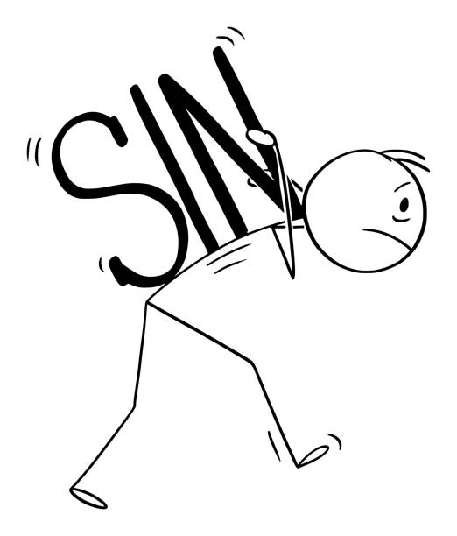
Sin: How Do We Deal With Problem?
Sin Taken Away
Forgiven

Slide 7
Sin: How Do We Deal With Problem?
False
Error

