Slide 2
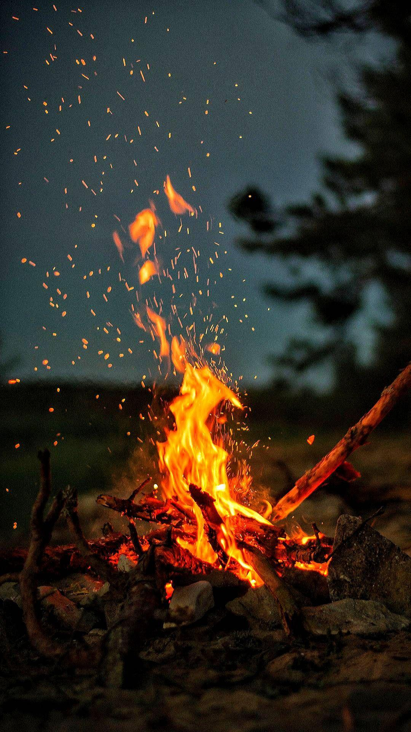
Acts 28:1-2

Slide 3
Trial and Tribulation
Worldliness
The Burden of Doing Good

Slide 4
The Word of God
Prayer
Fellowship with Christ
Fellowship with Christians

Slide 5
Not Forsaking the Assembly
Greet One Another
“Continuing Daily with One Accord”

Slide 6
Acts 28:1-2

