Slide 1
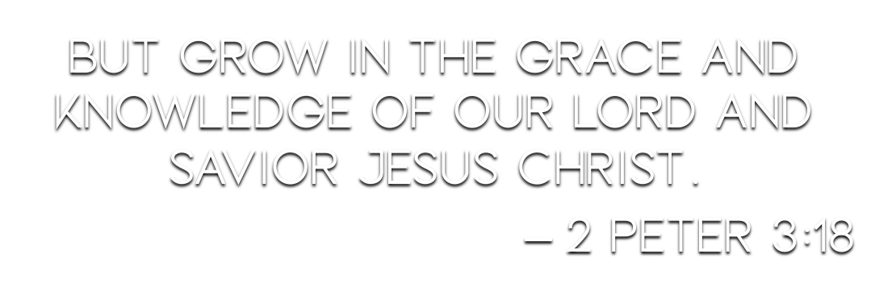

Slide 3
Faith is distinct from the listed virtues – 2 Peter 1:5-7
Faith is already evident in the Christian, and will lead to growth – Ephesians 4:13; 2 Peter 1:8-9; Matthew 13:23; John 15:1-8
Access into God’s grace is by faith, and growth in God’s grace continues to be by faith – Romans 5:1-2; 1 Peter 1:5

Slide 4
“Through the eyes of faith, a disciple of Christ sees tribulation as a tool for growth.”
Romans 8:20, 25, 28 – subject to futility in hope, hope leads to perseverance, things work together for our good.
Romans 5:3-5 – faith, joy, perseverance, character, hope
The virtues are not independent of faith but built on faith. (cf. 2 Peter 1:5-7)

Slide 5
The foundation on which the virtues are added is faith in Christ – 2 Peter 1:2-4
Man’s wisdom may get some things right, but it will not lead to growth, nor pleasing God – cf. Acts 17:28-31
There is evidence of Christ’s influence in the world, but it is always Christ Himself we must turn to for spiritual growth – 2 Peter 1:3; Romans 10:17

Slide 6
“to them that have obtained like precious faith with us through the righteousness of God and our Saviour Jesus Christ.” (2 Peter 1:1, KJV)
“faith of the same value” (NKJV footnote)
“the righteousness of God” – Romans 1:16-17
Produces faith – Galatians 2:16
The wisdom of men does NOT produce the “faith of the same value.”
Example: 1 Corinthians 1-2

