Slide 1
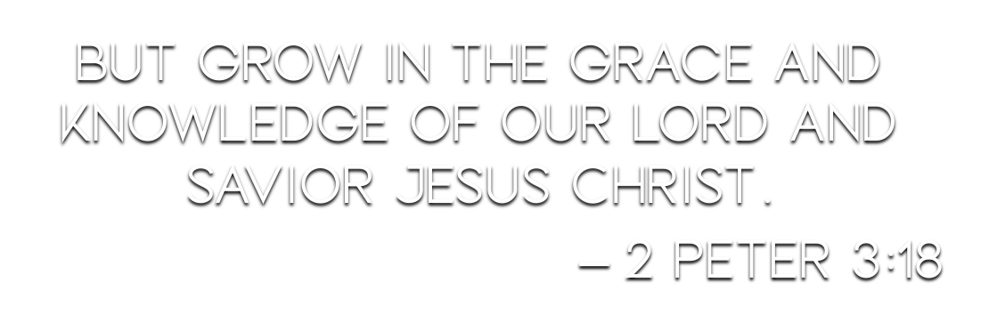

Slide 3
“For if these things are yours and abound, you will be neither barren nor unfruitful in the knowledge of our Lord Jesus Christ.” (v. 8)
The Corinthians were admonished for thinking they had reached the spiritual pinnacle – 1 Corinthians 4:8-13
Paul said he had much room to grow – Philippians 3:12-14
We are to increase more and more – 1 Thessalonians 4:9-10

Slide 4
“For if these things are yours and abound, you will be neither barren nor unfruitful in the knowledge of our Lord Jesus Christ.” (v. 8)
If we abound in these things we will not be:
Barren – “pertaining to being unproductive, useless, worthless.” (BDAG)
Unfruitful – John 15:1-8; Galatians 5:22-23

Slide 5
“For he who lacks these things is shortsighted, even to blindness, and has forgotten that he was cleansed from his old sins.” (v. 9)
“has forgotten” – lēthē lambanō – “‘having received forgetfulness’; this man let somebody give him amnesia” (Lenski); “to receive as merely a self-prompted action” (VINE)
Failure to grow shows focus on temporal – 2 Peter 3:10-13; Mark 8:36

Slide 6
“For he who lacks these things is shortsighted, even to blindness, and has forgotten that he was cleansed from his old sins.” (v. 9)
This forgetfulness is an abandonment of the very purpose and implications of our cleansing (v. 4).
Newness of life – Romans 6
To serve God – Hebrews 9:14; 1 Peter 3:21
Zealous for good works – Titus 2:14
Some turned back and were trying to take others with them – 2 Peter 2:18-22

Slide 7
“For he who lacks these things is shortsighted, even to blindness, and has forgotten that he was cleansed from his old sins.” (v. 9)
This shortsightedness is a failure to maintain the goal of transformation into the divine nature (vv. 3-4).
Christ in us – Galatians 2:20
Conformed to His image – Romans 8:29-30
Transformation – Romans 12:2; 2 Corinthians 4:16-5:8; 1 John 3:1-3

Slide 8
“Therefore, brethren, be even more diligent to make your call and election sure, for if you do these things you will never stumble.” (v. 10)
It is our responsibility to be found faithful – 2 Peter 3:14
“Sure” – bebaios – “firm, steadfast, secure” (VINE).
Opposite – 2 Peter 2:18-19; Matthew 7:21-23
How to make it “sure” – Ephesians 4:1; 1 Thessalonians 1:2-10

Slide 9
“Therefore, brethren, be even more diligent to make your call and election sure, for if you do these things you will never stumble.” (v. 10)
“never stumble” – ptaiō (5x) – “to trip, i.e. (figuratively) to err, sin, fail (of salvation)” (STRONG) – Romans 11:11; James 2:10; 3:2 (2x)
The Christian abiding in God’s word will not sin – 1 John 3:9; Psalm 119:11
Aiming toward maturity and purification is how we will be found “without spot and blameless” (2 Peter 3:14).

Slide 10
“For so an entrance will be supplied to you abundantly into the everlasting kingdom of our Lord and Savior Jesus Christ.” (v. 11)
“for in this way…” (NASB) – by “giving all diligence” (v. 5)
“Supplied” (v. 11) = “giving” (v. 5) – “If we supply diligence, God will supply entrance.”
“abundantly” – Romans 8:37; Hebrews 7:25

